Slide 1


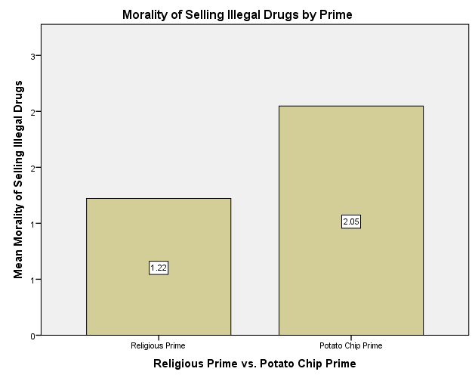
TITLE OF POSTER
Student Names
Faculty Name(s)
Course
Background/Introduction
Results
Discussions
First paragraph: Summarize what you found.
Were hypotheses supported?
(Remember nothing is PROVEN with the scientific method; we only find SUPPORT.)
Second paragraph: limitations of your study.
Third paragraph: Your future directions.
Add heading as needed
Include several bullet points of an introduction that flow.(Agnew, 1991)
Here’s another bullet point about the introduction (Sutherland, 1947)
If you would like to have an abstract, and you have room, you may do that as well. I only use them if I have room. Put the abstract before the intro if you decide to do that, with its own title bar.
Make sure you introduction flows well, even though you are not using the entire introduction as you would if you had been presenting a paper.
Feel free to change and move any of the titles to better fit your poster.
Make sure font is one in which the letters are the same size all around.
References
Agnew, R. (1991). The interactive effects of peer variables on delinquency. Criminology, 29(1), 47-72.
Sutherland, E.H. (1947). Criminolgy (4th Ed). Philadelphia: Lippincott
Only include references that you used in your poster.
Notes:
we

