Slide 1











Slide 2





The Alamo Colleges District is a group of five colleges in Greater San Antonio:
Easy admissions
Affordable
Wide variety of programs
In-person or online
Small classes
Clubs, athletics and events
Transfer with ease

Slide 3


BEGIN DISCOVERING THE PATH TO YOUR FUTURE
STILL FIGURING OUT WHAT YOU WANT TO DO?
Visit Career Coach, a tool that shows how your interests relate to the world of work.
alamo.edu/careercoach
350+
Certificates
Associate degrees
Bachelor’s degrees
PROGRAMS
EXPLORE THE POSSIBILITIES
alamo.edu/programs

Slide 4





A personal success team guiding you from enrollment to completion
Career coaching to help you explore options and get a job
Hands-on learning in state of the art facilities and with industry partners
Free textbook rentals, loaner laptops,
and VIA bus pass
Plus, low-cost health services

Slide 5




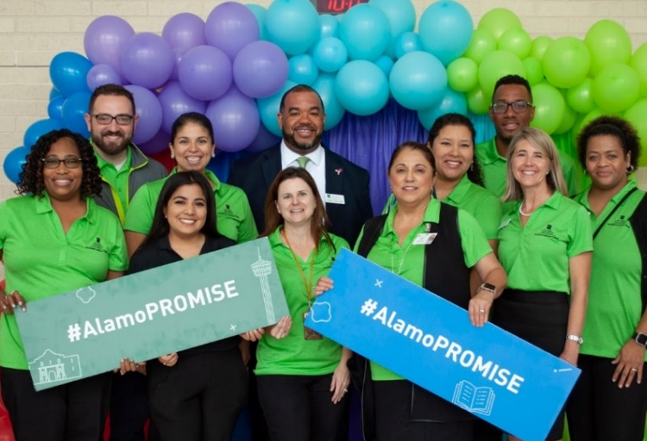

AlamoPROMISE offers eligible graduating high school seniors in Bexar County the opportunity to attend one of the Alamo Colleges tuition-free.

Slide 6





The Promise of Tuition-free College
Tuition, fees, books and instructional materials fully covered by financial aid grants and/or scholarships
​
Covers completion of an associate degree
or up to 3 consecutive years ​
No income requirements​
No class rank or incoming GPA requirements

Slide 7

How to become a Promise Scholar
1: Apply for admission to one of our colleges
Submit your Fall application for admission to any of our five colleges through ApplyTexas at goapplytexas.org.
2: Complete your financial aid application
Submit a FAFSA or TASFA and complete any requirements needed to issue your financial aid award. Students need to re-submit a financial aid application for every academic year they are enrolled to maintain AlamoPROMISE eligibility.
3: Enroll in classes for fall
Complete your enrollment steps, attend New Student Orientation, and register for classes the fall after you graduate from high school.
Notes:
Update QR code

Slide 8
Important Dates
Priority Date: Feb. 28
Complete ApplyTexas and Financial Aid applications
Applications completed after the Priority Date will be considered for AlamoPROMISE on a space-available basis.
Enroll for Fall
Students must enroll the fall semester immediately following high school graduation to participate in AlamoPROMISE.
Notes:
Update QR code

Slide 9


Learn more:
alamo.edu/promise
Questions?
promise@alamo.edu

