Slide 1
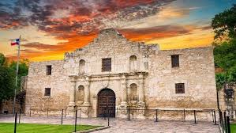
2018 Budget Summary
At San Antonio College
February 16, 2018

Slide 2
Introduction
Summary of the 2018 Budget
2018 Funding Methodology
Q&A

Slide 3
FY 2018 Operating Budget Recap
Funded our Strategic Priorities:
Employee Compensation Adj. eff 1/1/18 (+$4.1m with add’l $2.1M in FY19)
Preventive Mtn.: Progress toward $21M target (+$2M to $16.5M total)
College Capital Budget: Progress toward $9M target (+$1M to $4.3M total)
Student Success Fund: Increased $1.5M to $3.6M total
AlamoINSTITUTES
Faculty Development
AlamoONLINE
EAB/Navigate & Student e-Portfolio
I-Best/Adult Education – integrate into credit classes
AlamoADVISE – 2 FTE per college for in-take advising
EFC Faculty Fellow

Slide 4
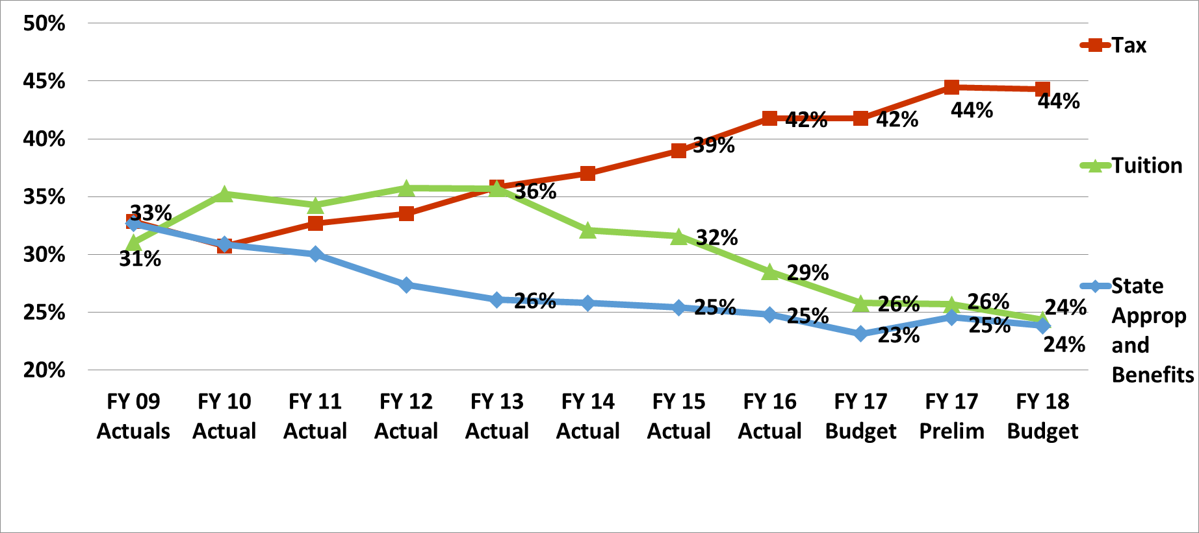
Historical Revenue Trend

Slide 5
State Funding

Slide 6
FY 2018 Expense Budget

Slide 7
“Big Picture” FY18 Funding Model
Step 1 – Determine Formula Revenue Projection
State funding – 2-yr biennium cycle
Tuition & Fees (based on Enrollment)
Ad Valorem Tax Revenue (based on Taxable Assessed Valuations & tax rate)

Slide 8
“Big Picture” FY18 Funding Model
“Formula” Mirror State Appropriation Methodology: APPROVED AT PVC 3/2/17 Core
SS Point Incentive (Beg. FY19, based on Prior Year (PY) improvement) if State incr.
Formula Funding Model ($ per calc. w/o core components)
+ College/DSO specific "Non-Formula" Expense (excluding CE) (equal to related revenue)
+ CE “Non-Formula” expense loaded to produce profit (target is $2M+)
PLUS: new CE FY18 Profit share IF FY17 CE profit > $2M
+ Overlays (Benefits, IT/Comm., Strategy SS Funds, Capital Budget, Full Yr. impact PY Board approved actions, General Institutional).
- Budget Gap Closure (Overlay if Revenues < than above Expense elements)
= Expense Budget Allocation that matches Revenues

Slide 9
Core Funding
Similar to approach taken by the State of Texas for appropriating funds to Community Colleges for core funding, regardless of institutional size
Colleges
Administrators (Labor only)
DSO
Administrators (Labor only)
Board of Trustees & Internal Audit – entire cost structure (labor & non-labor) as approved by the Board
General Counsel & Ethics – entire cost structure (labor & non-labor); these are district-wide enterprise costs

Slide 10
Formula Funding
Instruction
Simplify calculation to $/CH for 28 disciplines
All Contact Hours used (DC, CE, Reg.)
Move Average Class Size and Labor % to new Efficiency incentive (metric gap closure to targets in FY18, give $ in FY19)
New Faculty Release: for Dual Credit Quality Oversight
Academic Support
Student Services
Advising (Colleges only)
Institutional Support
Operations & Maintenance (DSO Facilities)

Slide 12
Overlays, Normalizations & Initiatives
Items above & beyond Formula & Non-formula funding
Fringe Benefits – based on final labor dollars
IT/Communications cross-charges (state reporting requirement that these items be allocated by function)
FY17 compensation – these increases not included in the FY16 “cost per” metrics
FY18 compensation – effective 1/1/18
Board Approved strategies
Other Strategic Initiatives

Slide 13
DSO General Institutional Funding
Enterprise-wide expenses
Bank fees, Armored Car services, Audit fees, Bexar County appraisal district fees, etc.
Insurance
Debt Service
Retiree Benefits
Staff Council & Unified Staff Council

Slide 14
Gap Closure Strategies
Reduction in Discretionary Accounts - $2M from OT/Temp., Meals, Travel, contractors, Other employee – recommendation only
Remaining gap to be allocated on % of Total Formula funding (excluding Core, Advising & DSO DPS, Utilities, Housekeeping, Grounds, Mtn)
Decisions on gap closure determined at the local level
Recommend 70%+ of gap closure coming from labor/positions, aligned with Staffing Mgmt. Ratios

Slide 15
Questions?

