Slide 1
Group Advising
Spring 2025

Slide 2
First Time in college team
Certified Advisors
Business and Public Service
  Itzel Orozco
  Ed Rangel
Creative And Communication Arts
  Jen Correa
Health and Bioscience
  Maria Cooper
  Marilyn Luna
STEM
  Vacant
College Readiness
  Kyle DeStefano
  Melissa Guerra
  Crystal Olivo

Slide 3
Objectives
Degrees and Pre-Majors
    Importance of having correct Pre-Major in system
GPS and ISP
Registration

Slide 4
Degrees
Associate of Arts
Associate of Science
Associate of Arts in Teaching
Associate of Applied Science
Certificate
Bachelor of Science in Nursing (RN to BSN Bridge Program)

Slide 5
Pre-Majors
Associate of Arts
  Accounting
  Art
  Architecture
  Criminal Justice
  English
  History
  Music
Associate of Science
  Biology
  Biology/Pre-Nursing
  Chemistry
  Computer Science
  Engineering
  Mathematics
  Psychology

Slide 6
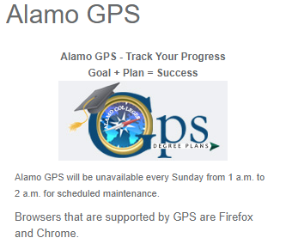
GPS
Intuitive software that outlines courses needed for degree
Provides a snapshot of your
  Degree
  Major/pre-Major
  GPA
  Holds
  Hours Attempted
  Academic Standing
  Advisors Name

Slide 7

Individual Success plan (isp)
Customized degree plan to keep you on your path to graduation and/or transferring
Course recommendations are based on:
  Declared major or pre-major
  Test scores
  Transfer credits
  AP and Dual Credits found in our system

Slide 8
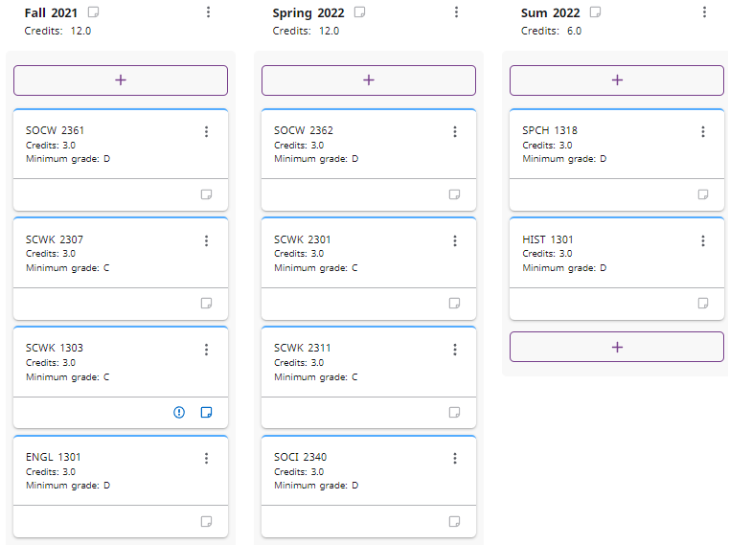
ISP

Slide 9
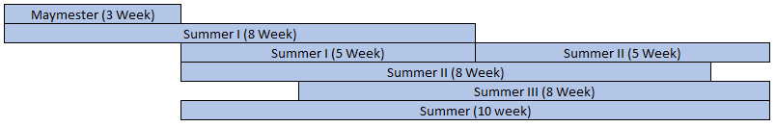
Registration: Parts of term
Summer
Fall and Spring

Slide 10


Slide 11
Registration: Course Load
Students should not enroll for more semester credit hours than the number of weeks in a semester or part of term
Fall/Spring Semesters
  16 Week Sessions - Maximum Hours: Eighteen (18) semester credit hours
Flex I and Flex II
  8 Week Sessions - Maximum Hours Per 8-Week Session: Eight (8) semester credit hours
Fall/Spring Start Two
  14 Week Sessions - Maximum Hours: Fourteen (14) semester credit hours
Fall and Spring, Flex I and II, and Start Two semester credit hours count toward the Fall and Spring totals.
Summer Semester
  Maymester 3 Week Session - Maximum Hours: Three (3) semester credit hours
  Summer I 5 Week Session - Maximum Hours: Six (6) semester credit hours
  Summer II 5 Week Session - Maximum Hours: Six (6) semester credit hours
  Summer 8-Week Session - Maximum Hours: Eight (8) semester credit hours
Not to exceed 17 semester credit hours for the entire Maymester and Summer session combined.

Slide 12
Registration: enrollment status
Fall/Spring Semesters
  Full-Time Student - Twelve (12) or more semester credit hours
  Half-Time Student - Six to eleven (6-11) semester credit hours
Summer Semester
  Full-Time Student - Six (6) semester credit hours
  Half-Time Student - Three to five (3-5) semester credit hours
Note: The above enrollment status is based on a semester, not sessions within the semester. For Financial Aid or Veteran Affairs enrollment status, please check with designated department.

Slide 13
Registration: Reading Registration Screen
**talk about CRN, Course and campus, days of week on one slide**
The CRN stands for Course Reference Number – this is a unique 5 digit number associated with that specific course offering; each course has a unique CRN

Slide 14
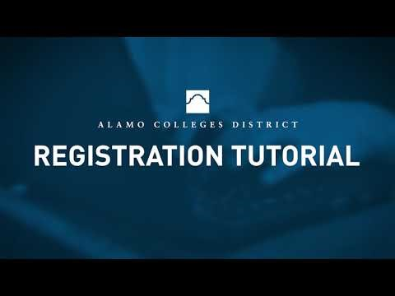
Registration
https://www.youtube.com/watch?v=F6QL4isD1q4

