Slide 1



ApplyTexas-Applicant
Center for Student Information
Morgan Herman ME.d
Enrollment Specialist
Darnelle Richardson-Hurtado
Enrollment Specialist
Daniel Ayala
Director, Center for Student Information

Slide 2
  ApplyTexas Testing and Feedback
12 Educational Institutions - Post-Secondary and K-12
Common Responses
Readability
Not mobile friendly
Too many clicks
Improve copy feature
Shorten completion time

Slide 3
  Changes to the Application
Database moved to Amazon Web Server(AWS) cloud
New URL
Mobile-friendly
Simplified account setup: username, email, and password
School search tool no longer a pop up
Application creation modified to one page
Core data can be changed on any open app and update across all open apps in profile

Slide 4
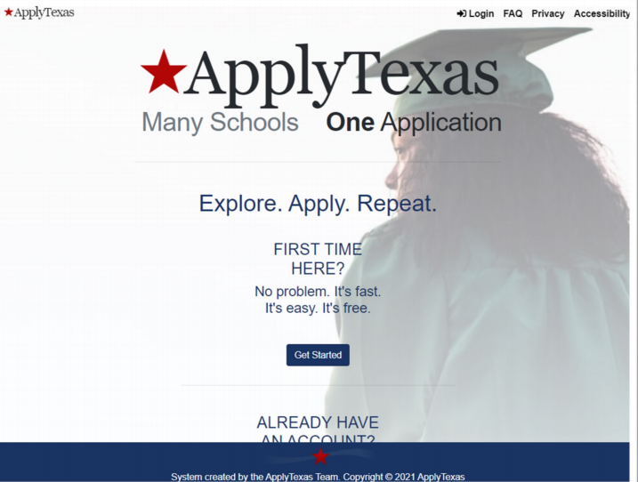
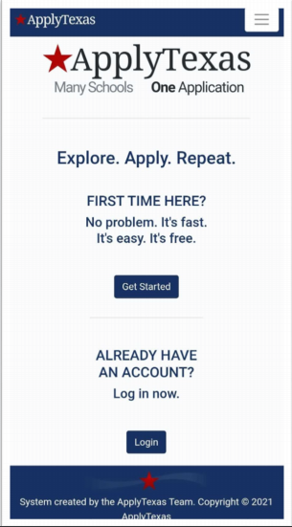
  Applicant/Student View
Desktop Preview
Mobile-Friendly Preview

Slide 5
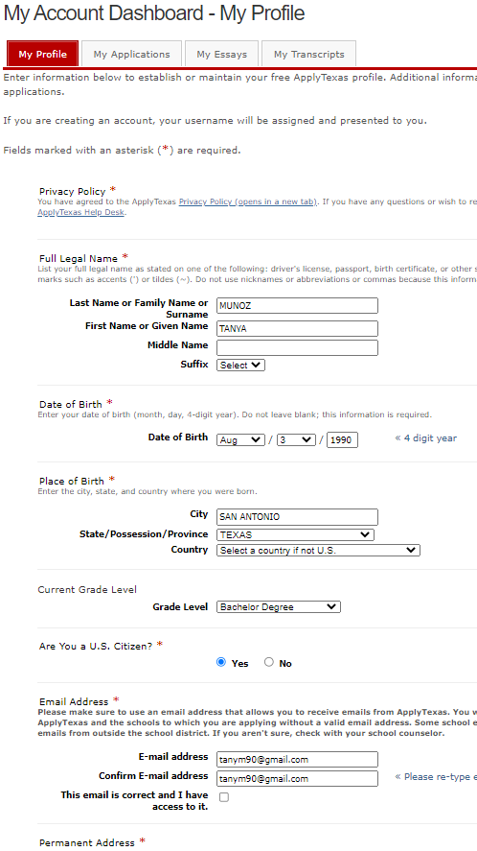
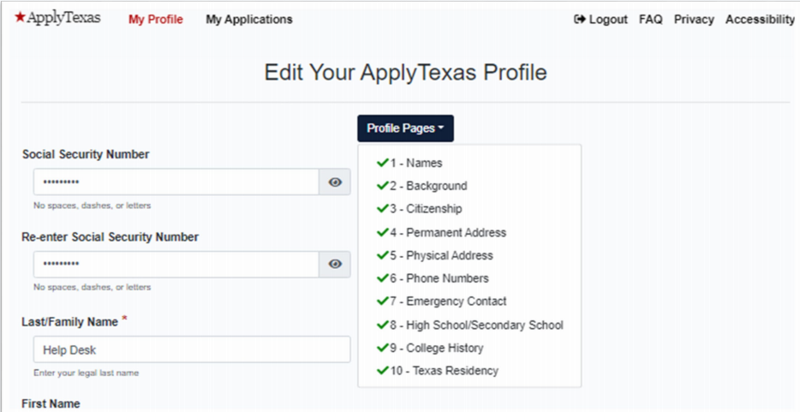
  Apply Texas Profile
Profile information is universal to all applications
Current
Upgrade
Notes:
On the left you have what ApplyTexas currently looks and beginning September 15th ApplyTexas upgrade will look like what we have on the right of the page.

Slide 6
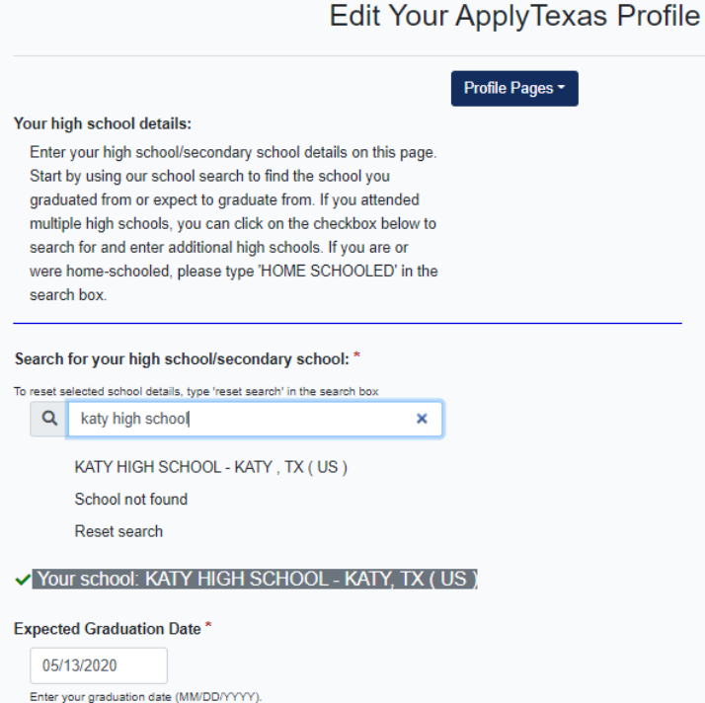
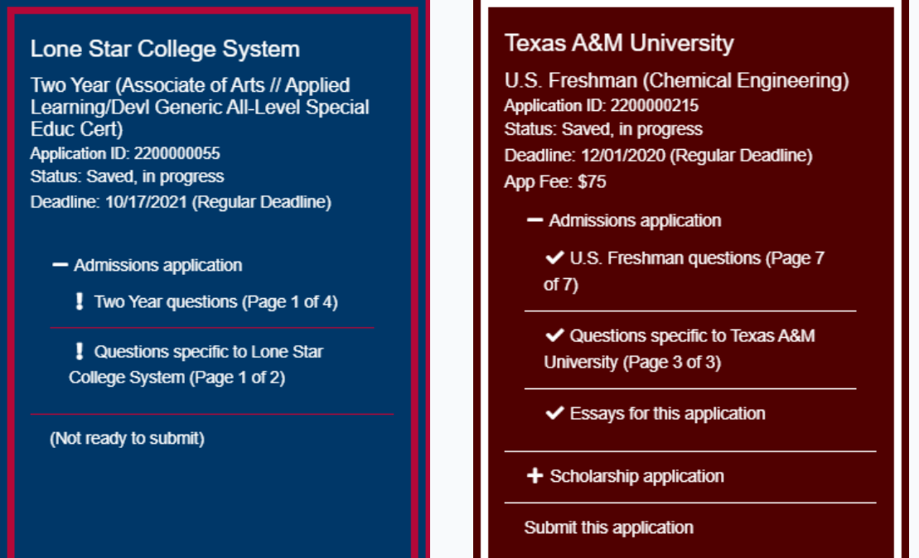
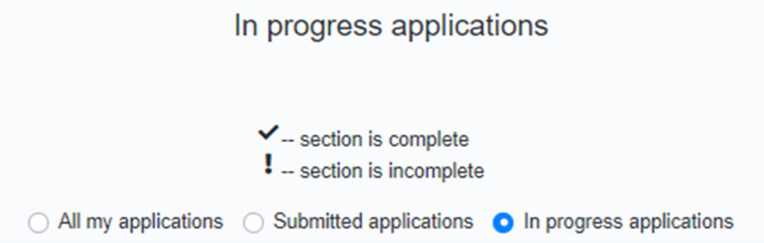
  Navigation Upgrades
HS search tool upgrade
Tracking Feature
Color-coded App Card
Notes:
We have the HS search tool upgrade that now if you type any school in the search bar the school will pop up to select and the green check next to the campus chosen will show complete. The new tracking feature will show a check for complete and an exclamation point for incomplete. Color-coded App card is color coded to the school chosen.

Slide 7
  Takeaways
Spring 2022 Application – September 15, 2021 (still on old ApplyTexas site - https://www.applytexas.org/adappc/gen/c_start.WBX ) (Old login)
Summer 2022 and Fall 2022 Applications – October 15, 2021 (new site - https://goapplytexas.org/ )(New login)
Upgrades will be launched with Summer 2022 application for Alamo Colleges
Prospective student users will need to create new login credentials to establish a profile within new environment (Oct. 15)
Notes:
Spring 2022 Application went live on September 15, 2021, Summer 2022 and Fall 2022 Applications will go live on October 15, 2021. Read the next sentences starting with Upgrades. Prospective student users will need to create new login credentials on October 15th to establish a profile within the new environment.

Slide 8
  Helpful Resources
ApplyTexas New Application
  CSI Public Information site
New ApplyTexas application site - https://goapplytexas.org/
Notes:
Here are helpful resources that we included new links to ApplyTexas. Everyone should have received an email on August 30th with instructions and the dates to go live on how to enter the new site.

Slide 9
Thank you!

