Slide 1




Alamo Colleges Foundation
2025-2026
Scholarship Reviewer Orientation

Slide 2

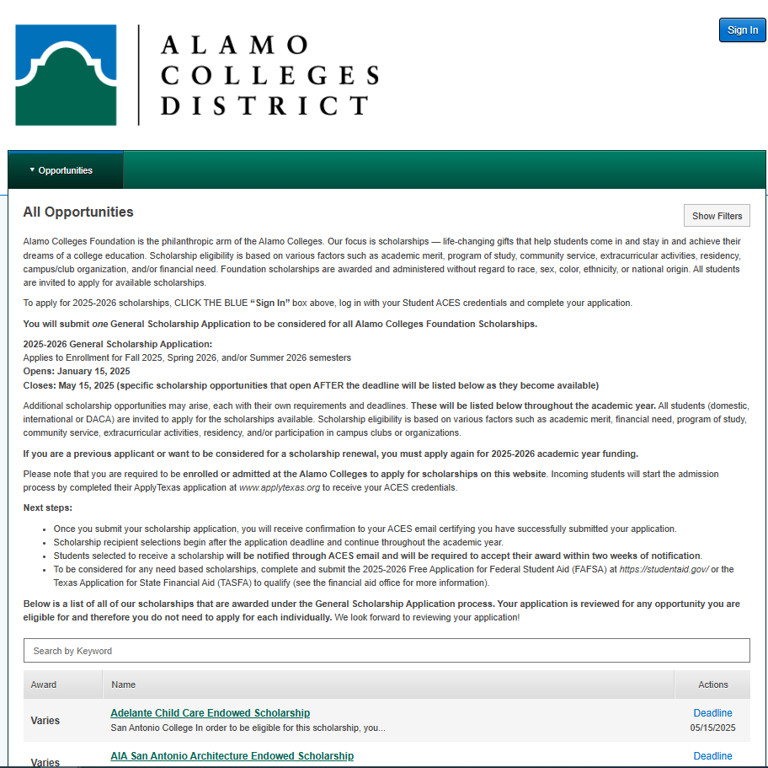
Awards Management (Scholarship Process and Management System)
Keeps our scholarship program running efficiently by giving access to one central awards platform.
A single website makes it easy to promote all scholarships on each campus to our student population.
Nightly integration with our student information system shortens the time it takes to complete an application and improves the quality and accuracy of data on each application.
Notes:
.

Slide 3
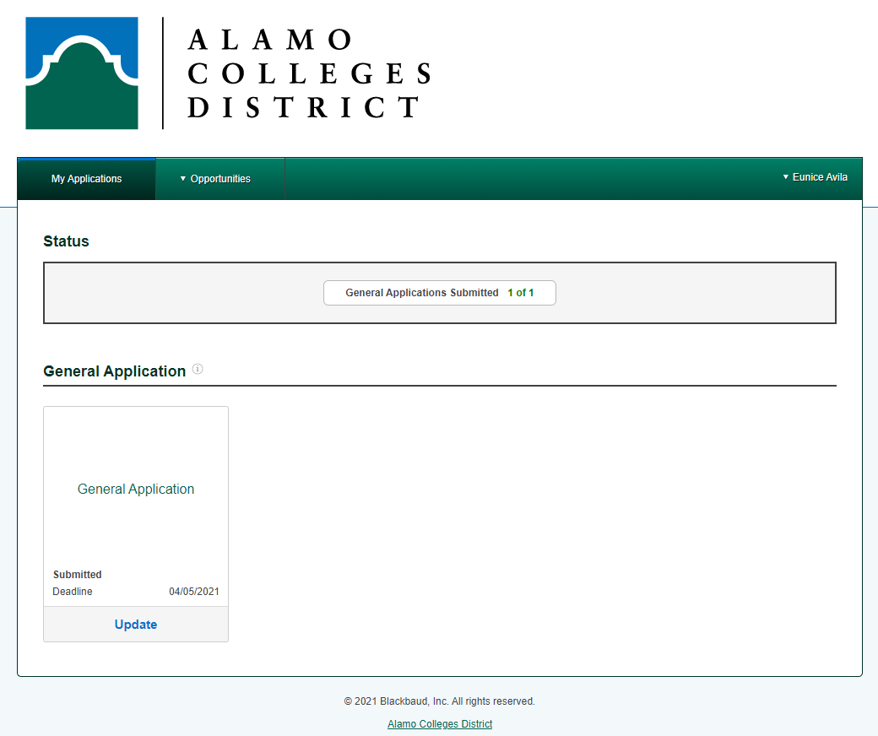
The Student Scholarship Application
Web-based application available to students 24/7
One application for full award year and considered for all Foundation Scholarships
Important Dates
Application Opens: January 15, 2025
Application Closes: May 15, 2025
Application Review/Scoring Period: May 16 – May 26, 2025

Slide 4
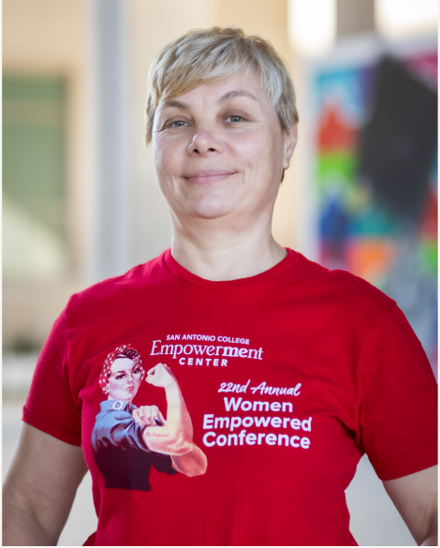

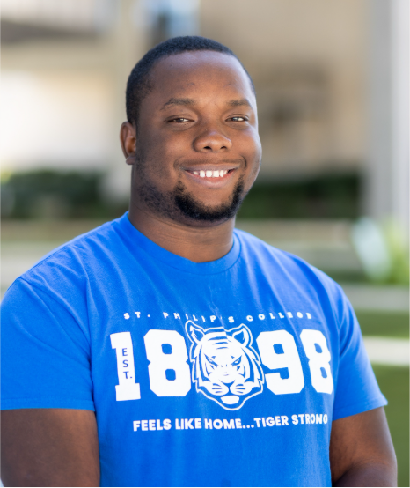
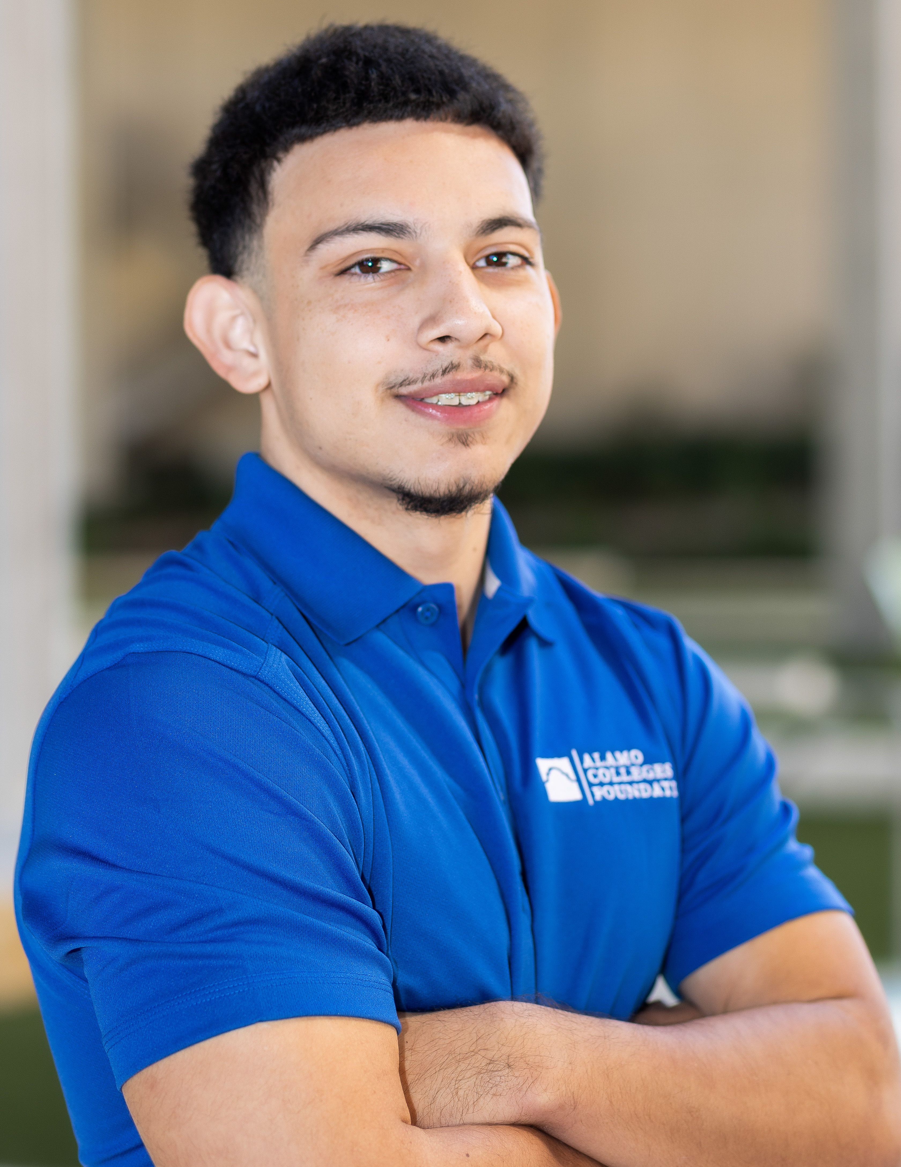
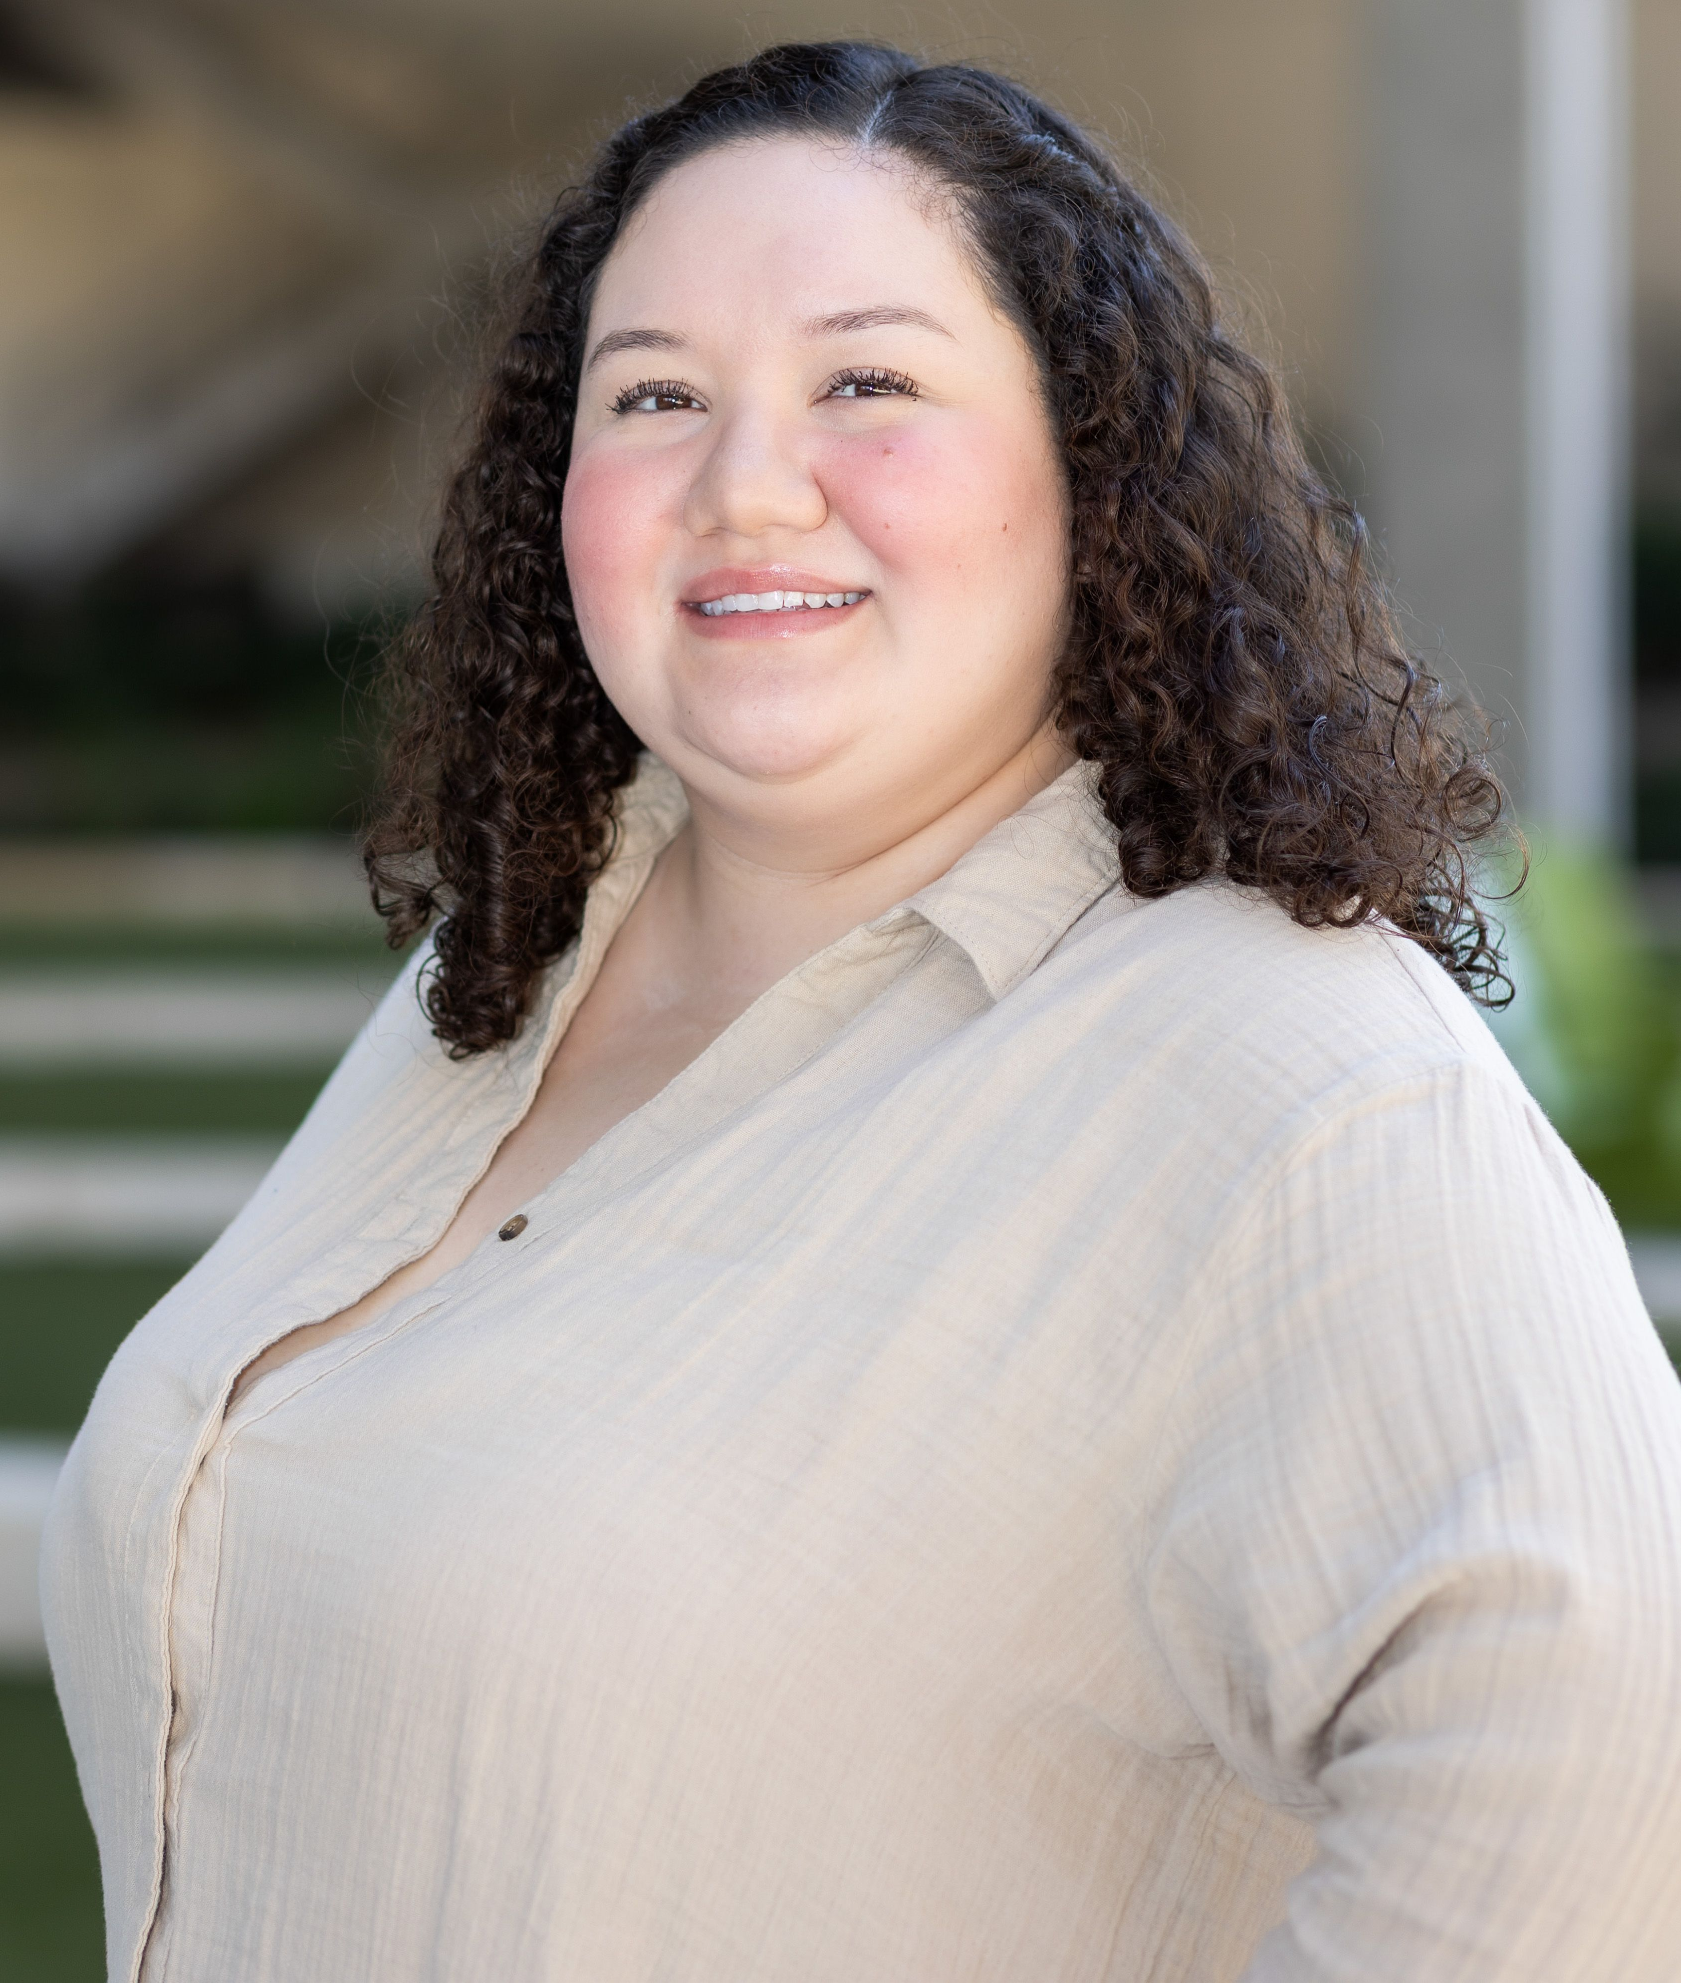
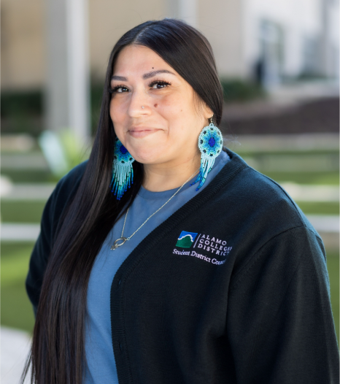
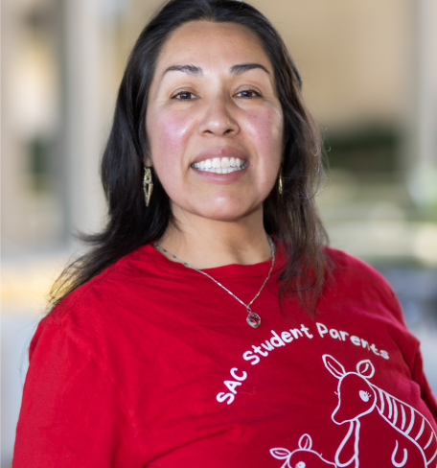
The reviewer process begins on May 16 – May 26, 2025. All reviews are due on May 26th.
It is estimated that up to 4 hours will be needed to complete all assigned reviews.
It is recommended that you complete approximately 5 reviews shortly after receiving the sign-in link, so that you can correctly estimate the amount of time needed to complete all reviews.
If for any reason you are unable to complete the reviews assigned to you, please contact the Scholarship team as
soon as possible at dst-scholarship@alamo.edu.

Slide 5


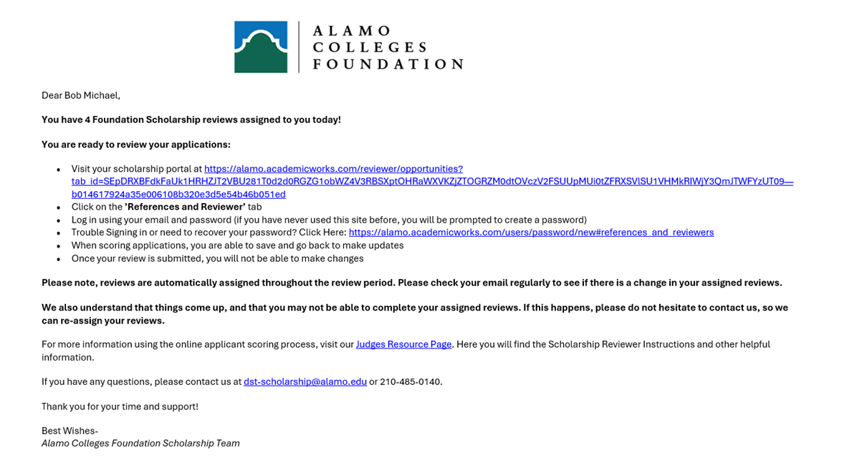
Step 1. Receive Reviewer Email
You will receive an email from dst-scholarship@alamo.edu on May 16th
The email contains the link to log into the system to begin reviewing applications, and a link to watch an instructional video on the process.

Slide 6
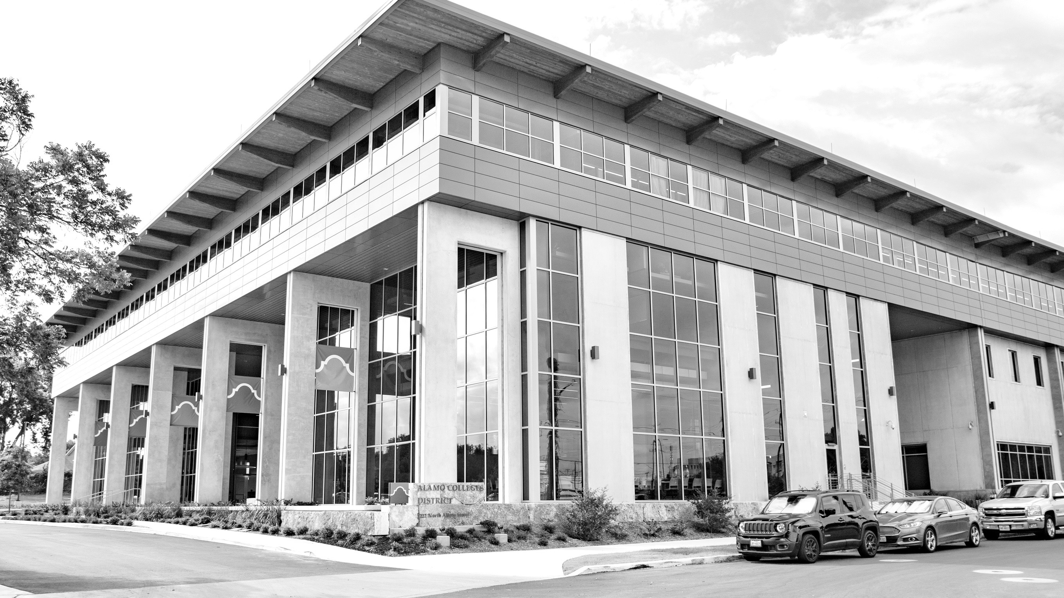
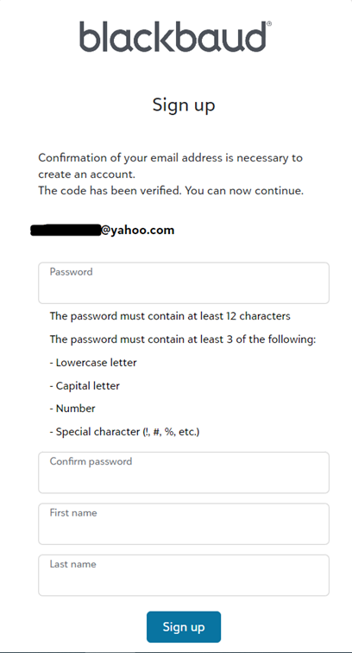
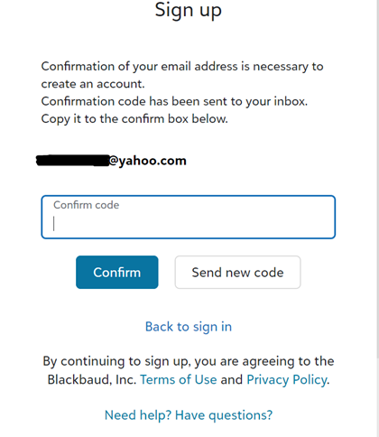
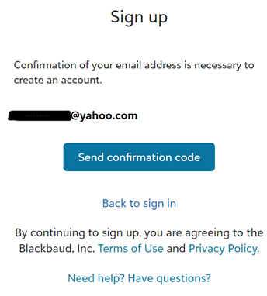
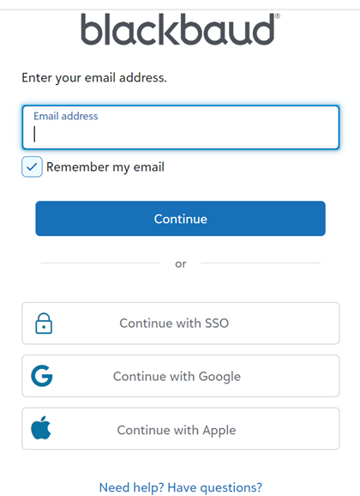
Creating Your Login Credentials
Create your password.
Copy the confirmation code that was sent to your email to confirm.
Enter the exact email address where the committee reviewer link was sent.
Confirm the email address and send confirmation code.

Slide 7
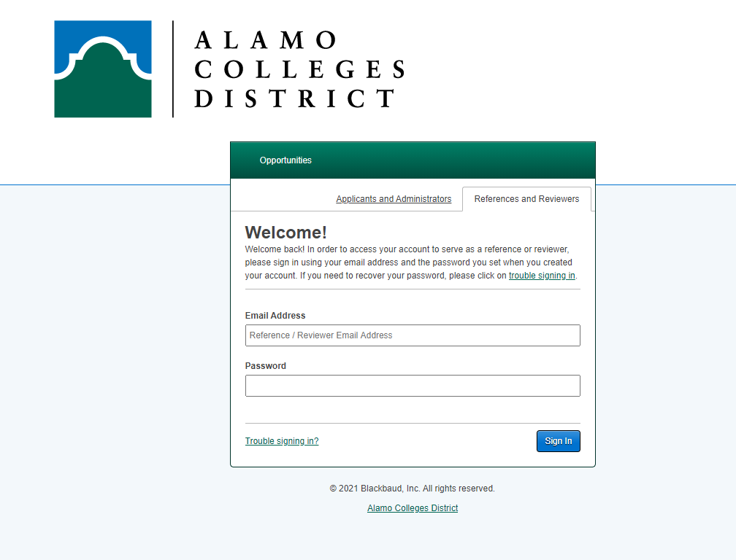
Step 2. Choose Reference & Reviewers Tab
To log in…
you must click on the “References and Reviewers” tab.
The “Applicants and Administrators” tab is for students that want to apply.

Slide 8

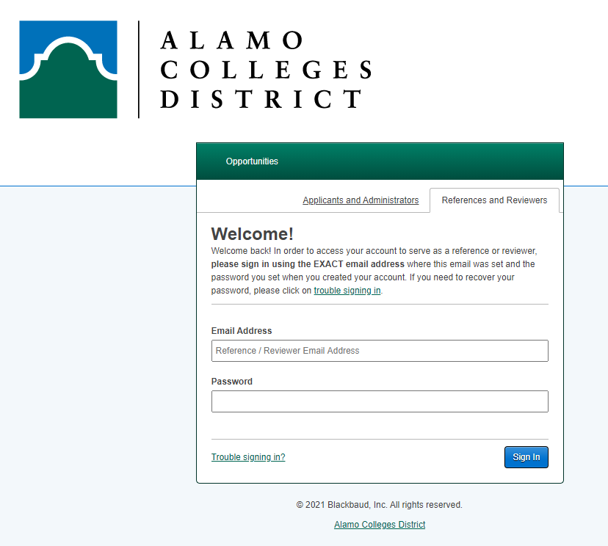
Step 3. Signing In
When you have your login credentials, Sign In using the same email address the link was sent to and your created password.
*If you have participated in judging previously, it will be the same password*
Your password will be reused each time you Sign-In as a reviewer
Please contact the scholarship team if you are needing assistance dst-scholarship@alamo.edu

Slide 9
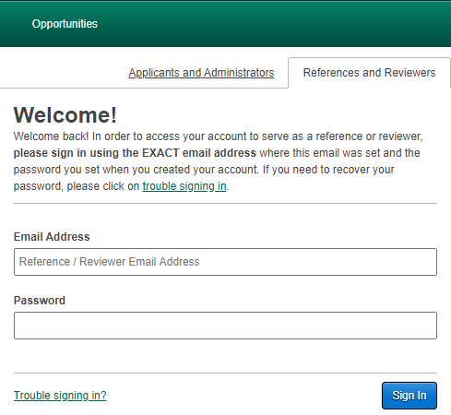
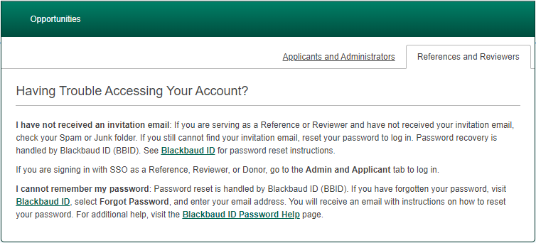
Trouble Signing In?
Click the “Trouble signing in” link in the lower left corner
To reset your password…
Enter the exact email address where the committee reviewer link was sent.
2. Click on “Forgot Password” in the lower right corner.
3. Confirm your email by sending a confirmation code and follow the password reset instructions as referenced on the ‘creating your login credentials’ slide.
For assistance, kindly reach out to the scholarship team at dst-scholarship@alamo.edu.

Slide 10

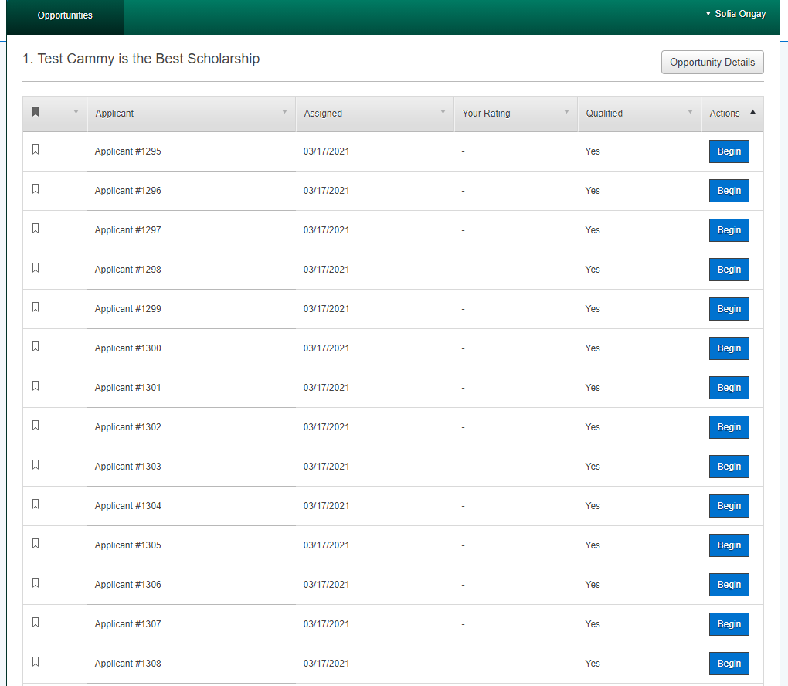
Step 4. General Applications
View the list of students that you are assigned to review.
All applicants are listed anonymously.

Slide 11
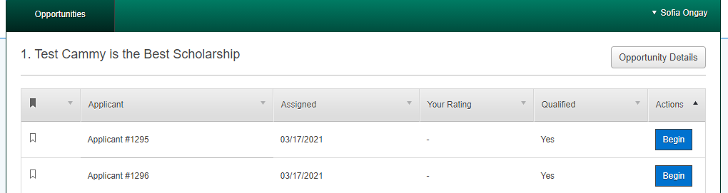
Step 5. Review students
Click “Begin” to review a candidate.

Slide 12
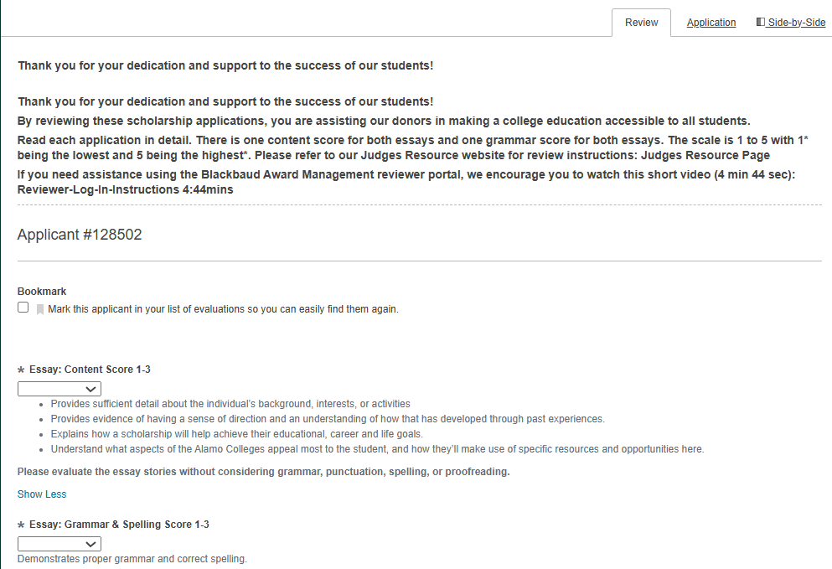
Viewing the application
The “Review” tab is where you score the applications.
To view the application, click the “Application” tab.
Use the “Side-by-Side” tab to view the student’s application and the review tab at the same time.

Slide 13
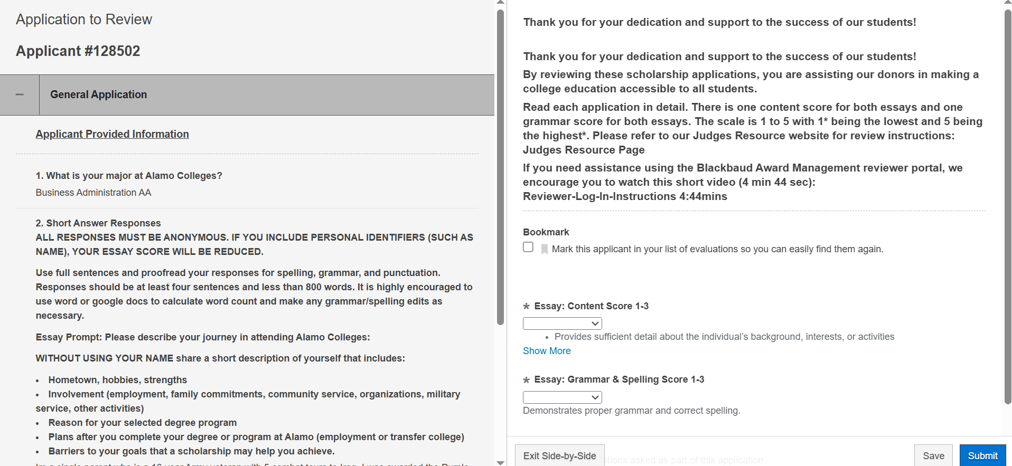
“Side-by-Side Option” (Recommended)
This allows you to scroll to review the student’s application and essays next to your rating criteria for quick reference.

Slide 14

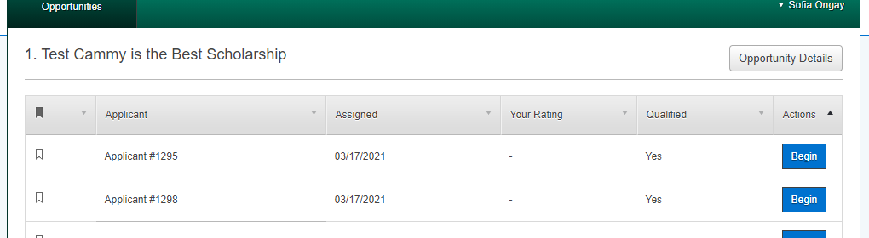
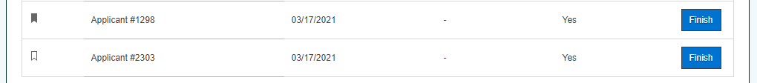
Bookmark feature
This feature makes it easy to find an applicant you may want to come back to review.
To review students with a bookmark, click on “Finish”.
Bookmark feature

Slide 15

Step 6. Review & Score
Rate the applicants using the scoring rubric. (See on next page)
Scores will be listed from 0-3.
Select the drop down on each item to select the score.

Slide 16

Scoring Rubric – Essay Information to Review
Essay Prompt: Please describe your journey in attending Alamo Colleges:
WITHOUT USING YOUR NAME include a short description of yourself
Hometown, hobbies, strengths
Involvement (employment, family commitments, community service, organizations, military service, other activities)
Reason for your selected degree program, plans after you complete your degree at Alamo (employment or transfer college)
And share any particular barriers to your goals that a scholarship may help you achieve.

Slide 17
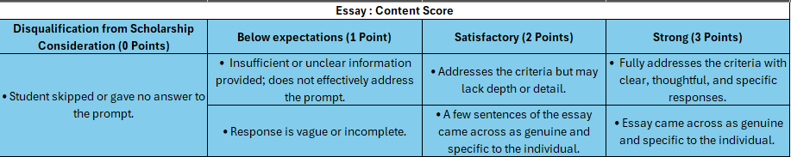
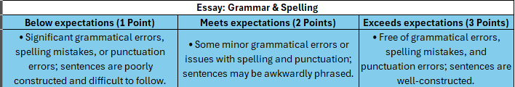
Scoring Rubric - Points
Essay Prompt - up to 3 points
*There is not a minimum amount a student can write*
Essays are capped at 800 words and students were encouraged to use at least 4 sentences.
Essay Grammar & Spelling: – up to 3 points
*The essay prompt score is evaluated without considering grammar, punctuation, spelling, or proofreading. Grammar is scored separately under the grammar and spelling points*

Slide 18
AI Statement and Information
We’ve let students know that AI tools can be helpful for brainstorming, outlining, or editing, but their final essay should reflect their own voice and perspective.
Here’s what we’re asking you to keep in mind:
We do not place significant emphasis if students used AI to help organize their thoughts.
What matters most is that the essay feels personal, authentic, and reflective of the student’s own experience.

Slide 19
Step 7. Finish & Submit
Don't forget to hit
'Submit’
after scoring to finalize your rankings.

Slide 20

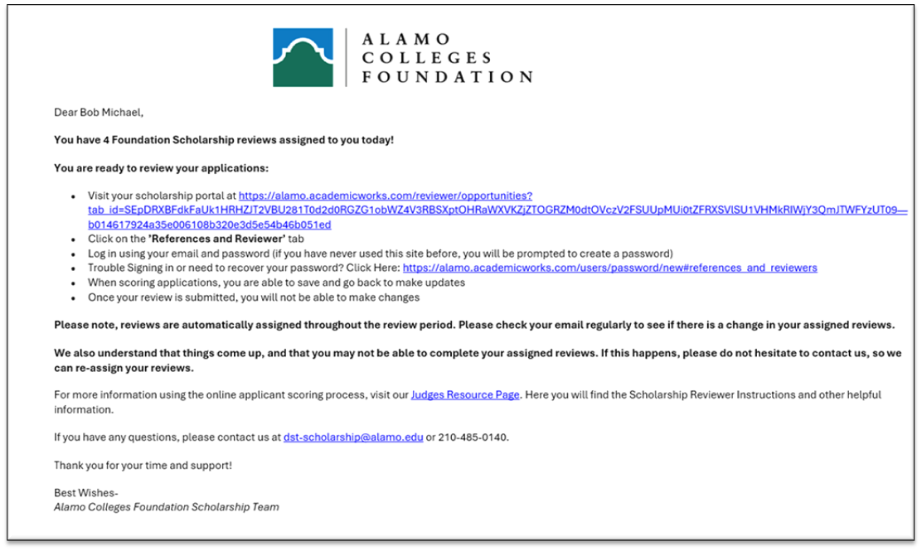


Questions & Answers
What if I finish judging my list of applicants before the application/scoring period is over?
What if I am no longer available to score/review applications?
It is recommended to check your list of applicants throughout the reviewing period. Additional applications can be distributed to reviewers daily.
Contact the Scholarship Team at dst-scholarship@alamo.edu. They will be able to redistribute your list of applications to the other reviewers.

Slide 21

We are here to help!
Your role is vital to the scholarship selection process. Thank you for taking the time to assist our students!
For questions, please contact the Scholarship Team:
Amy Carcanagues
acarcanagues@alamo.edu
O: (210) 485-0776
Evelyn Campos
ecampos134@alamo.edu
O: (210) 485-0140
Sofia Ongay
songay@alamo.edu

Slide 22
Thank You

