Slide 1




Alamo Colleges Foundation
2026-2027
Scholarship Reviewer Orientation

Slide 2

Overview
Awards Management System
Scholarship/ Reviewer Cycle
Credential Set up
Navigating through the applications
Essays and scoring guides
Questions and connections

Slide 3
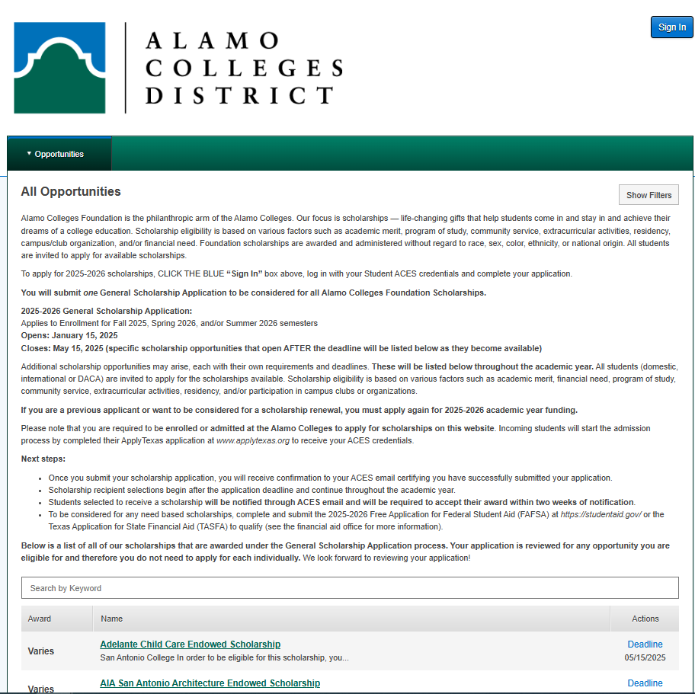
Awards Management
(Scholarship Process and
Management System)
Keeps our scholarship program running efficiently by giving access to one central awards platform.
A single website makes it easy to promote all scholarships on each campus to our student population.
Nightly integration with our student information system shortens the time it takes to complete an application and improves the quality and accuracy of data on each application.

Slide 4

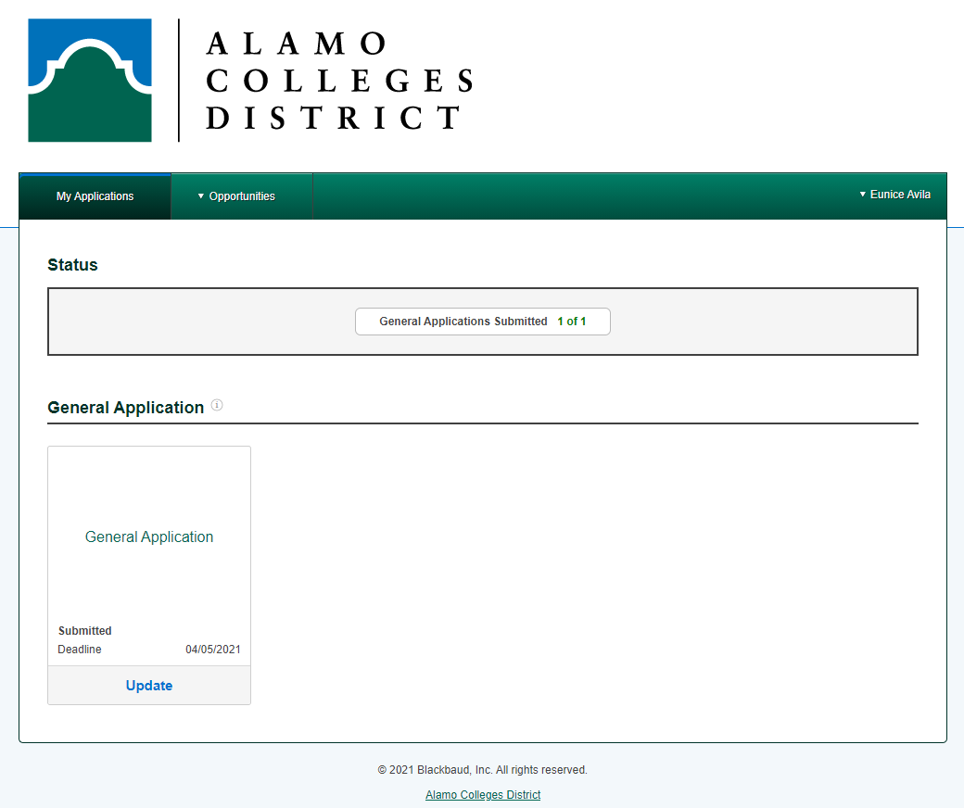
2026-2027 Foundation Scholarship Cycle
Web-based application available to students 24/7
One application for full award year and considered for all Foundation Scholarships
Important Dates
Application Opens
Feb 15, 2026
Application Closes
May 15, 2026
Review Process
May 19- May 28, 2026

Slide 5

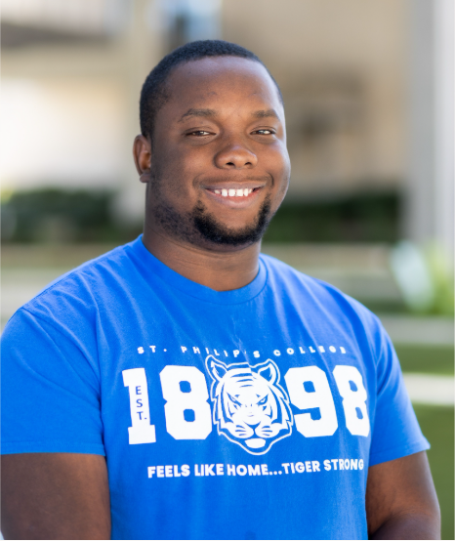

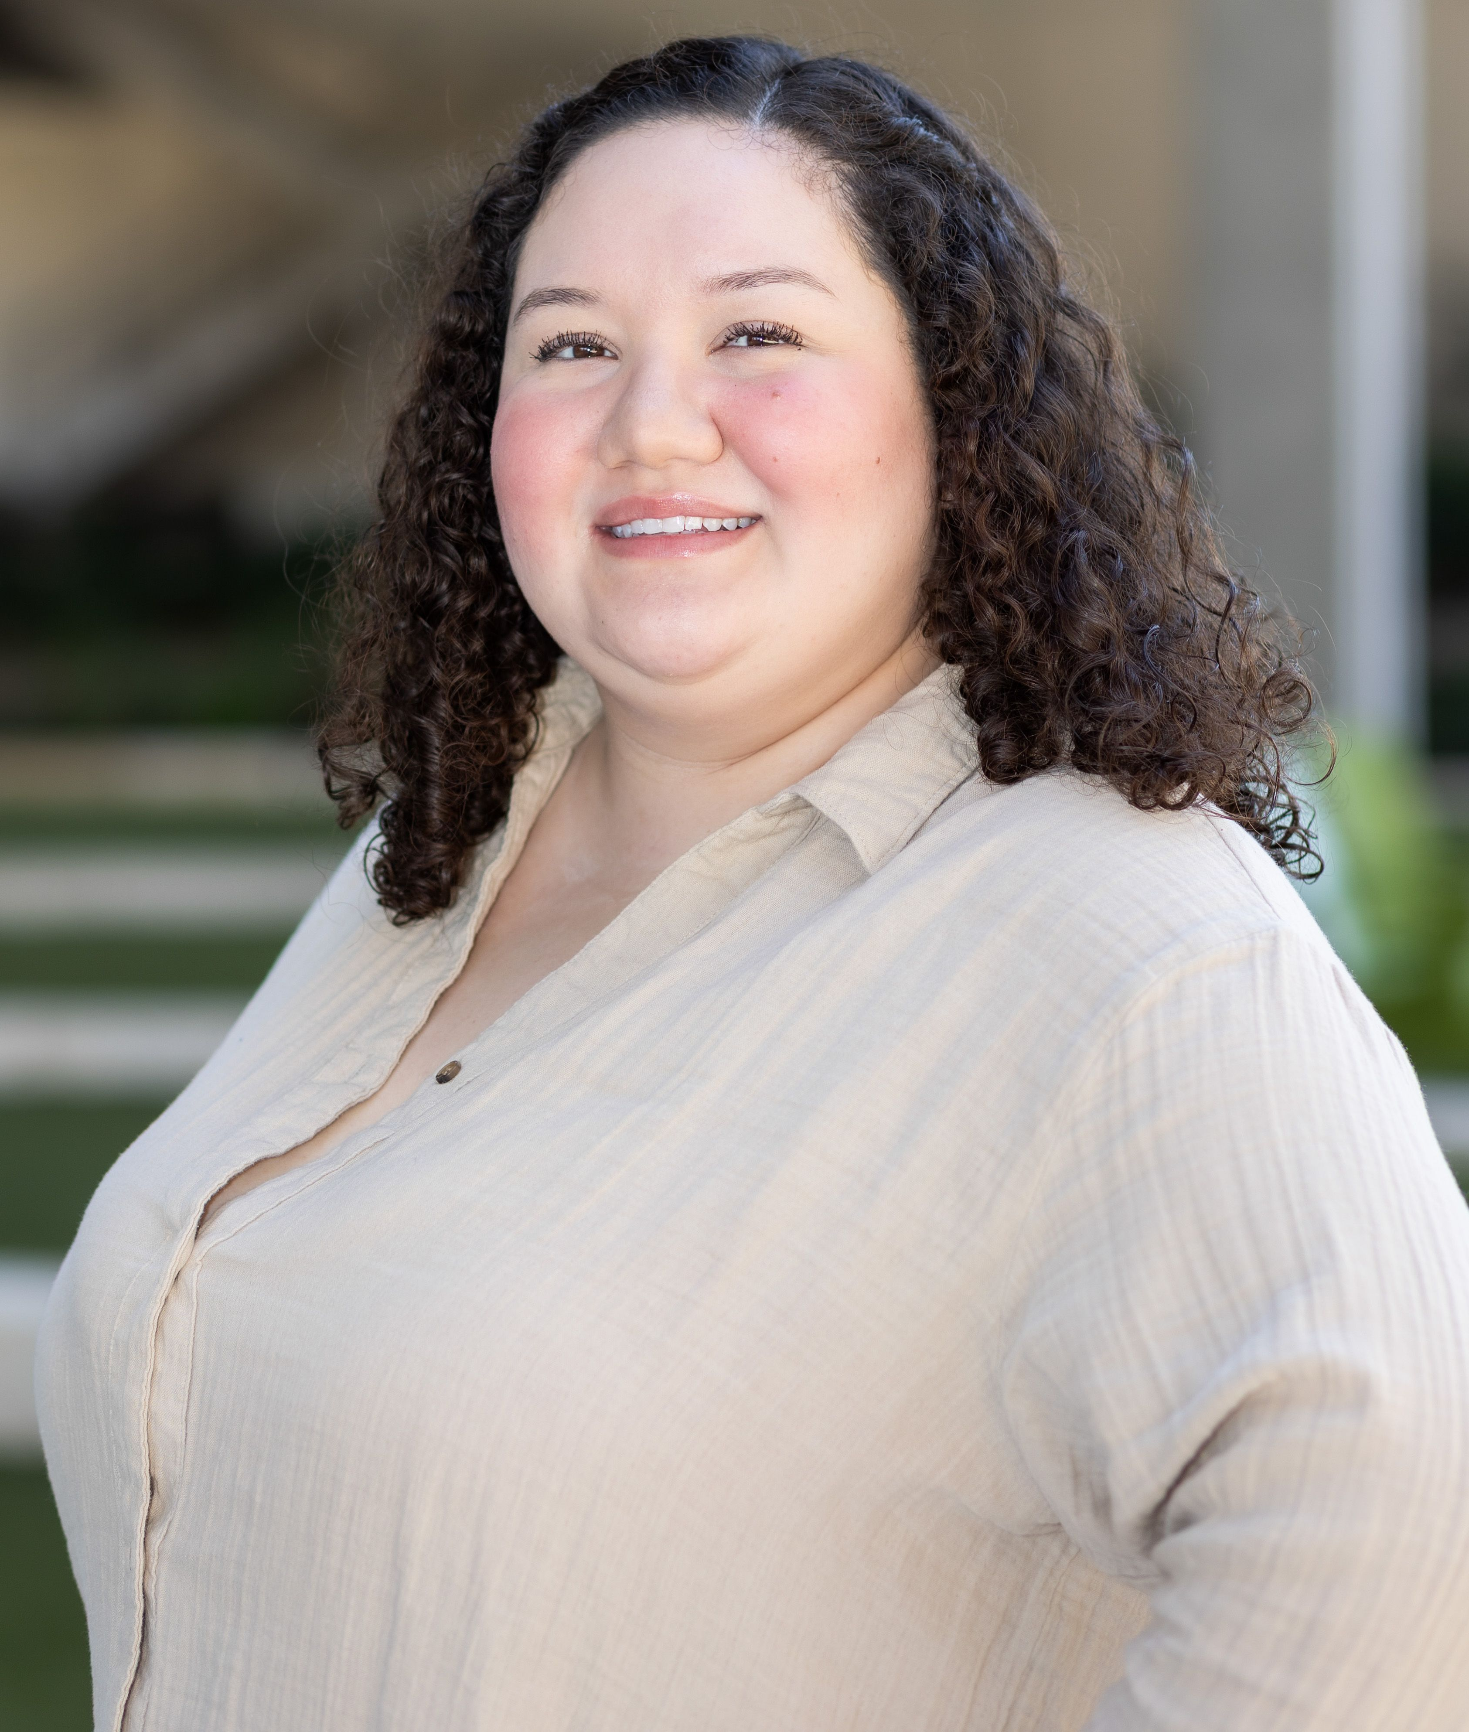
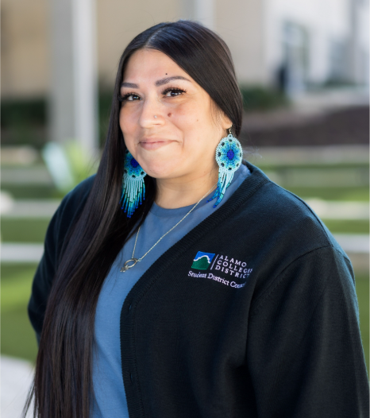
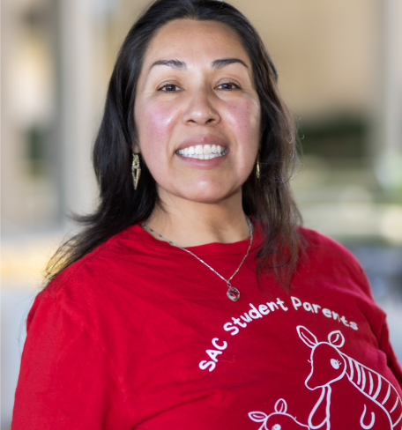
The reviewer process begins on May 19 – May 28, 2026. All reviews are due on May 28th.
It is estimated that up to 4 hours will be needed to complete all assigned reviews.
It is recommended that you complete approximately 5 reviews shortly after receiving the sign-in link, so that you can correctly estimate the amount of time needed to complete all reviews.
If for any reason you are unable to complete the reviews assigned to you, please contact the Scholarship team as
soon as possible at dst-scholarship@alamo.edu.

Slide 6
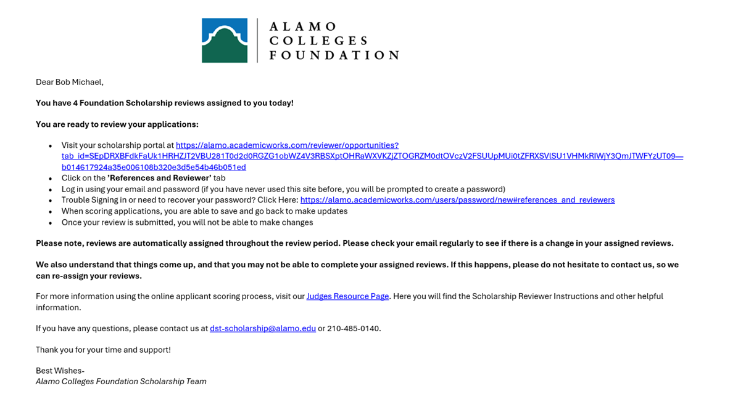
Step 1. Receive Reviewer Email
You will receive an email from dst-scholarship@alamo.edu on May 19th
The email contains the link to log into the system to begin reviewing applications, and a link to watch an instructional video on the process.

Slide 7
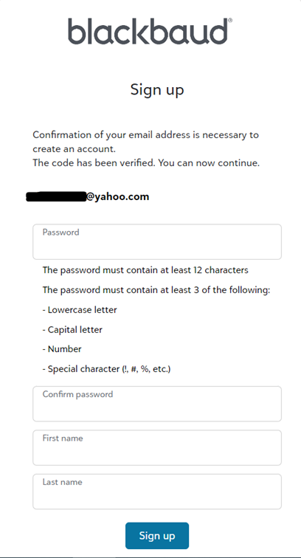
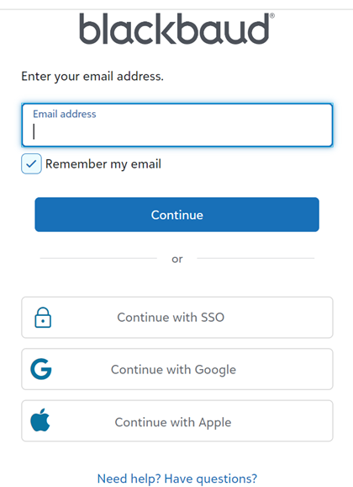
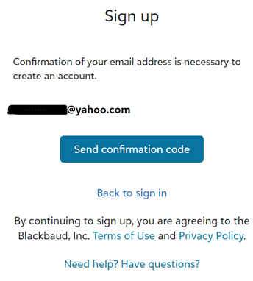
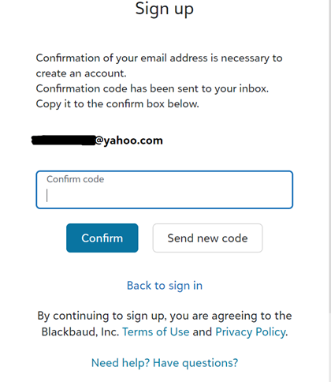
Creating Your Login Credentials
Create your password.
Enter the exact email address where the committee reviewer link was sent.
Copy the confirmation code that was sent to your email to confirm.
Confirm the email address and send confirmation code.

Slide 8
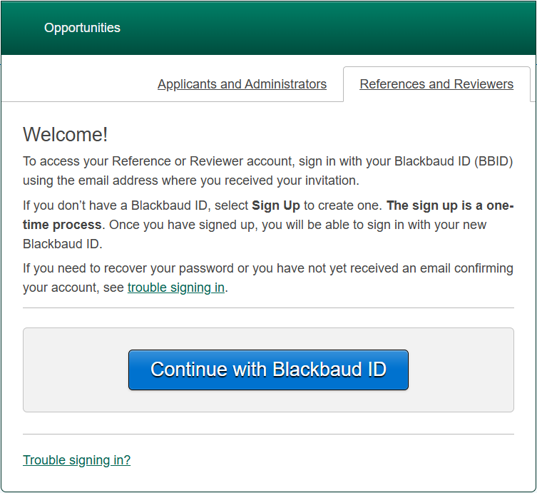
Step 2. Choose Reference & Reviewers Tab
To log in…
you must click on the “References and Reviewers” tab.
The “Applicants and Administrators” tab is for students that want to apply.

Slide 9
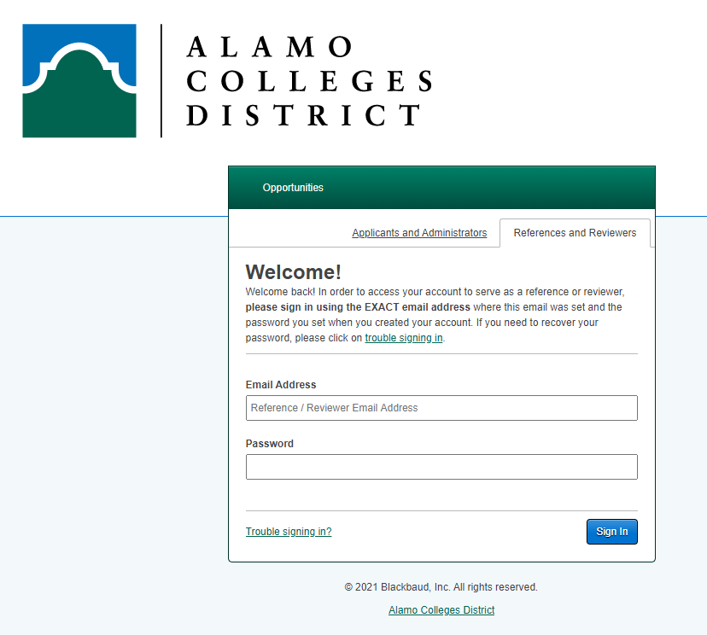
Step 3. Signing In
When you have your login credentials, Sign In using the same email address the link was sent to and your created password.
*If you have participated in judging previously, it will be the same password*
Your password will be reused each time you Sign-In as a reviewer
Please contact the scholarship team if you are needing assistance
dst-scholarship@alamo.edu

Slide 10
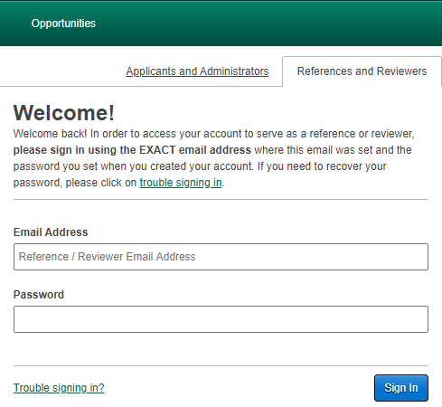
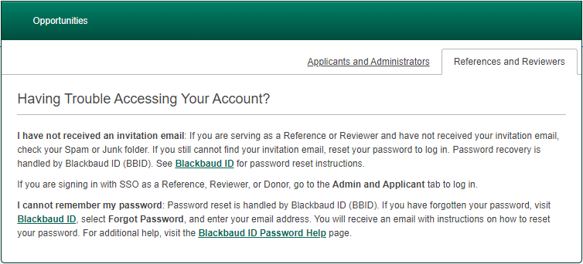
Trouble Signing In?
Click the “Trouble signing in” link in the lower left corner
To reset your password…
Enter the exact email address where the committee reviewer link was sent.
2. Click on “Forgot Password” in the lower right corner.
3. Confirm your email by sending a confirmation code and follow the password reset instructions as referenced on the ‘creating your login credentials’ slide.
Please contact the scholarship team if you are needing assistance
dst-scholarship@alamo.edu

Slide 11
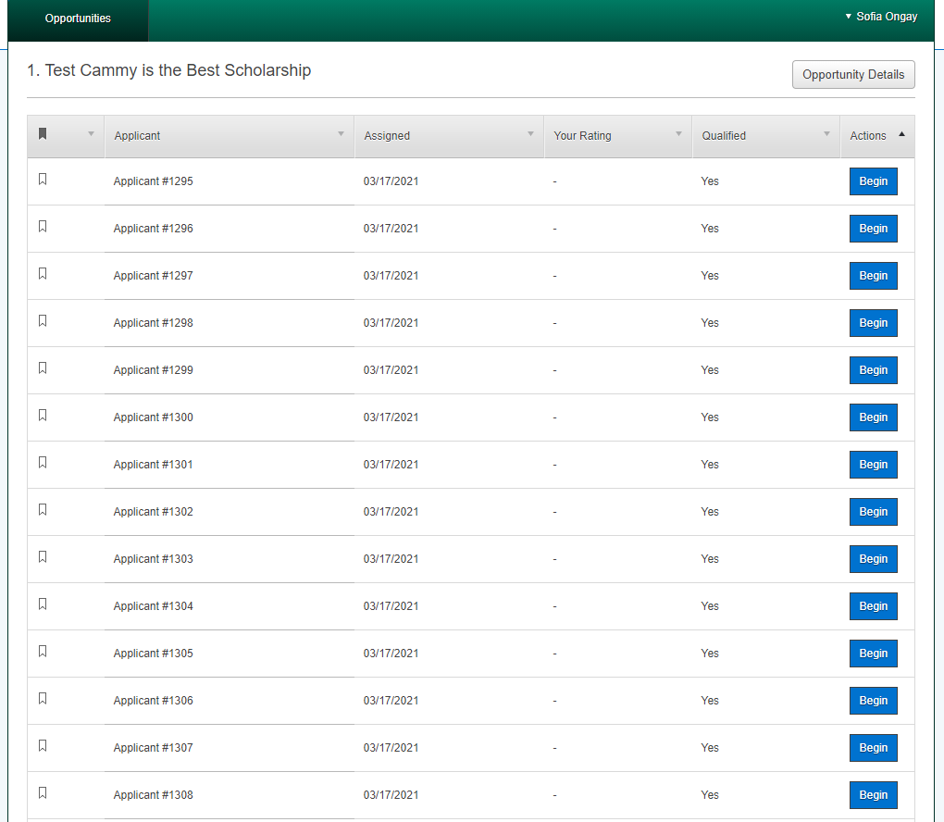
Step 4. General Applications
View the list of students that you are assigned to review.
All applicants are listed anonymously.

Slide 12
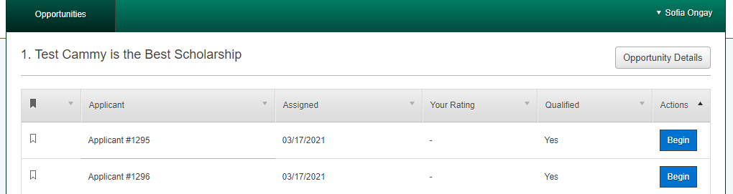
Step 5. Review Applications
Click “Begin” to review a candidate.

Slide 13
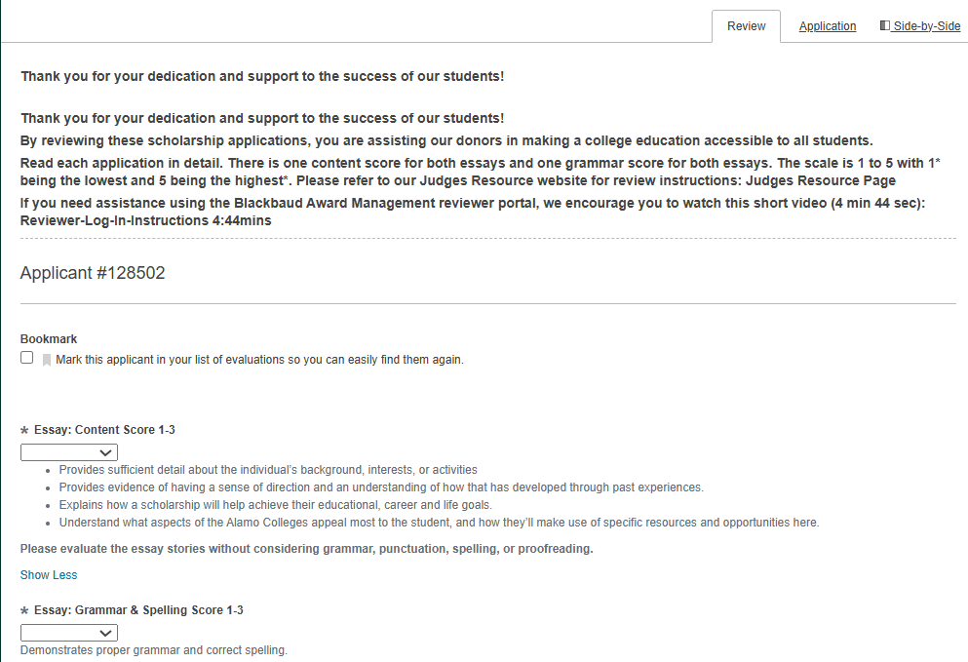
Viewing the Application
To view the application, click the “Application” tab.
Use the “Side-by-Side” tab to view the student’s application and the review tab at the same time.
The “Review” tab is where you score the applications.

Slide 14
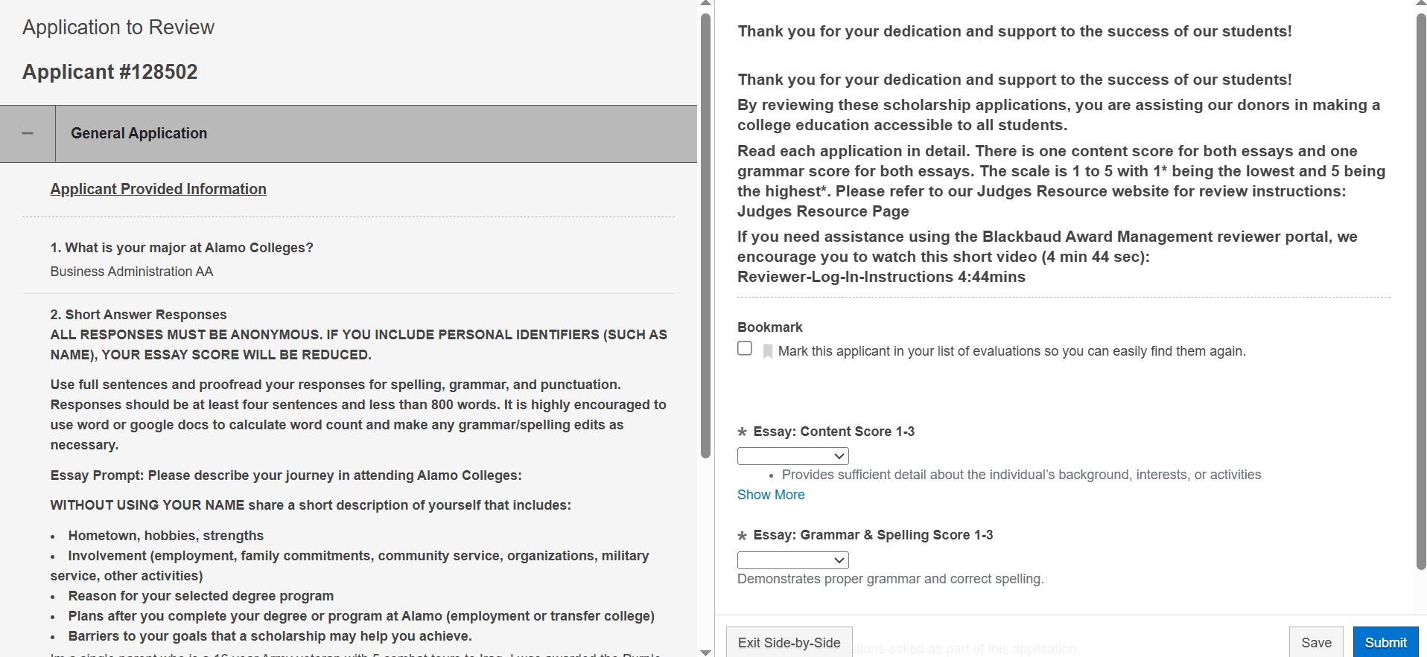
“Side-by-Side Option” (Recommended)
This allows you to scroll to review the student’s application and essays next to your rating criteria for quick reference.

Slide 15
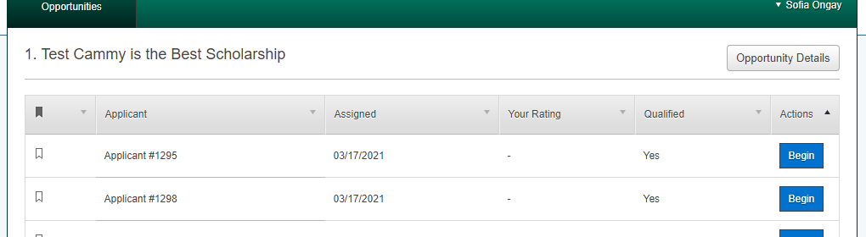
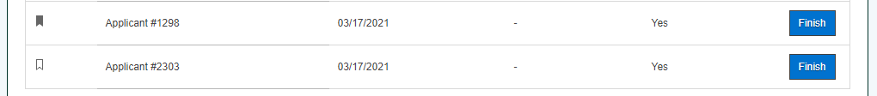
Bookmark feature
This feature makes it easy to find an applicant you may want to come back to review.
To review students with a bookmark, click on “Finish”.

Slide 16

Step 6. Review & Score
Rate the applicants using the scoring rubric.
Scores will be listed from 1-5
Select the drop down on each item to select the score.

Slide 17
Essay Information to Review
Student Essay Requirements:
All essays must remain anonymous and not to include their names.
Keeping responses, no more than 400 words for each prompt and try to provide at least 150 words for each prompt.
Be authentic– it is the student's opportunity to share their story, goals, and motivations. Giving personal responses and examples when they can.
Essay Prompt 1:
Describe your academic and career goals — explain what you are studying, why you chose this path, and your plans after completing your credential (for example employment options or additional education plans).
Essay Prompt 2:
Describe something you are proud of. For example, employment, service, school, family involvement, participation in organizations, an event, a recognition, or a challenge you have overcome so far.

Slide 18

Essay Information Continued...
The purpose of their personal essays is to help the reviewer understand who they are beyond grades and data.
Prompt 1 content is evaluated on whether the essay demonstrates:
Clear educational and career goals
Motivation, direction, and authenticity in their story
Prompt 2 content is evaluated on whether the essay demonstrates:
Resilience and problem-solving
Personal growth and reflection
Authenticity of story
Essay grammar for both prompts will be evaluated on whether their essays demonstrates:
Clear organization and flow
Correct grammar, spelling, punctuation, and attention to detail
Demonstrates effort

Slide 19
Essay Prompts Scoring Rubric - Points
Content Score (1-5)
Score | Description
5 – Excellent | Exceptionally strong in all areas; exceeds expectations
4 – Strong | Above average; well-developed responses
3 – Satisfactory | Meets basic expectations; adequate but could be more detailed
2 – Developing | Incomplete or unclear; lacks depth or organization
1 – Limited | Minimal effort; unclear or off topic; response is a few words

Slide 20
Essay Prompts Scoring Rubric - Points
Effort, Quality & Grammar Score (1-5)
Score | Description
5 - Excellent | Writing is exceptionally clear, well-organized; few to no grammar, spelling, or punctuation errors
4 - Strong | Organization and flow are clear with only minor issues; few grammar or mechanical errors that do not affect understanding
3 - Satisfactory | Organization is generally understandable, some grammar or spelling errors; shows average effort; some areas could be more polished
2 - Needs Improvement | Organization is weak or difficult to follow; frequent grammar or punctuation errors; shows limited effort
1 - Limited | Lacks clear organization; writing is hard to understand; numerous grammar, spelling, and punctuation errors; Shows minimal effort with little attention to detail

Slide 21
Reviewing Tips
While comparison is a natural instinct, it's crucial during the application review process to focus on evaluating each applicant based on the content and quality of their application, rather than in relation to others.
Focus on the evidence provided in the application. Evaluate what the applicant has shared in relation to the essay prompt, rather than relying on your own knowledge or feelings, ensuring alignment with the review criteria.
We often react to students' language use, mistakenly assuming it reflects their intelligence or potential. However, writing skills can be influenced by various factors, including background and access to educational resources. When assigning a score for content, ignore spelling, grammar, and other mechanics. Reserve that score for the separate grammar score section. (a separate weight is applied for grammar)
Monitor how your approach to applications and scoring might change due to stress, interruptions, or fatigue. Take breaks and revisit applications, especially those reviewed early or late in the process. Re-review similar scores for consistency and rescore if necessary, ensuring that your notes connect to the evidence in the application materials.

Slide 22
AI Statement and Information
AI tools can be helpful for brainstorming, outlining, or editing, but the final essay should reflect the student’s own voice and perspective.
AI is transforming how students write, but it does not have to replace authenticity. We are not looking for flawless writing or perfect grammar.
What matters most is that the essay feels personal, authentic, and reflective of the student’s own experience. Valuing honesty, vulnerability and specific examples- things on the applicant can provide.

Slide 23
Step 7. Finish & Submit
Don't forget to hit
'Submit’
after scoring to finalize your rankings.

Slide 24
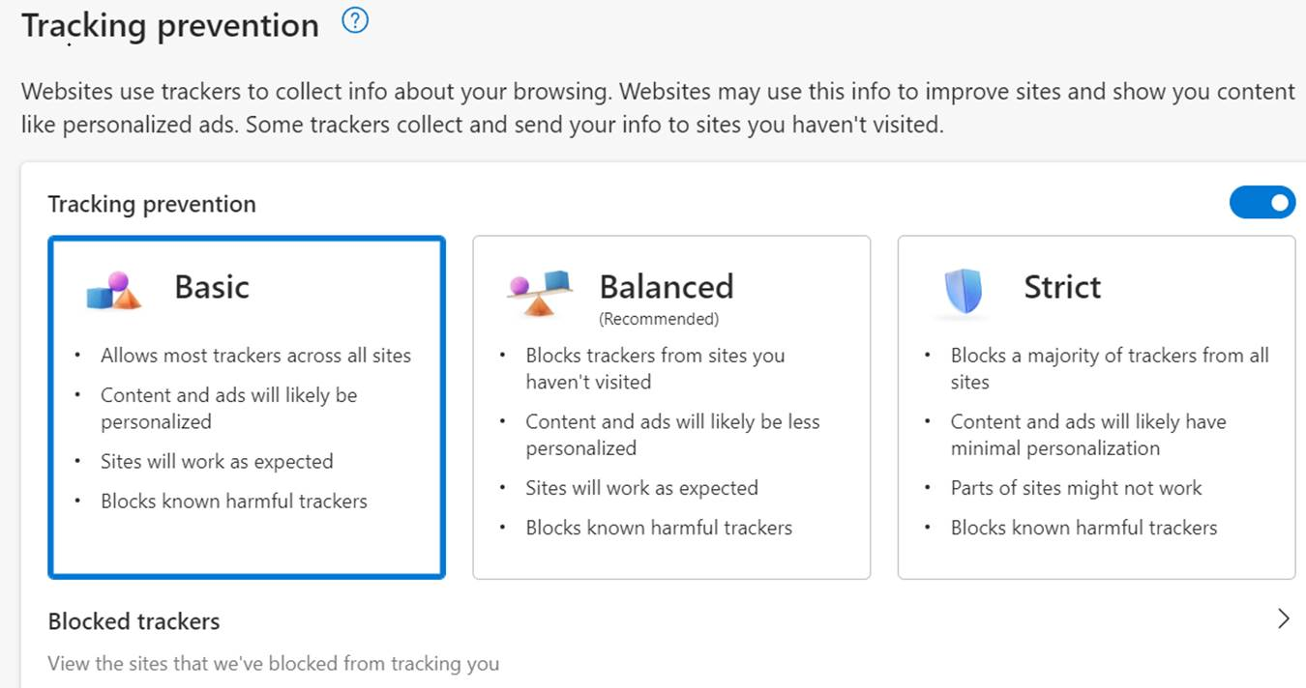

FAQs
What if I finish judging my list of applicants before the application/scoring period is over?
  It is recommended to check your list of applicants throughout the reviewing period. Additional applications can be distributed to reviewers daily.
What if I am no longer available to score/review applications?
  Contact the Scholarship Team at dst-scholarship@alamo.edu. They will be able to redistribute your list of applications to the other reviewers.
When I try to verify my email, I do not get the code, what do I do?
    Updating the tracking settings on your web browser may apply:

Slide 25

We are here to help!
Your role is vital to the scholarship selection process. Thank you for taking the time to assist our students!
For questions, please contact the Scholarship Team:
Amy Carcanagues
acarcanagues@alamo.edu
O: (210) 485-0776
Evelyn Campos
ecampos134@alamo.edu
O: (210) 485-0140
Sofia Ongay
songay@alamo.edu
O: (210) 485-0615

Slide 26
Thank You

