Slide 1




Alamo Colleges Foundation
Scholarship Application Overview

Slide 2
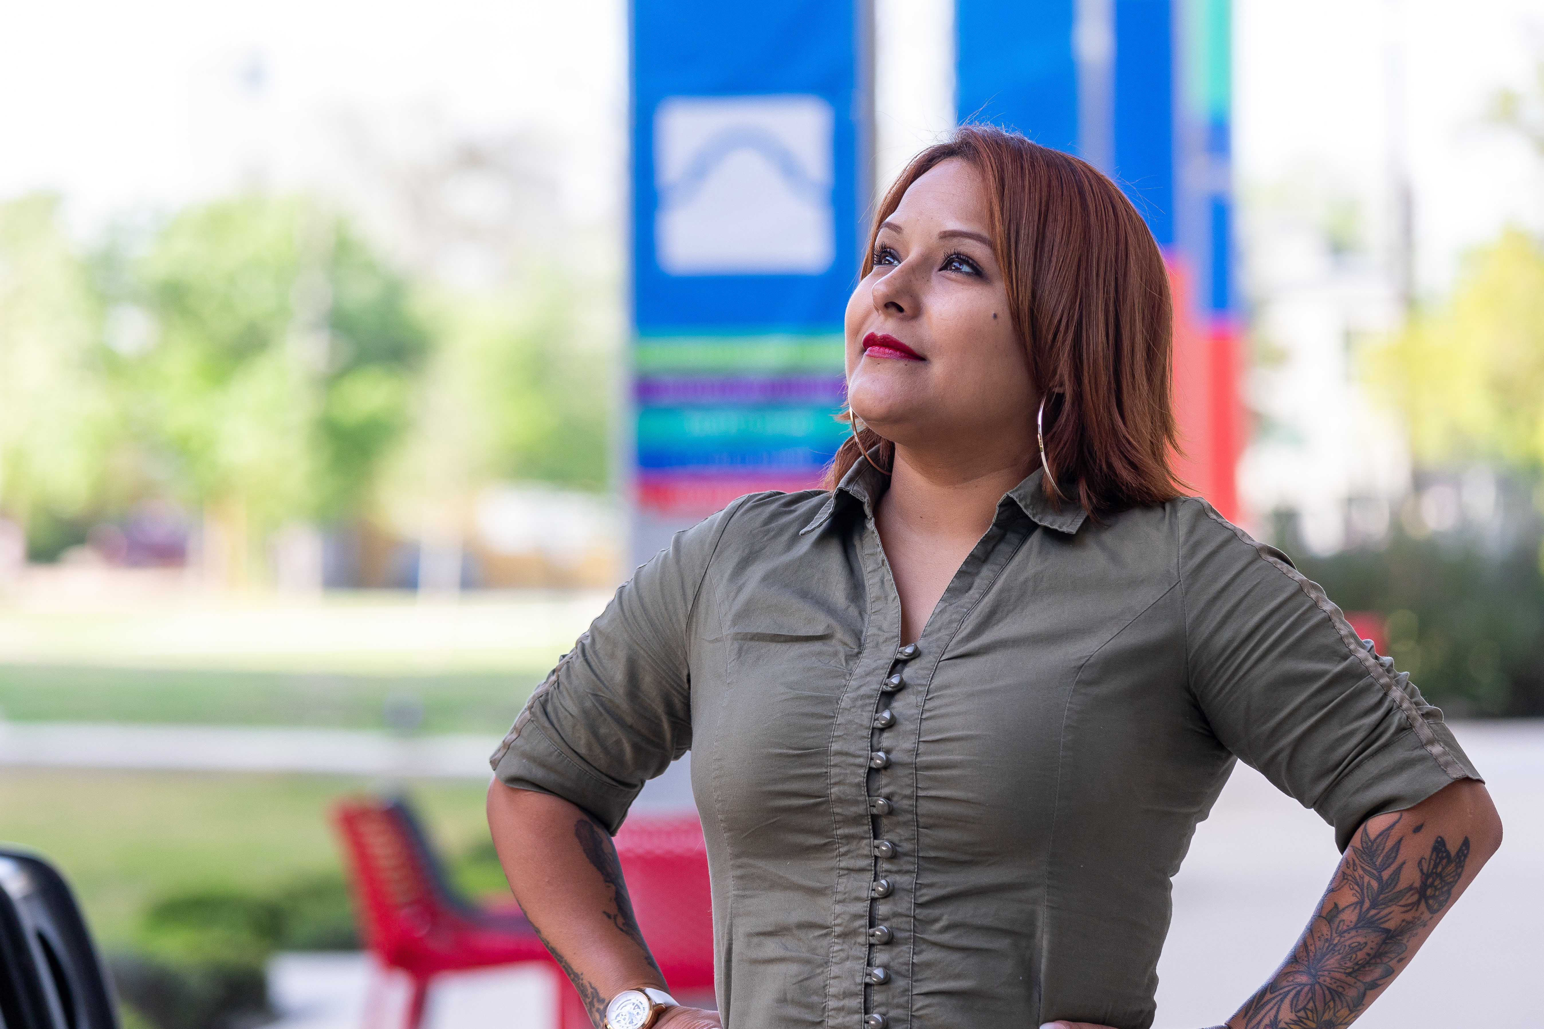



Alamo Colleges Foundation
We are the philanthropic arm of the Alamo Colleges.
Our focus is on raising money
for student scholarships —
these are life-changing gifts that help you come in and stay in, supporting your dreams of a college education.
Annalisa, SAC Graduate

Slide 3
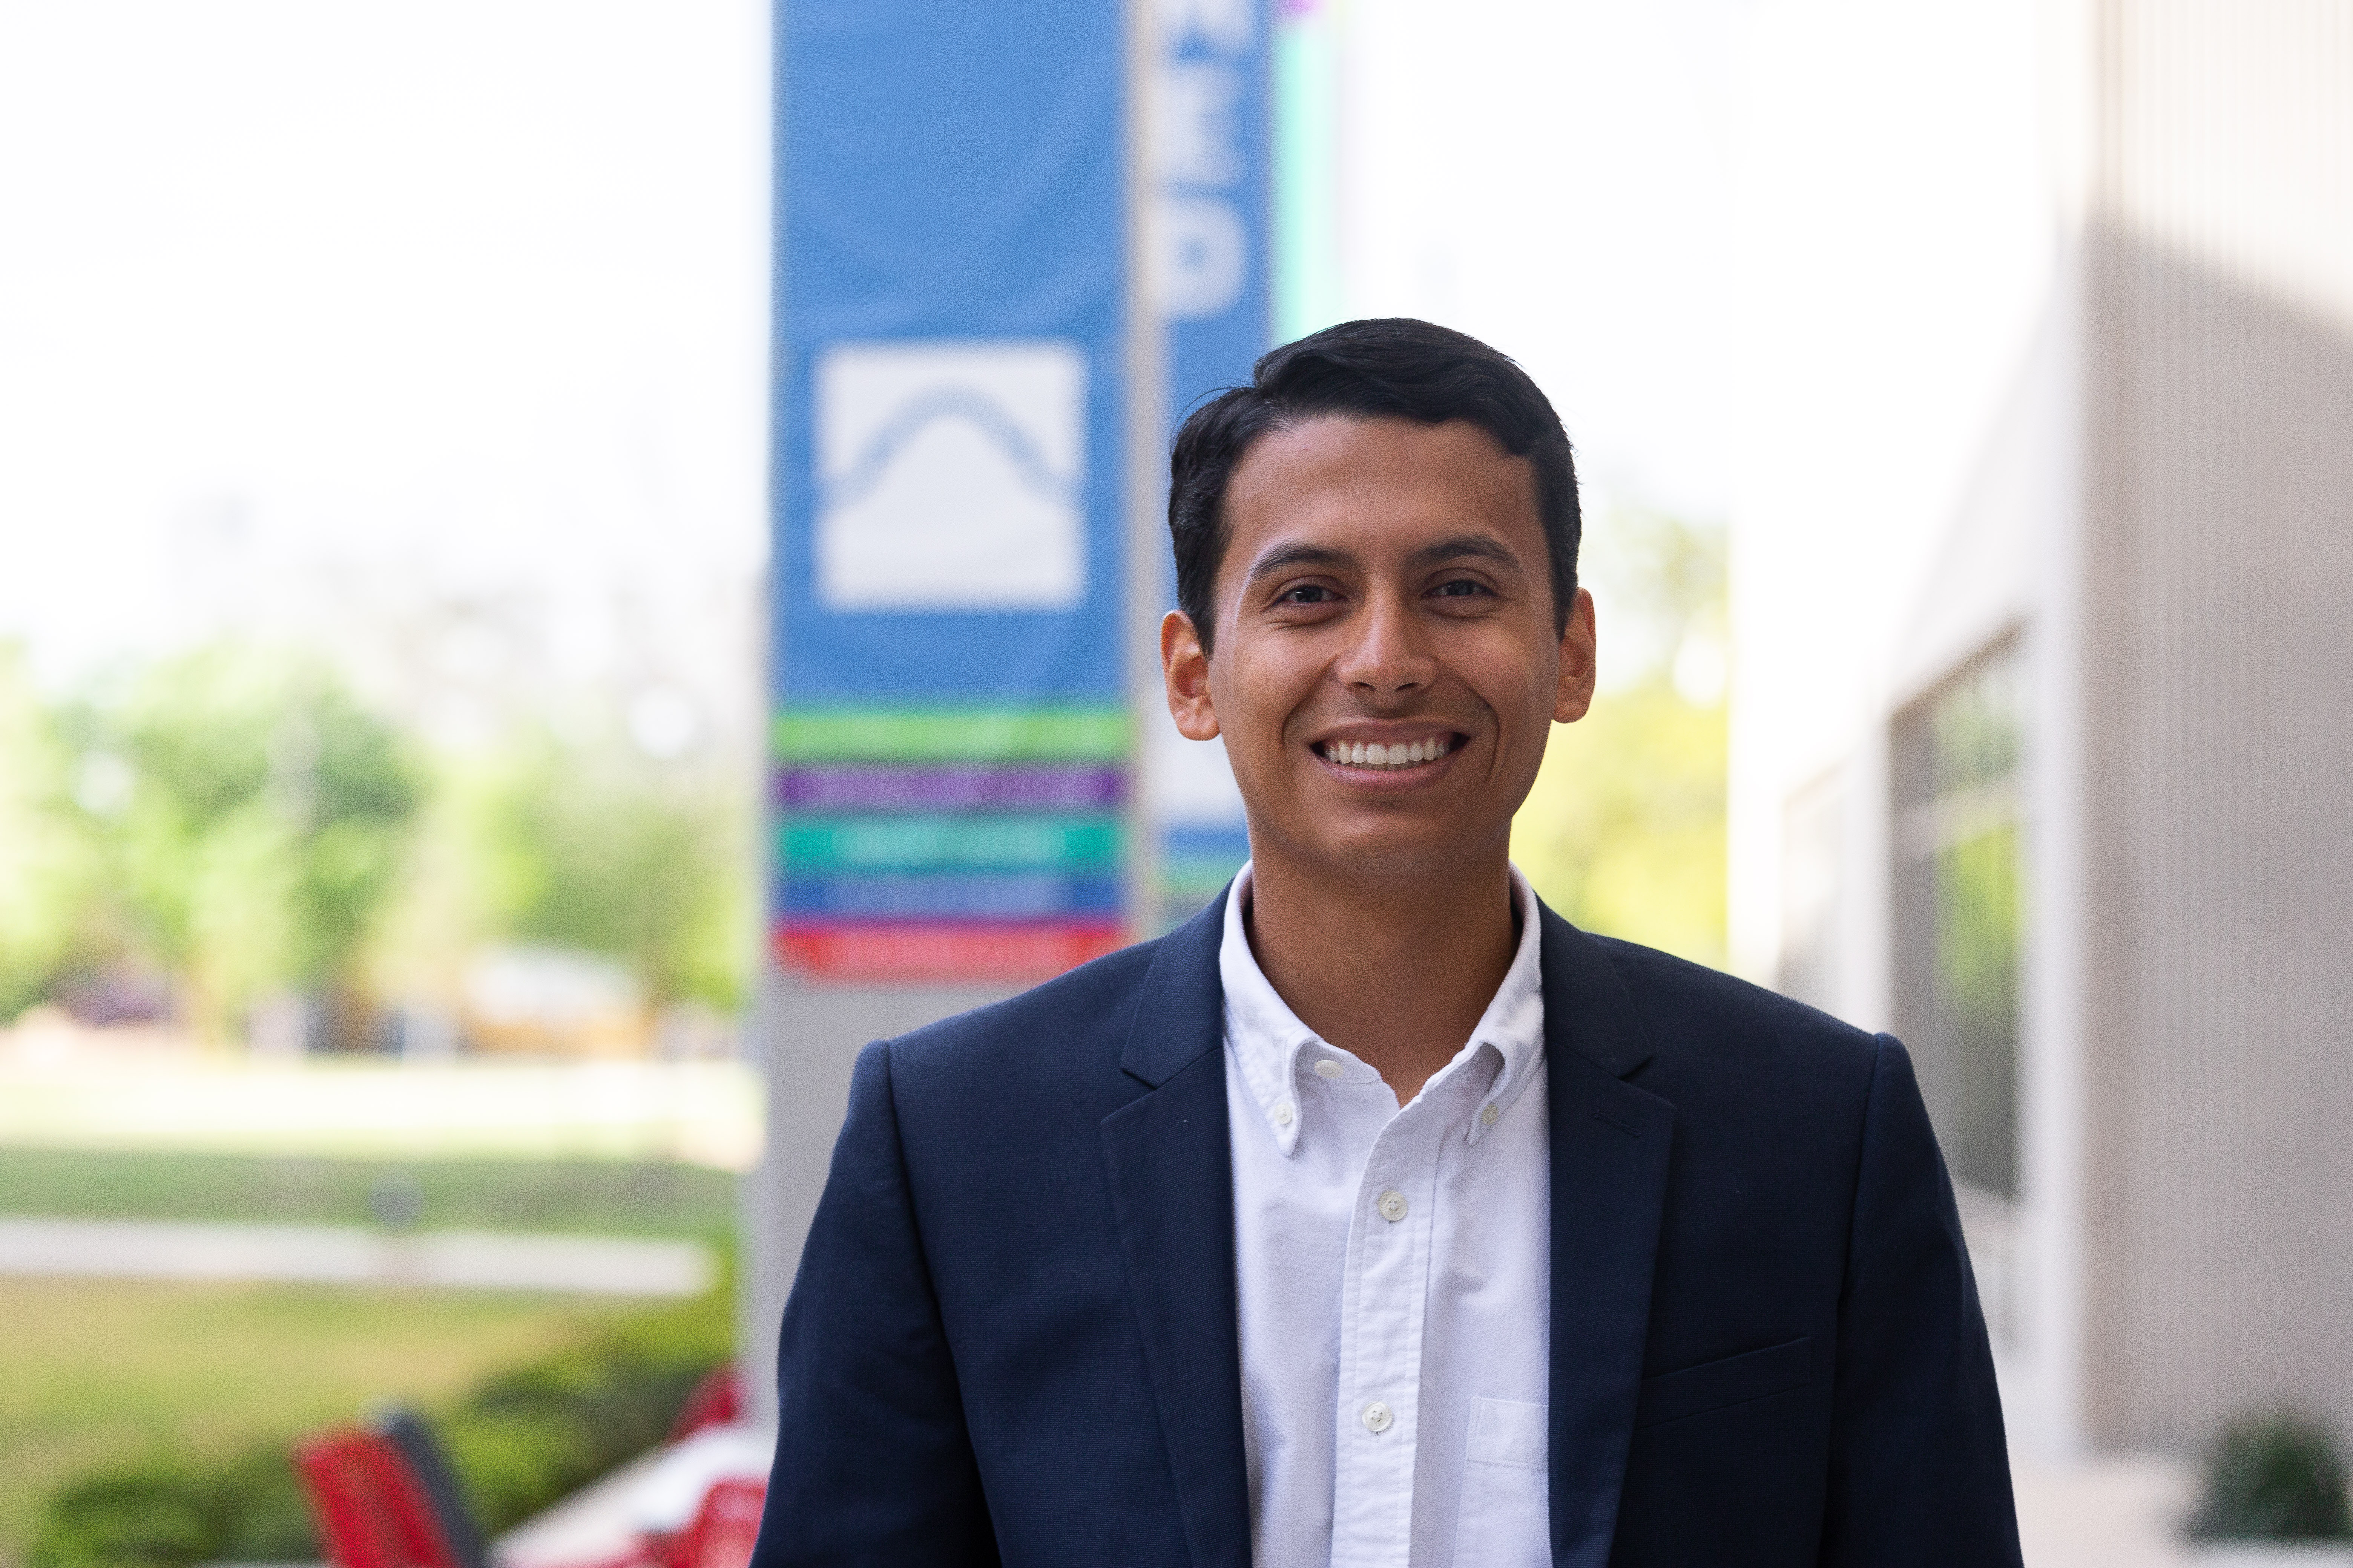
OVERVIEW
Scholarship Cycle
How to Apply
Review timeline
Preparing to apply and
crafting your essay
Notification if selected
Understanding scholarship requirements
Questions and Connections
Gabriel, SAC Graduate

Slide 4
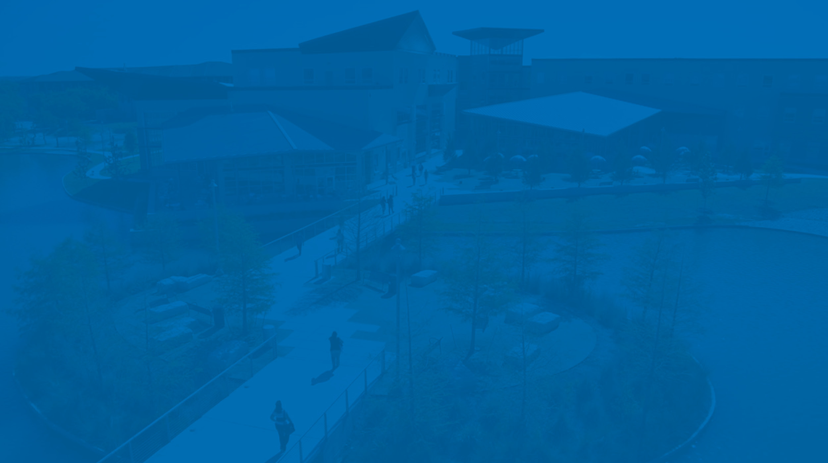
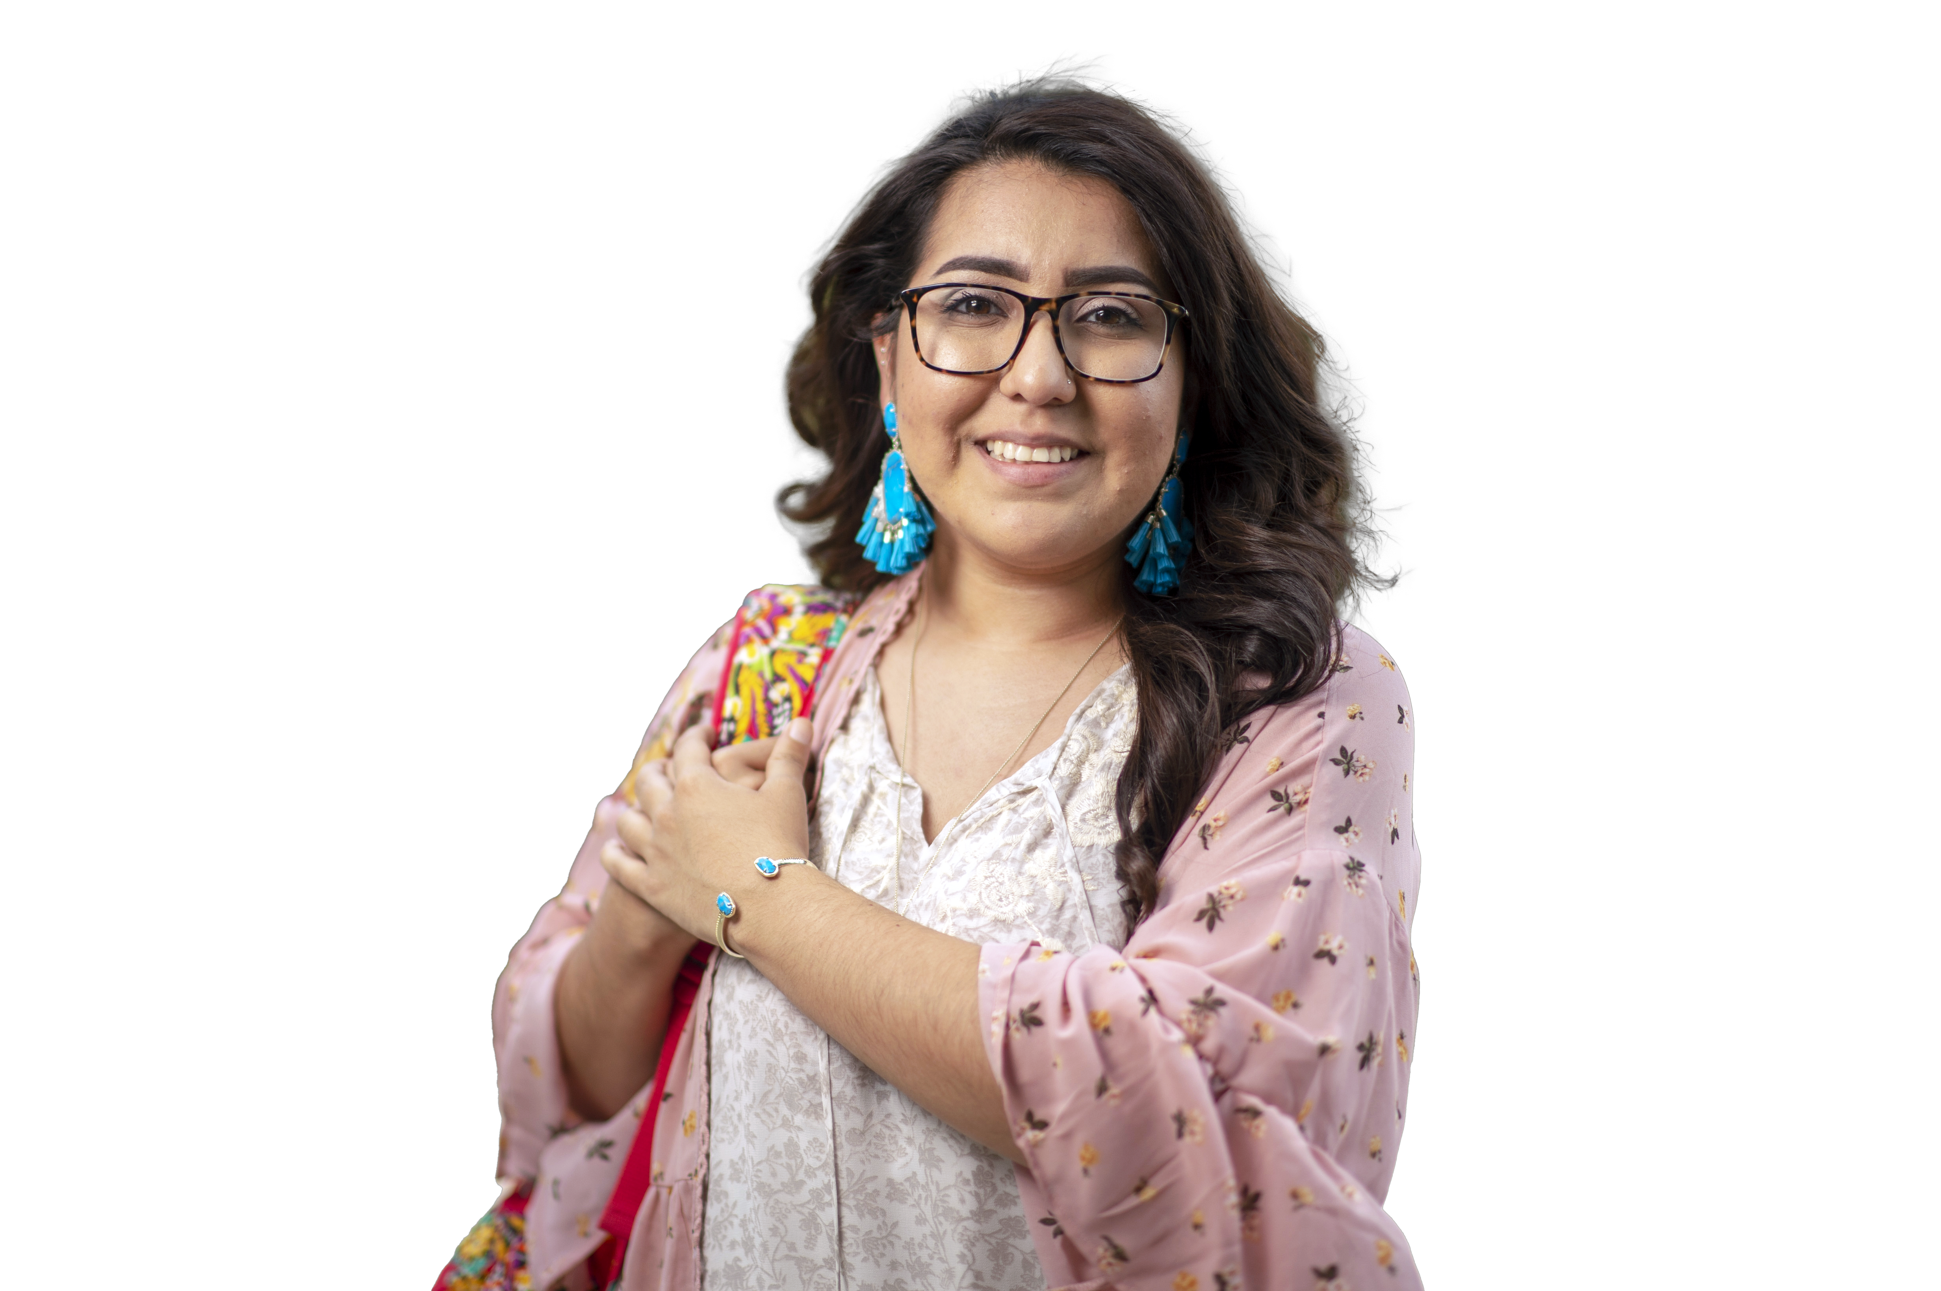
2026-2027 Foundation Scholarship Cycle
Each academic year has one General Foundation Scholarship application.
The 2026-27 General Foundation Application is for students that will enroll at least half-time in the Fall 2026, Spring 2027, and/or Summer 2027 semesters.
You must submit an application every academic year to be considered.
Some scholarships require financial need. To be considered for need based awards, you must submit the 2026-2027 Free Application for Federal Student Aid (FAFSA) at https://studentaid.gov or Texas Application (TASFA) as soon as possible.
Awards can be used at any of the Alamo Colleges, however some awards are tied to your Home Campus of record.
Application Opens
Feb 15, 2026
Application Closes
May 15, 2026
Review Process
May 19- May 28, 2026
Awarding Begins
June 1, 2026
*awarding is ongoing
through the academic year

Slide 5






Scholarship Application Overview
Applicants must have an Alamo ACES account to apply!
You will be asked to share academic, professional, and personal information.
Questions are provided to determine eligibility for all opportunities
You can write about your Recognitions, Military Service, Employment, Family Duties, or Extracurricular Activities.
Be authentic!
We want to know your story!
One application for ALL opportunities

Slide 6
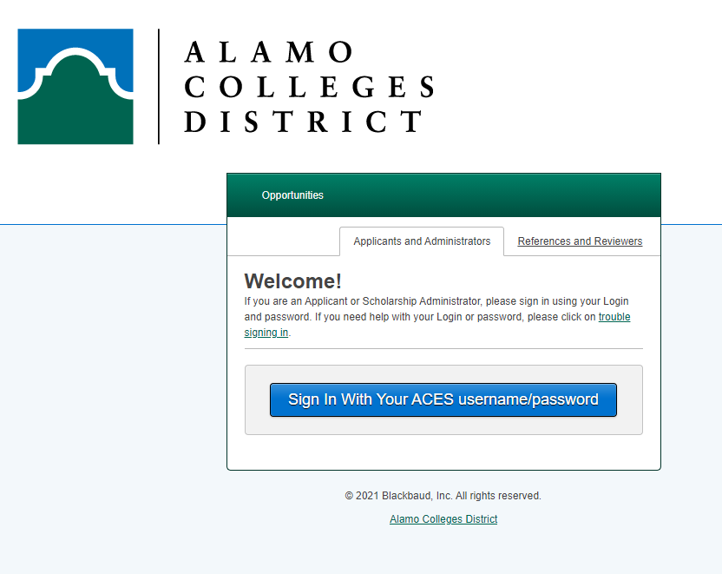
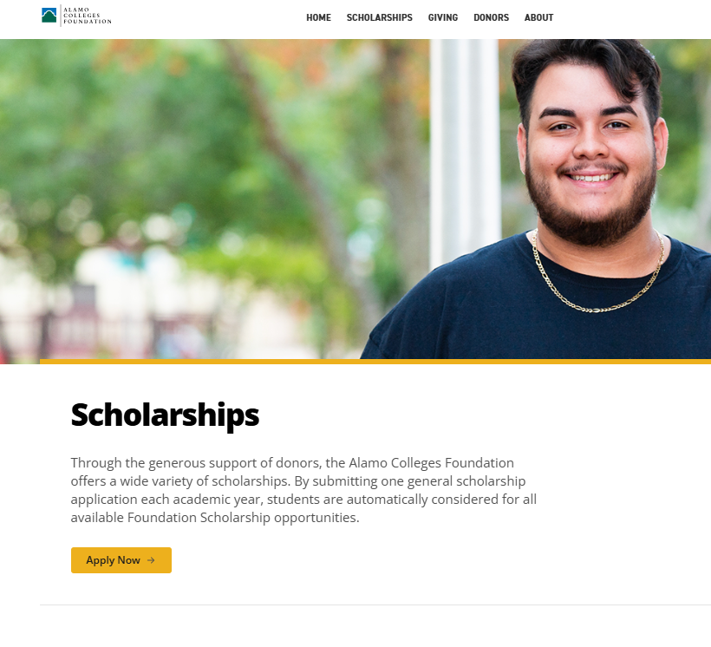
Applying via Alamo Academic Works
https://alamo.academicworks.com/users/sign_in
Sign in using your ACES Username and Password
If you do not know your ACES login information, please call the Helpdesk at
210-485-0555.

Slide 7
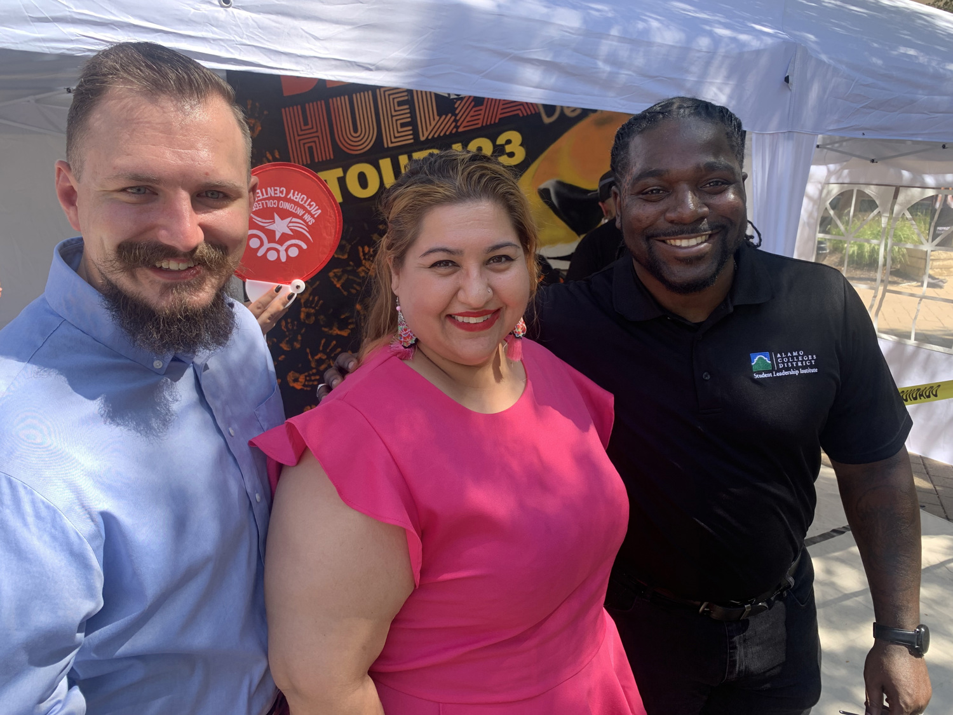
Be Prepared – What You Will Need to Submit
Once logged in, you may begin completing the General Foundation Application
You will also be asked to complete:
  Several supplemental questions with Yes/No answers
  2 Short Essays
  An AI Assistance Acknowledgment
  An Agreement & Certification Acknowledgement
Once submitted, you will receive an email confirmation that your application was completed from dst-scholarship@alamo.edu
Richard, SAC Graduate
Patrick, SAC Graduate
Michele, PAC Graduate

Slide 8

Essays Tips
All essays must remain anonymous —
DO NOT include your name.
Your essays will be scored on content, effort, quality, and grammar. Use full sentences and proofread prior to submitting.
Read and make sure you understand the prompt.
Keep your response no more than 400 words for each prompt, but at least 150 words for each.
Be authentic-- this is your opportunity to share your story, goals, and motivations.
Give personal responses and examples.

Slide 9

Essay Tips Continued…
The intent of the personal essays are to allow the scholarship committee to know you better. Consider including:
Clear educational and career goals
Motivation, direction and authenticity of story
Consider starting with a personal reflection or an experience that is particularly meaningful to you to help you focus on what matters most to you and express your authentic perspective.
Talk about what is important to you and your goals, past achievements or frustrations and what you learned from them, activities that you have been deeply committed to, and/or relationships that guided you in your development.

Slide 10

Grammar Matters
Start with an outline and then begin to write paragraphs about each point. You will be scored on your clear organization, correct grammar, attention to detail, and overall effort. Consider these three pointers:
Edit essays prior to submitting; use spell-check and grammar tools, but do not rely on them completely.
You may want to utilize a writing lab for additional review and feedback. At a minimum have a friend/family member read over it.
Check the word count to ensure your response fits within the required range.

Slide 11


AI Assistance Acknowledgment
AI is transforming how students write, but it does not have to replace authenticity. We are not looking for flawless writing or perfect grammar. AI can help organize and outline, just remember we are looking for your authentic voice.
Tell us your story in your own words. We want to understand who you are, not just how well you can write.
Scholarship committees value honesty, vulnerability and specific examples- things only you can provide.

Slide 12
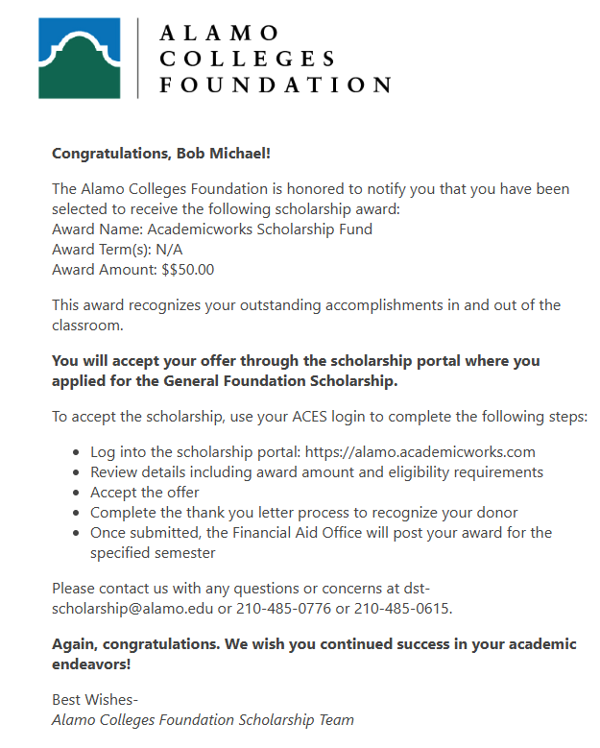
Award Notification
If you are selected to receive a scholarship, you will receive an email to your ACES student email account. The email will be coming from the district scholarship team: dst-scholarship@alamo.edu
The email will contain several required steps to accept your scholarship award offer in the scholarship portal:
  Reviewing the scholarship criteria
  Submitting a thank-you note
  Uploading a photo for the donor associated with your scholarship
Once all steps are completed, your award will be forwarded to Financial Aid for processing.

Slide 13
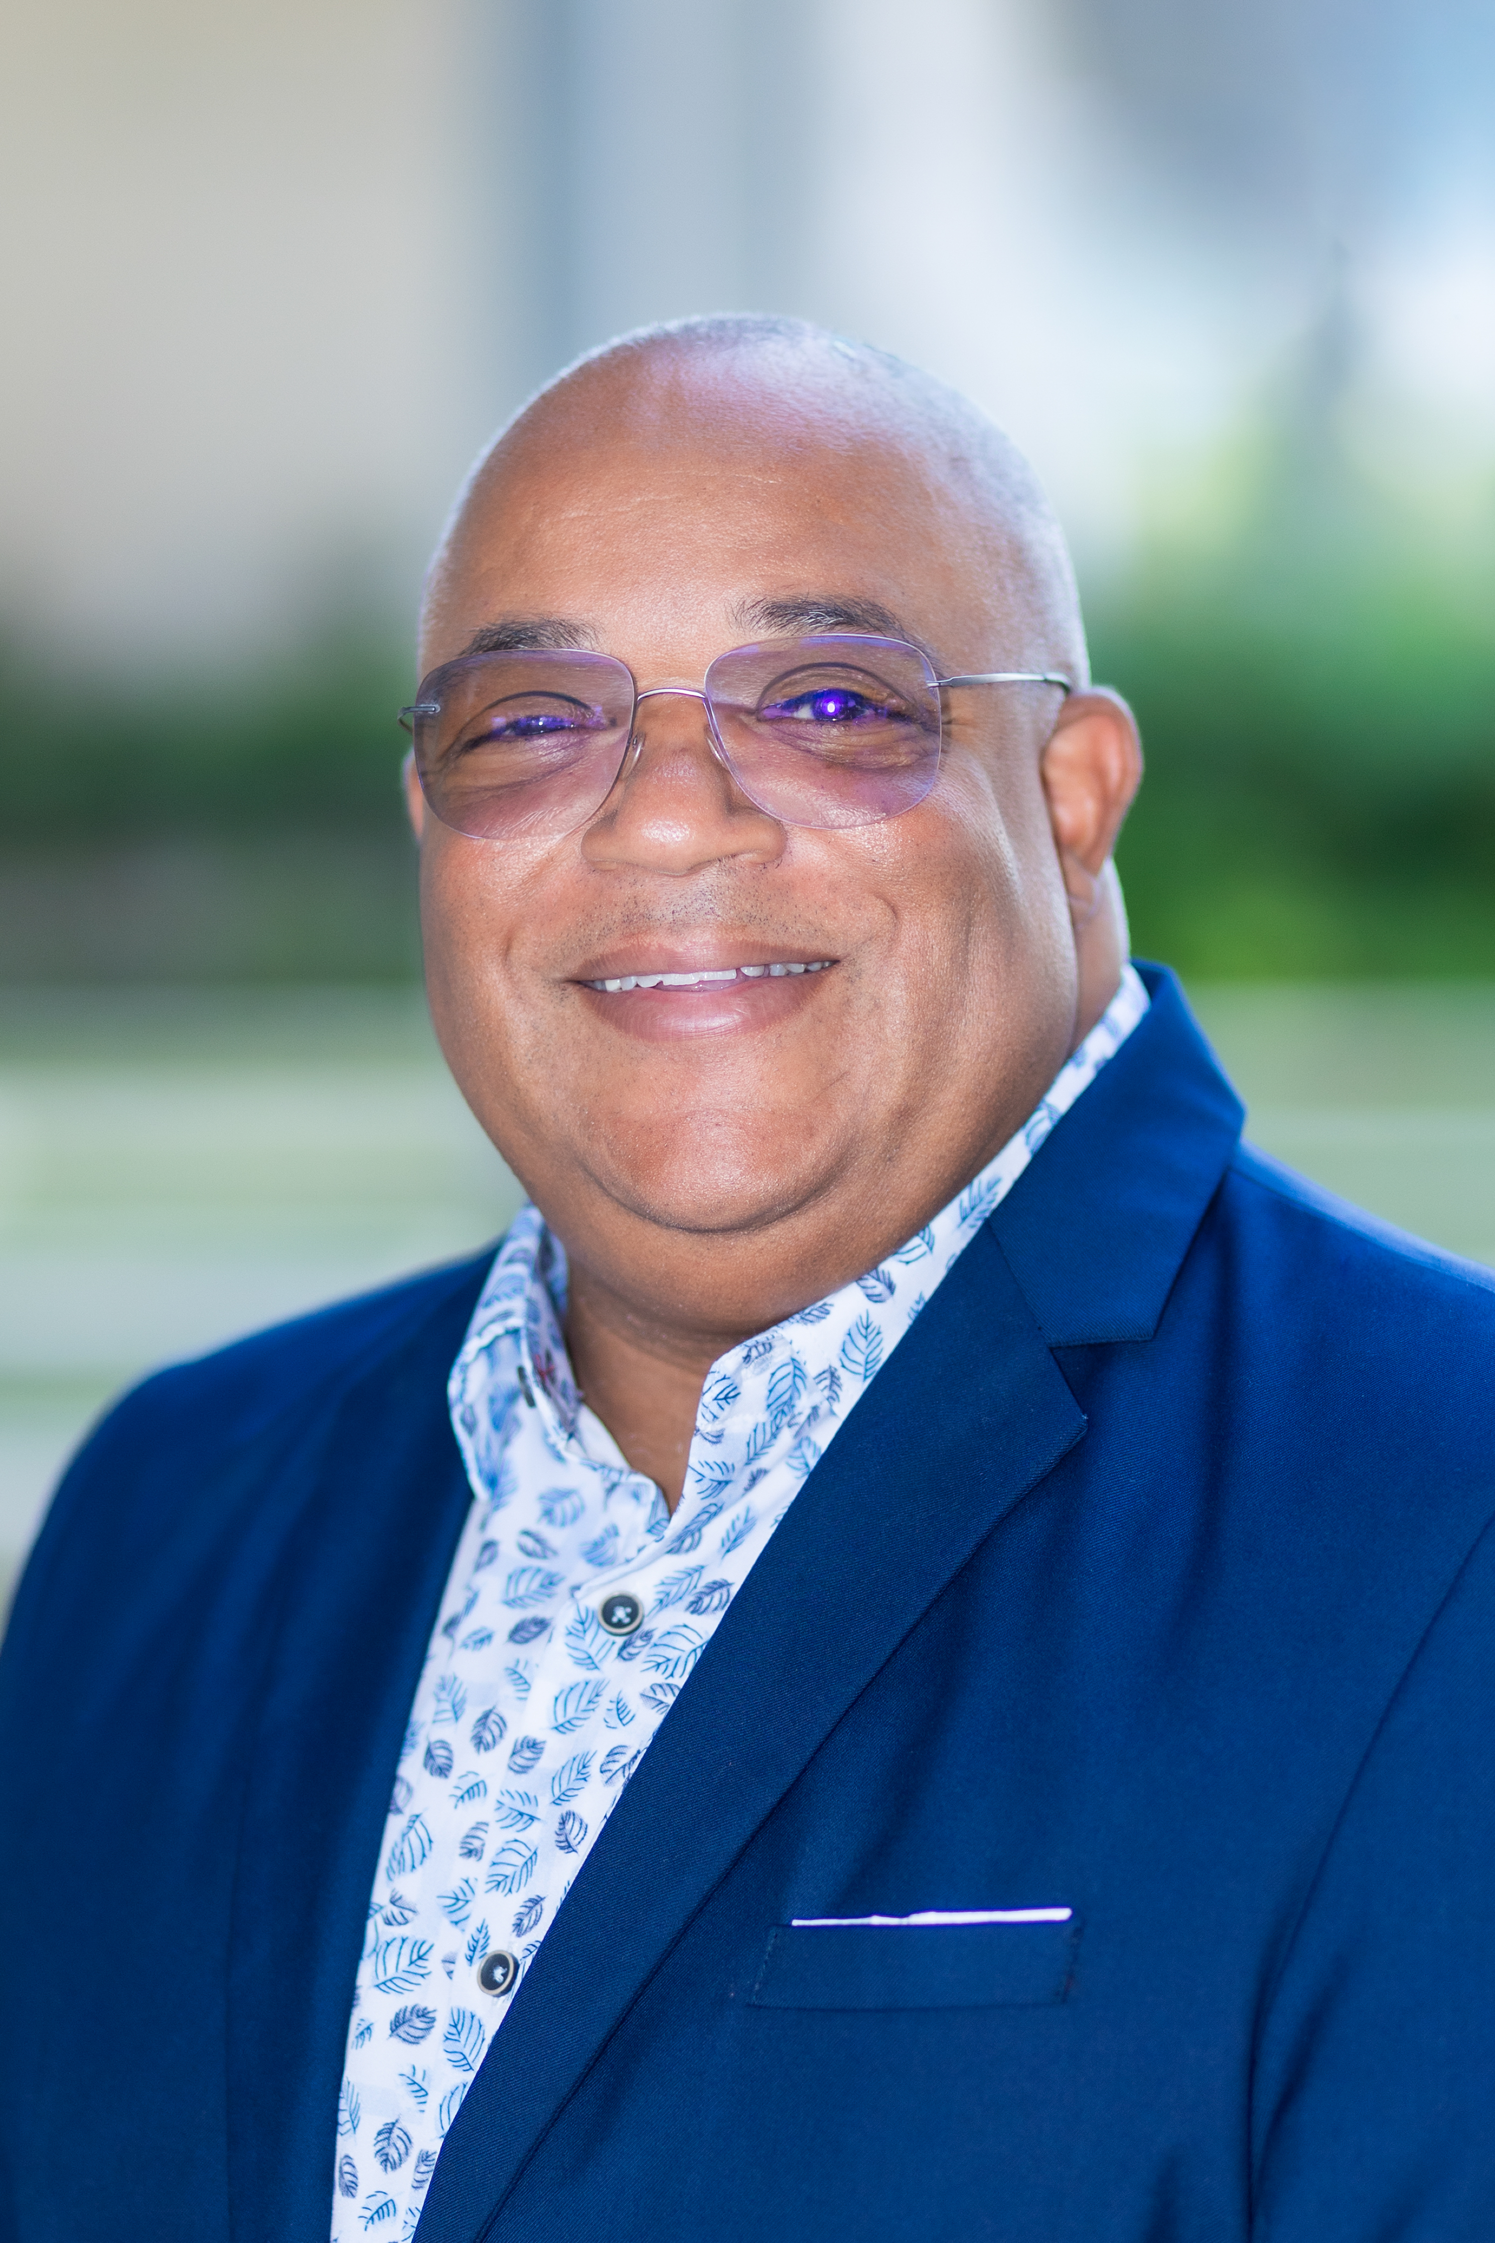
Understanding Scholarship Requirements
Each scholarship has its own unique set of requirements.
Students must review, accept, and adhere to all stated conditions upon receiving an award.
Please note that scholarships may be revoked or canceled if a student’s eligibility status changes or if they no longer meet the outlined qualifications.
Such changes may also impact a student’s tuition balance and/or financial aid status.
If any changes occur that may affect your eligibility, contact dst-scholarship@alamo.edu to review and determine continued scholarship eligibility.
Donavan, NLC Student

Slide 14
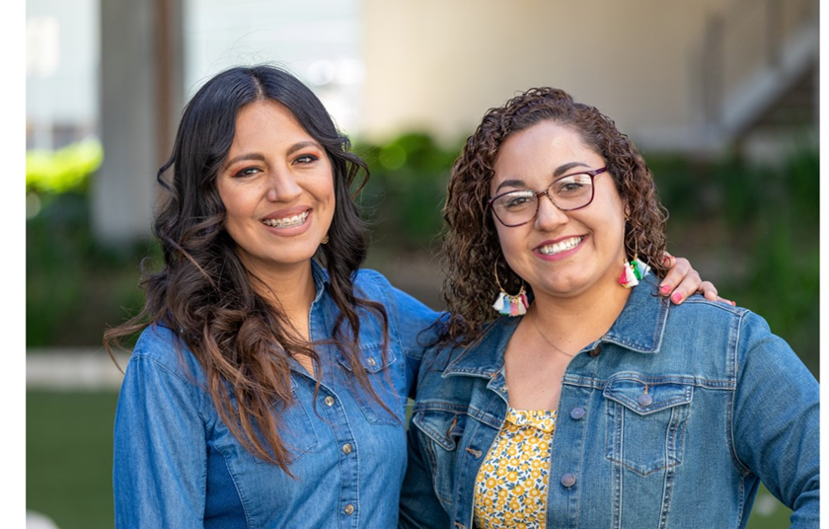



Let’s Stay Connected!
Follow Us for the latest news and announcements!
@alamocollegesfd
@AlamoCollegesFd
@AlamoCollegesFoundation
Find more information and
application links online at https://www.alamo.edu/foundation/scholarships/
For questions, please email us dst-scholarship@alamo.edu
Brenda, SAC Graduate

Slide 15
Thank you.
Learn more at
alamo.edu

