Slide 1



10th Annual College Connection Summit
September 30, 2021
Bridgedette Garza
Director of Student Access and
Support Services

Slide 2

Alamo Colleges Online
Notes:
www.alamo.edu/online

Slide 3
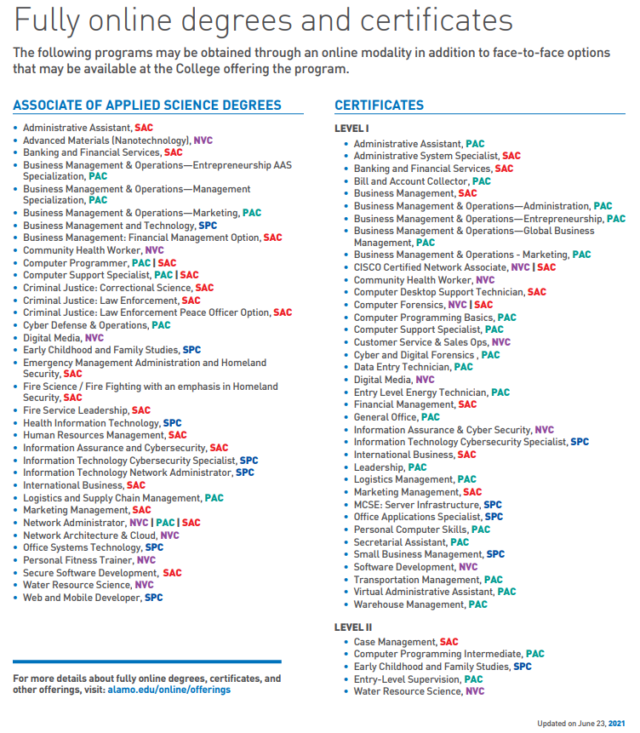
Alamo Colleges Online
Alamo.edu/online/offerings
Notes:
www.alamo.edu/online

Slide 4
Thank You!
For more information
Contact an Enrollment Coach at
210-245-7095 or AlamoONLINE@alamo.edu.

