Slide 1




ALAMO COLLEGES FOUNDATION
BOARD MEETING
November 13, 2024

Slide 2
CALL TO ORDER
W. WENDELL HALL
CHAIR

Slide 3



CERTIFICATION OF QUOROM
Presenter:
Ross Laughead, Office of General Counsel, Office of Legal Services, Alamo Colleges District

Slide 4
APPROVAL OF MINUTES
Presenter:
W. Wendell Hall, Chair

Slide 5
Student Highlight
Amy Carcanagues
Director of Scholarship Programs

Slide 6
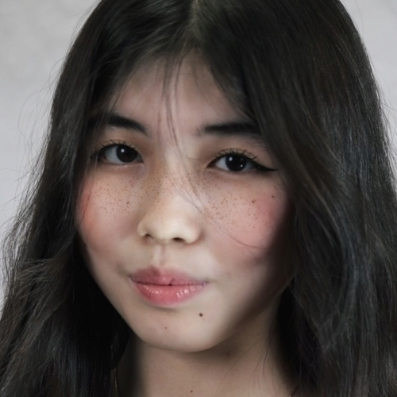
Inkar Bakhytzhanova
Hometown: Almaty, Kazakhstan
College: San Antonio College
Major/Program: Pre-Nursing
“ Receiving a scholarship has profoundly changed my life. It lifted a huge financial burden, allowing me to focus on my studies and pursue my passions without constant worry. The scholarship has been a beacon of hope, validating my hard work and dedication. It's given me the courage to aim higher and dream bigger. I’m deeply grateful for this opportunity, and it inspires me every day to excel and pay this generosity forward. Thank you for believing in me. “

Slide 7
Thank you.

Slide 8
BOARD APPOINTMENTS
W. WENDELL HALL
CHAIR

Slide 9
ACTION ITEM –
APPROVE APPOINTMENTS OF PRINCIPAL OFFICERS
ACTION ITEM: Approve appointments of principal officers, a Chairperson, a Vice-Chairperson, a Secretary and a Treasurer.
BACKGROUND: The principal officers of the Foundation shall consist of a Chairperson, a Vice- Chairperson, a Secretary, and a Treasurer, al of whom shall be members of the Board of Directors. Principal officers shall be elected by the majority vote of the Directors present at the annual meeting of the Board of Directors.
RATIONALE: Principal officers, also serve on the Executive Committee, and are essential to provide leadership in managing the business, property and affairs of the Foundation.
RECOMMENDATION TO THE BOARD: Approve appointment of principal officers, the Chairperson, Vice-Chairperson, Secretary and Treasurer as follows:
  Chairperson: W. Wendell Hall
  Vice- Chairperson: David Christian
  Secretary: Martha Tijerina
  Treasurer: Deborah Knapp

Slide 10
APPOINTMENTS OF COMMITTEE CHAIRS
COMMITTEE ON DIRECTORS - DAVID CHRISTIAN
INVESTMENTS COMMITTEE - SLOAN THOMAS
FINANCE & AUDIT COMMITTEE - DEBORAH KNAPP
DEVELOPMENT COMMITTEE - LAURA LINHART KISTNER

Slide 11
COMMITTEE ON DIRECTORS
DAVID CHRISTIAN
VICE-CHAIR

Slide 12
ACTION ITEM – NORMA REYES
ACTION ITEM: Approve nomination to appoint Norma Reyes to the Alamo Colleges Foundation Board for a three-year term.
BACKGROUND: Mrs. Reyes is a community leader passionate about education and service. She supports the Alamo Colleges Foundation’s efforts in gaining connections within the community and has led fundraising efforts with the Rey Feo organization. With experience in the tourism industry and at Reyes Industries, she holds leadership roles in several local organizations, including Chair of the San Antonio Can High School Board, Board Member of the Bexar County Family Justice Center, and active member of the Women’s Club of San Antonio and the Military Civilian Club. She has also served on the Miss Fiesta Committee and San Antonio Fiesta Commission.
RATIONALE: Members are essential to managing the business, property, and affairs of the Foundation.
RECOMMENDATION TO THE BOARD: Approve nomination to appoint Mrs. Reyes to the Alamo Colleges Foundation for a second three-year term.
Term will expire: 7/31/2027

Slide 13
ACTION ITEM – W. WENDELL HALL
ACTION ITEM: Approve to re-appoint W. Wendell Hall to the Alamo Colleges Foundation Board for a three-year term.
BACKGROUND: Members are essential to managing the business, property, and affairs of the Foundation. The Foundation continues to bring on board members who are passionate about our mission and who have the willingness to fundraise on our behalf. Mr. Hall serves as the Chair of the Foundation, bringing both a deep commitment to our mission and a wealth of experience to the organization.
RATIONALE: Members are essential to managing the business, property, and affairs of the Foundation.
RECOMMENDATION TO THE BOARD: Approve the reappointment of W. Wendell Hall to the Alamo Colleges Foundation for a second three-year term.
Term will expire: 12/31/2027

Slide 14
ACTION ITEM – SHAWN SEABERG
ACTION ITEM: Approve to re-appoint Shawn Seaberg to the Alamo Colleges Foundation Board for a three-year term.
BACKGROUND: The Foundation continues to bring on board members who are passionate about our mission and committed to fundraising on our behalf. Mr. Seaberg brings a wealth of knowledge and experience. He is the Division President of PulteGroup and is eager to support the Alamo Colleges Foundation’s efforts in building connections within the homebuilding community. Driven by his passion for education and his dedication to serving the San Antonio community, Mr. Seaberg is committed not only to advancing the Foundation's mission but also to serving others in need, regardless of their background or circumstances.
RATIONALE: Members are essential to managing the business, property, and affairs of the Foundation.
RECOMMENDATION TO THE BOARD: Approve the reappointment of Shawn Seaberg to the Alamo Colleges Foundation for a second three-year term.
Term will expire: 12/31/2027

Slide 15
ACTION ITEM – SLOAN THOMAS
ACTION ITEM: Approve to re-appoint Sloan Thomas to the Alamo Colleges Foundation Board for a three-year term.
BACKGROUND: Mr. Thomas brings a wealth of knowledge and experience. Mr. Thomas is the Director of Commercial Sales at Alamo Title, where he works in Commercial and Corporate Business Development. He was recently elected as an Elected Commissioner to the Fiesta Commission. As a community leader, Mr. Thomas is deeply passionate about the Foundation’s mission to ensure that all learners have access to high-quality education.
RATIONALE: Members are essential to managing the business, property, and affairs of the Foundation.
RECOMMENDATION TO THE BOARD: Approve the reappointment of Sloan Thomas to the Alamo Colleges Foundation for a second three-year term.
Term will expire: 12/31/2027

Slide 16
Thank you.

Slide 17


2024
STATE OF THE DISTRICT
Notes:
Fastppt.net

Slide 18
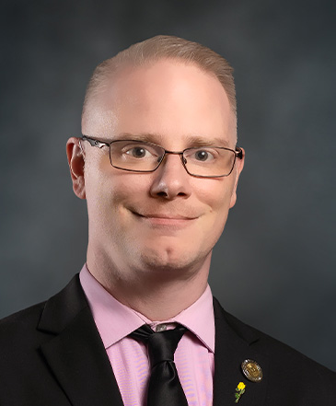
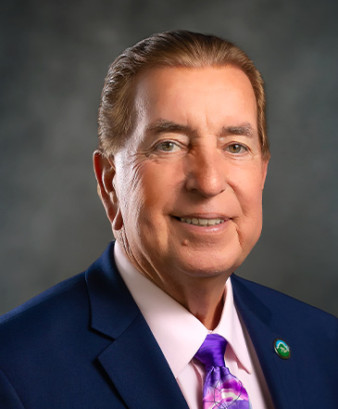
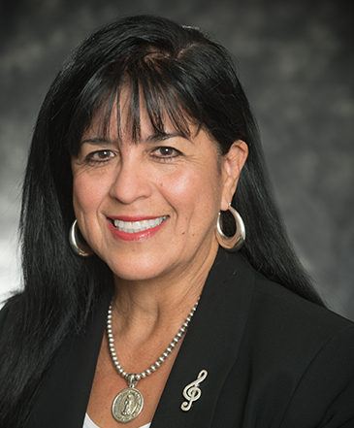
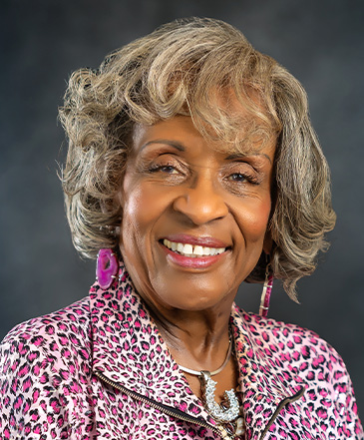
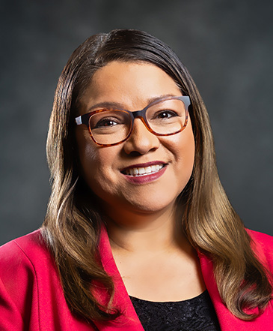
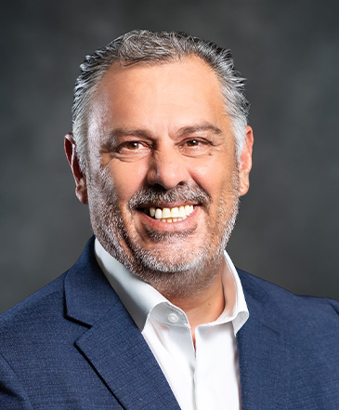
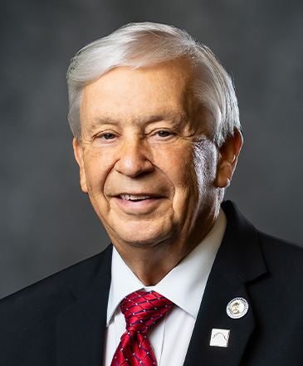
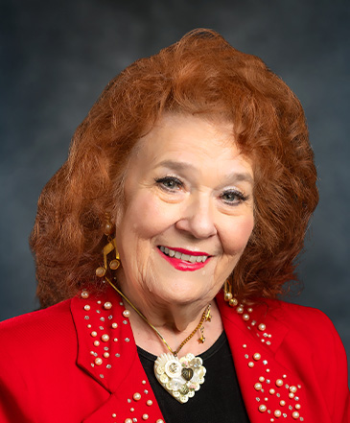
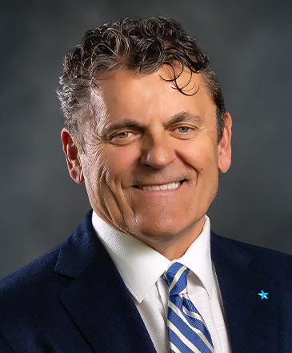
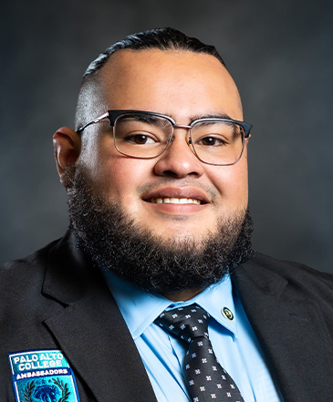
Board of Trustees
Chair
Clint Kingsbery
District 8
Vice Chair
Joe Alderete, Jr
District 1
Secretary
Anna U. Bustamante
District 3
Asst Secretary
Gloria Ray
District 2
Dr. Lorraine Pulido
District 4
Gerald Lopez
District 5
Dr. Gene Sprague
District 6
Dr. Yvonne Katz
District 7
Leslie Sachanowicz
District 9
Logan Martinez
Student Trustee

Slide 19
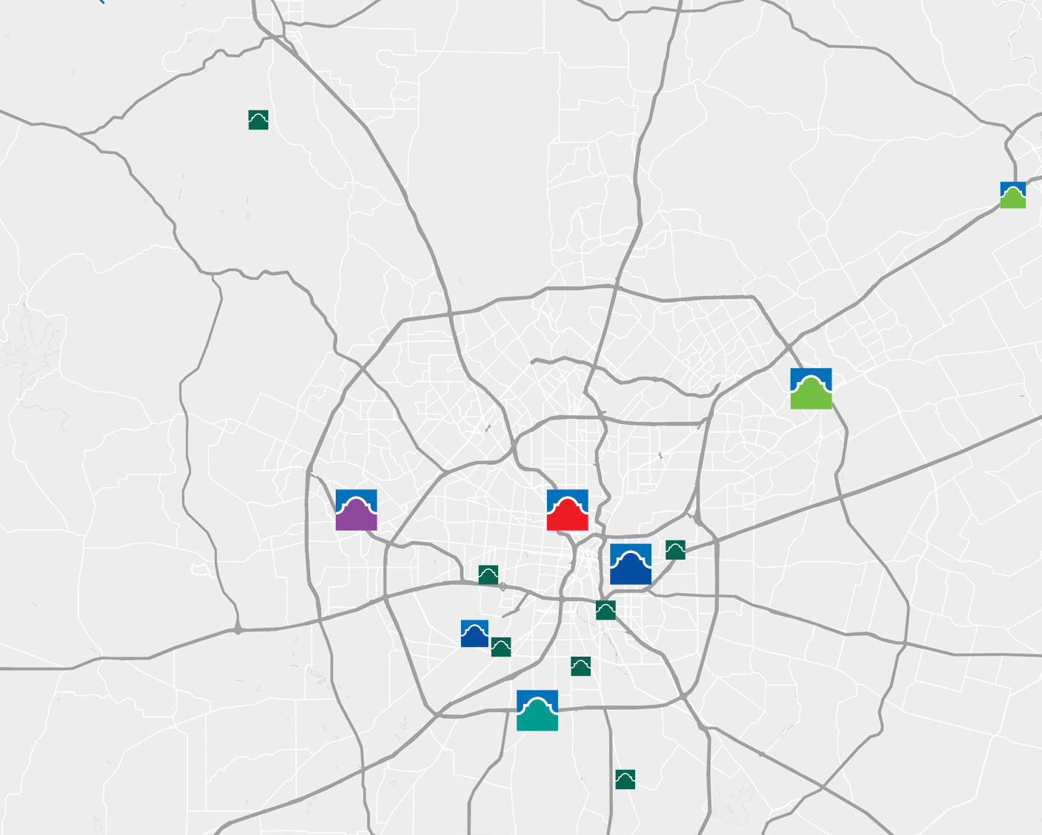
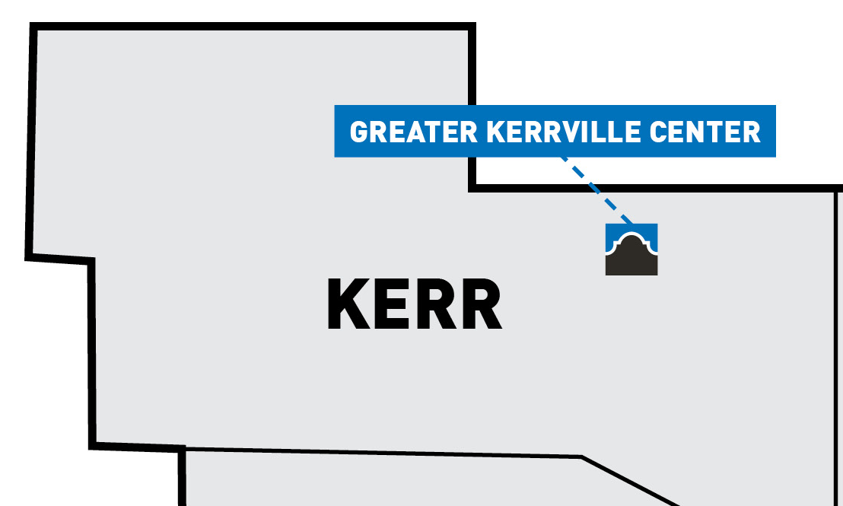

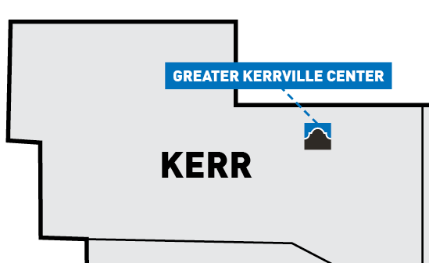





5 Alamo Colleges
  Northeast Lakeview College
  Northwest Vista College
  Palo Alto College
  St. Philip’s College
  San Antonio College
8 Education & Training Centers
23 Early College High Schools
20 P-TECH High Schools
Largest provider of higher education and workforce training in the 7th largest city in the United States.

Slide 20











20,000
Northwest Vista College
9,400
Northeast Lakeview College
Public Higher Ed Partners
33,000
8,000
39,000
78,000
6,000
Faculty & Staff
17,400
St. Philip’s College
1,900
Education &
Training Centers
20,000
San Antonio College
12,400
Palo Alto College

Slide 21


Slide 22

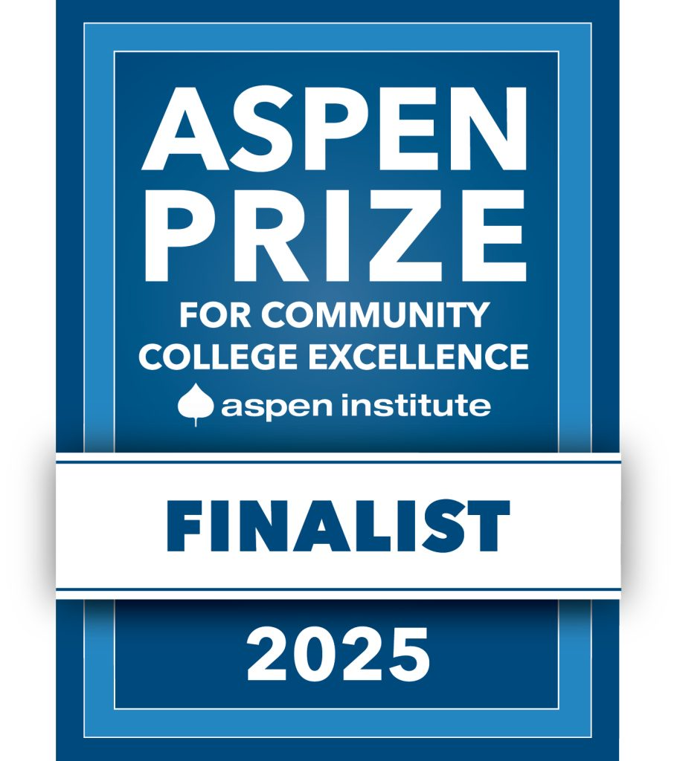

RECOGNITIONS
ACHIEVING THE DREAM
ASPEN PRIZE
GREAT PLACE TO WORK
STUDENT SUCCESS & INSTITUTIONAL EQUITY
COMMUNITY COLLEGE EXCELLENCE
EMPLOYEE EXPERIENCE

Slide 23

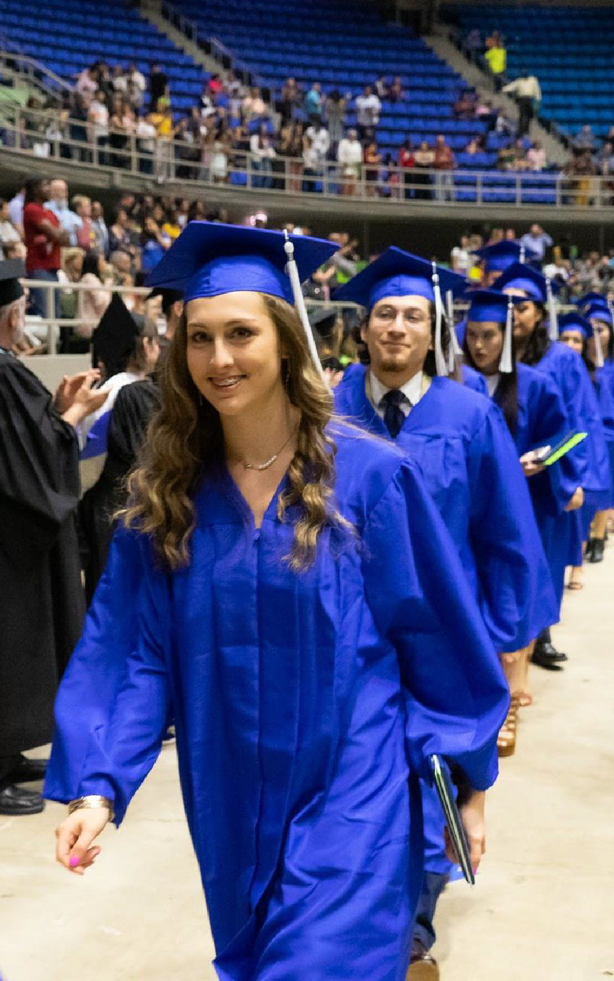

SETTING
THE STAGE

Slide 24
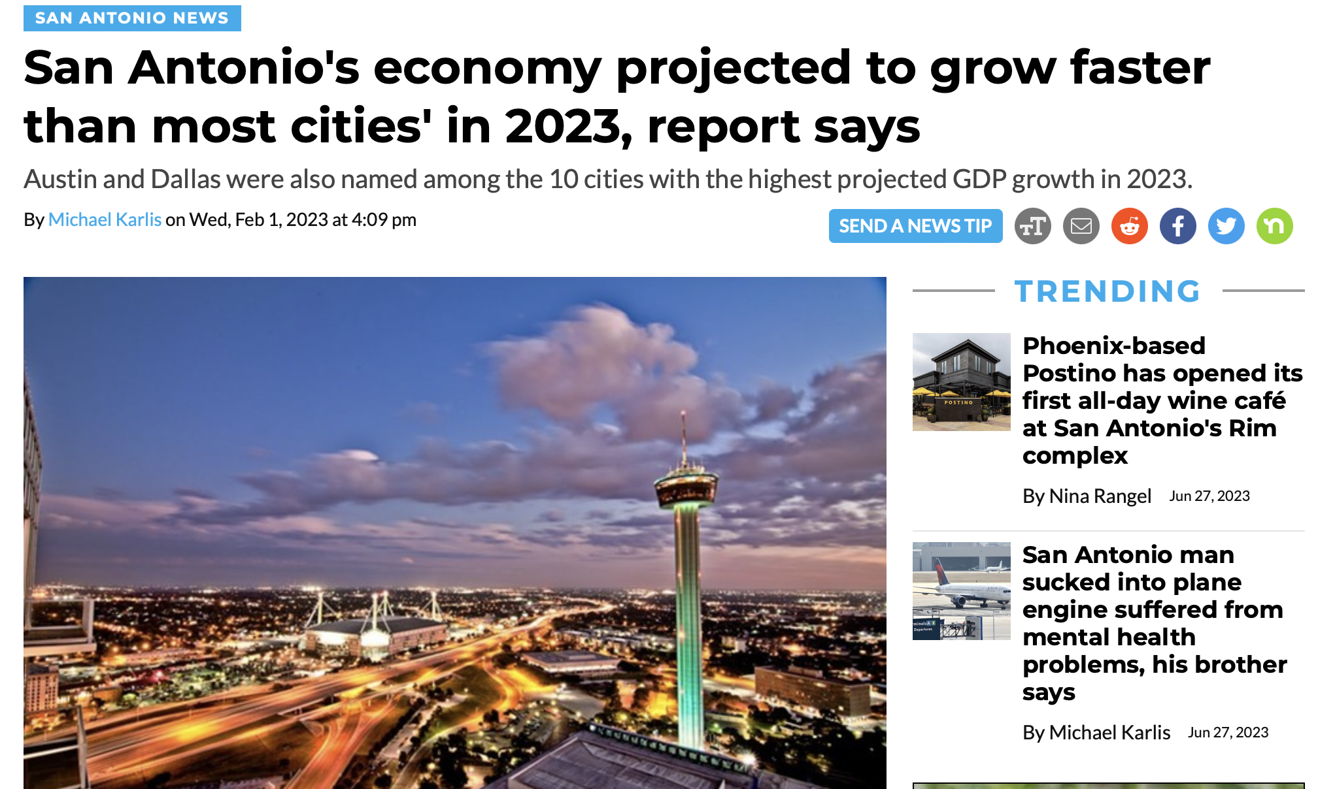
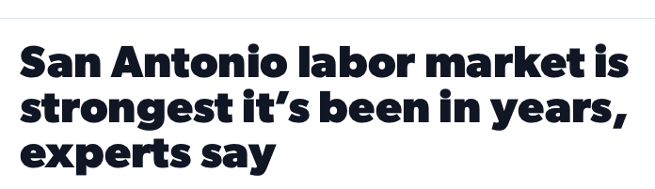
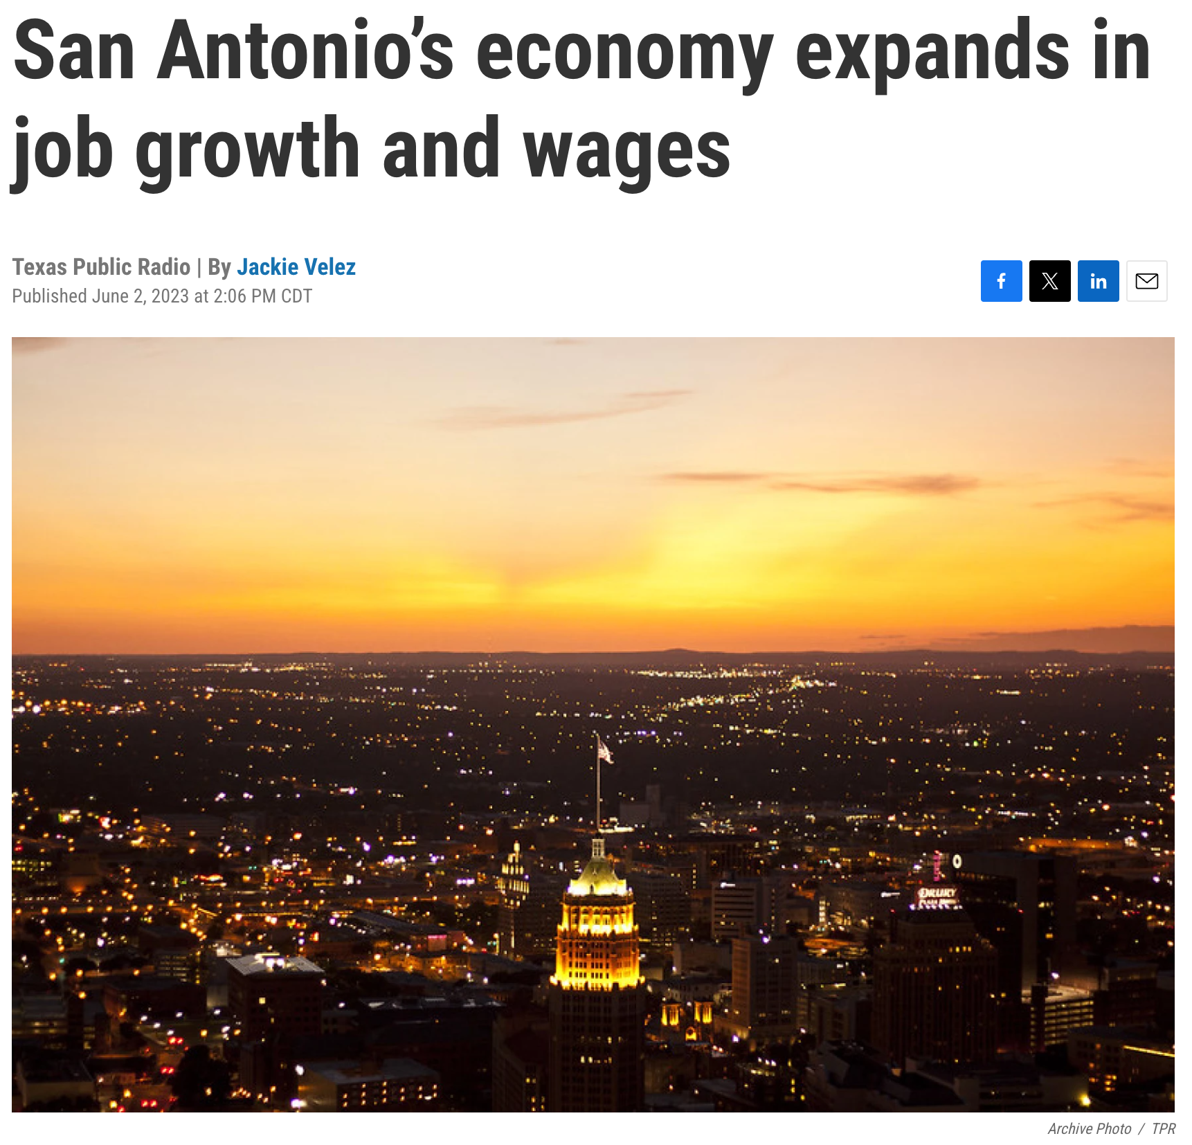
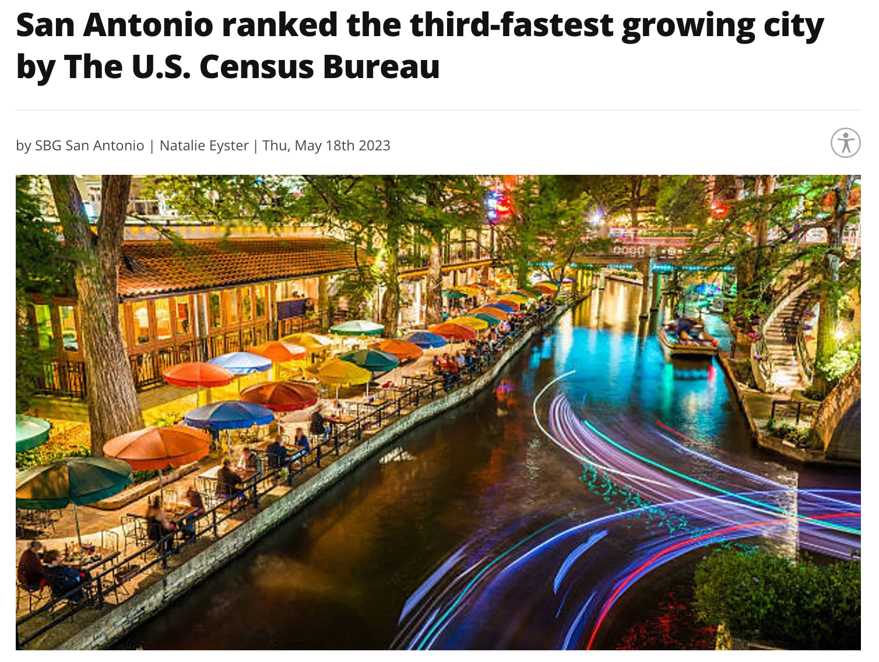
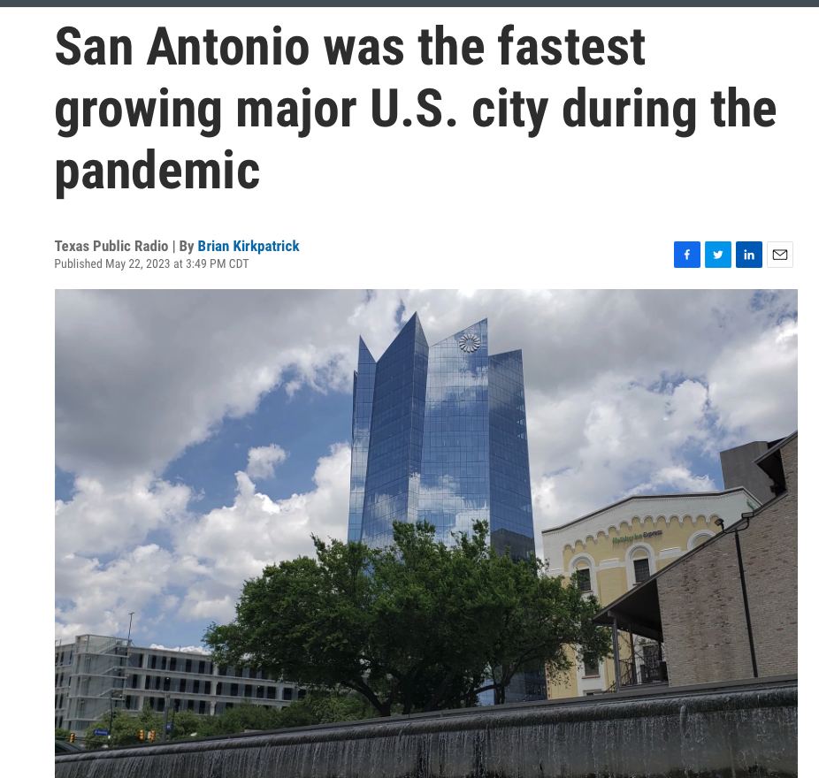
SAN ANTONIO
SURGING ECONOMICALLY

Slide 25
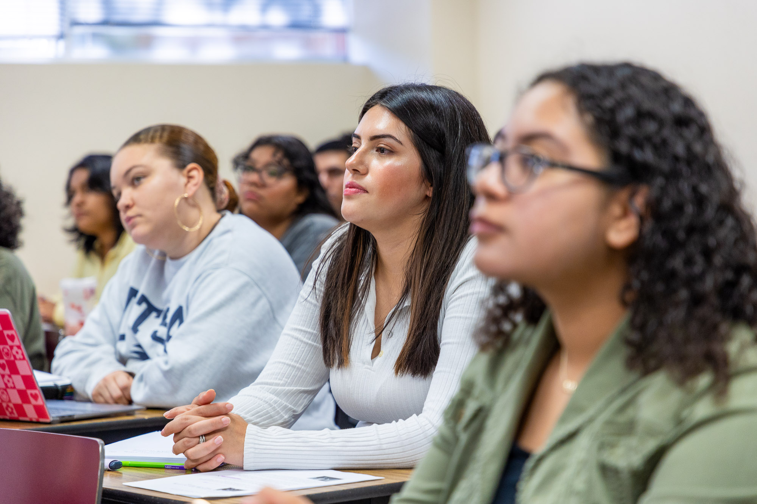


SAN ANTONIO
IS STILL
CHALLENGED
1 in 5
People in San Antonio
live below poverty level
46%
Above poverty rate but still struggling with basic needs
23%
adults have some college and no degree

Slide 26
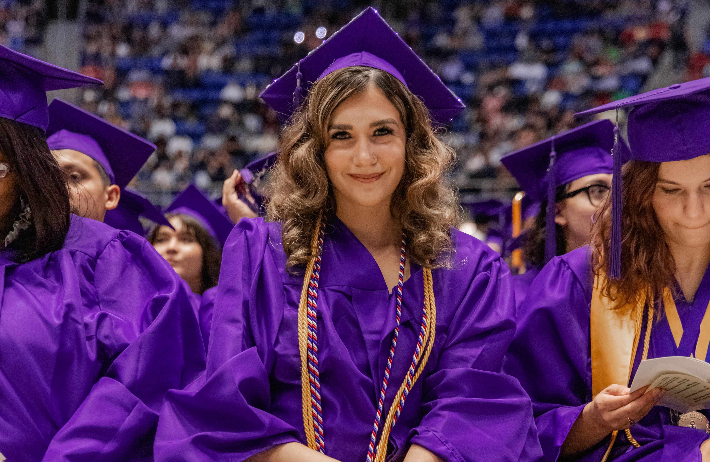

ECONOMIC
MOBILITY
$9,400
The average associate degree graduate from the Alamo Colleges will see an increase in earnings of $9,400 each year compared to someone with a high school diploma working in Texas.
The community also benefits from the increased economic output added tax revenue and public sector savings.

Slide 27
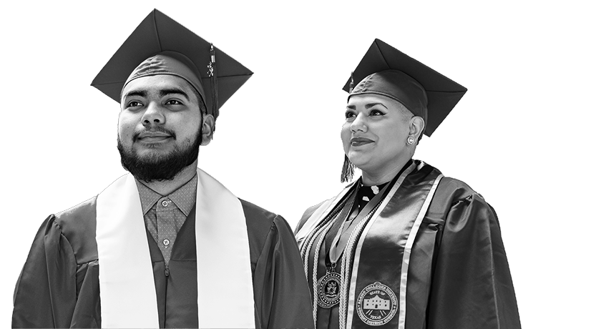
“Partnering to end poverty through education and training”
Notes:
Introduce our moonshot milestone

Slide 28
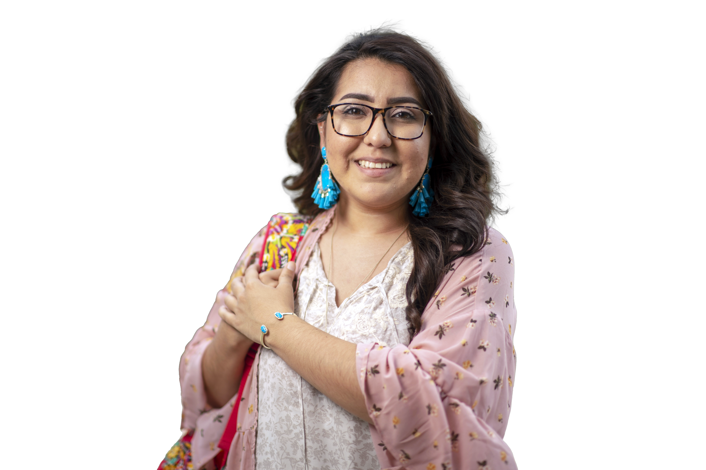

LEARNER PROFILE
100,000 Students Served Annually
66% Hispanic
9% African-American
19% White
3% Asian
3% Other
32% Full-Time
68% Part-Time
70% Rely on Financial Aid &
Scholarships
29.2% Economically Disadvantaged
17% Academically Disadvantaged
61% Female
39% Male
17% Student Parents
7% Military Affiliated
25.5% Adults 25+
Notes:
- Academically economically disadvanted, students 26+
- Military affiliated includes those serving and those not including spouses and other dependents

Slide 29

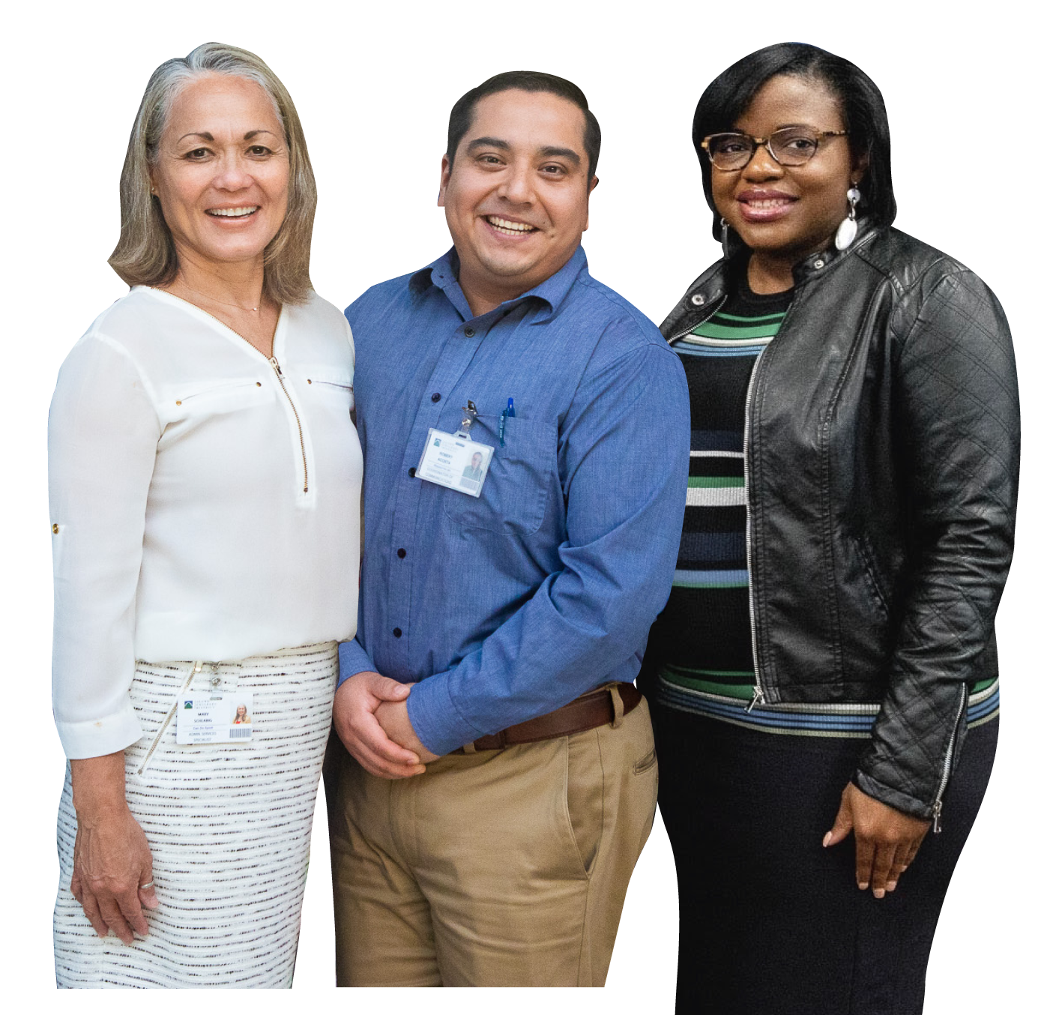
EMPLOYEE PROFILE
51.1% Hispanic
32.5% White
9.2% Black
2.9% Asian
4.3% Other
57% Female
43% Male
FULL TIME
Faculty - 791
Staff – 1,784
Total – 2,575
PART TIME
Faculty - 884
Staff – 1,129
Total – 2,013
*Updated March 2024

Slide 30
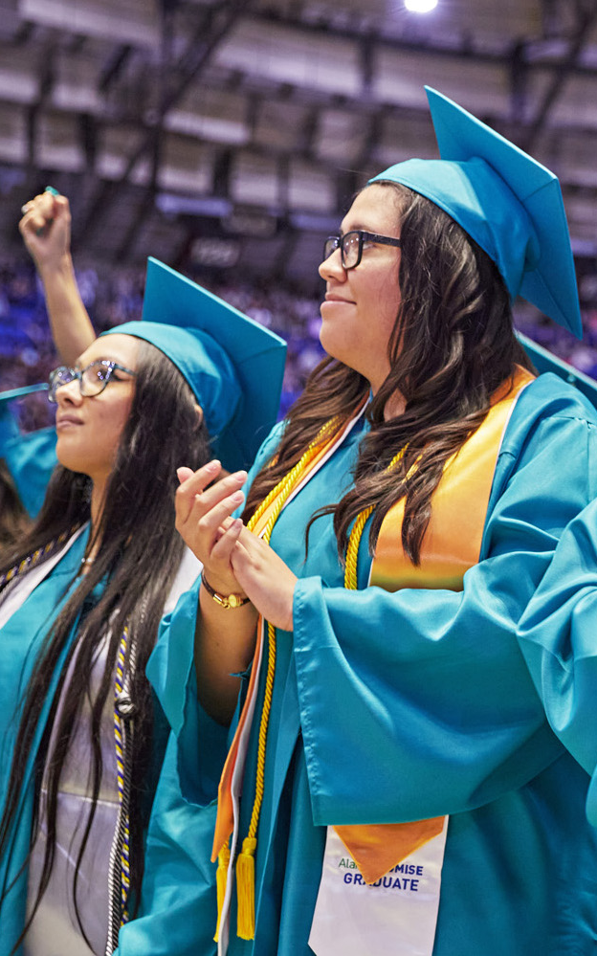

MILESTONES TOWARD
OUR MOONSHOT
Access, Success, & Completion

Slide 31






THEN & NOW
2018
2024
78,000
16,643
15,808
60,818
4.4
Years
3.7
Years
13,160
9,060
Enrollment
College Freshmen
HS Dual Credit Enrollment
Time to Degree
28%
74%
26%
8 Months
Notes:
Option B

Slide 32







5 YEAR INITIATIVES
2019
Student Advocacy Network
2020
2021
Launch of Bachelor of Nursing Program
2021

Slide 33
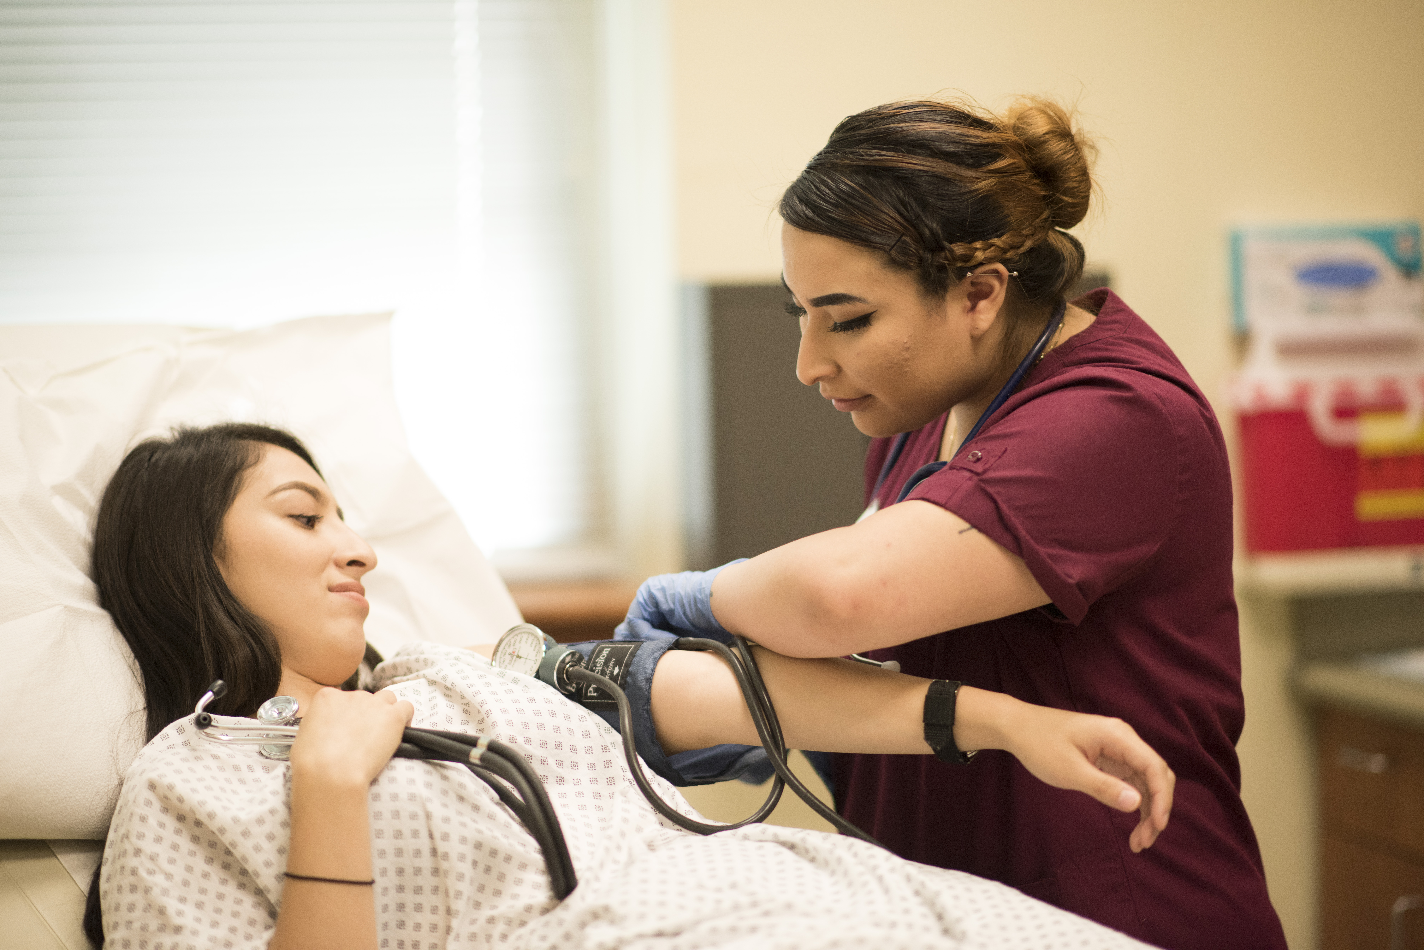


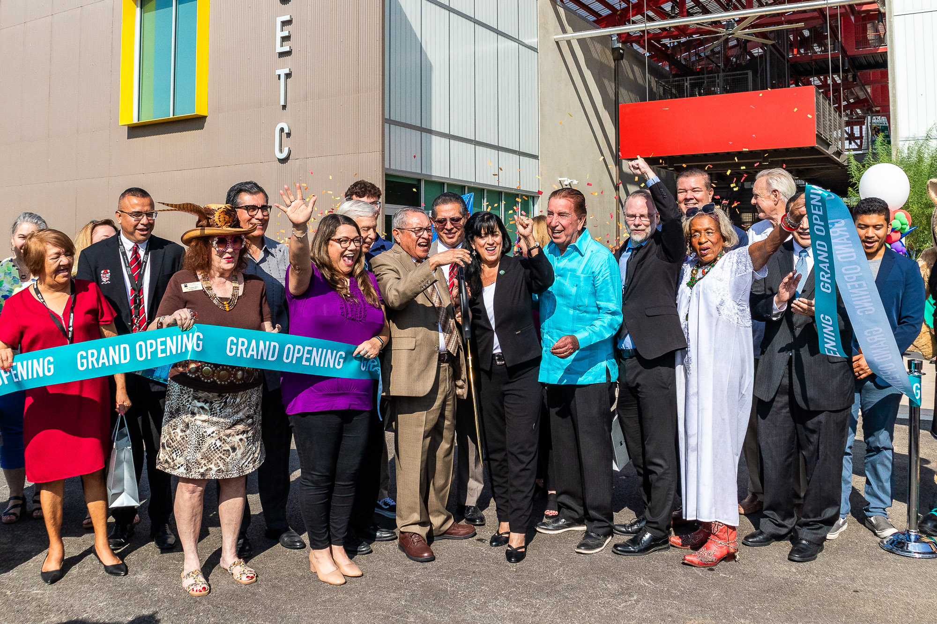

Transfer Advising Guides (TAGS) Reduced Time to Completion
2021
Expansion of AlamoPROMISE to all Bexar County HS Seniors
2023
2024
Capital Improvements Projects Completion

Slide 34

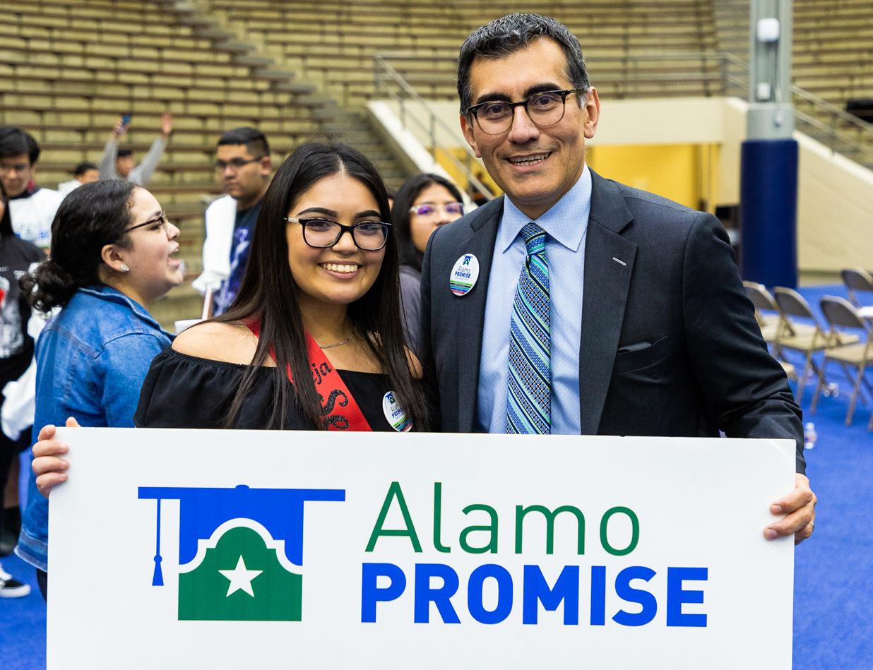
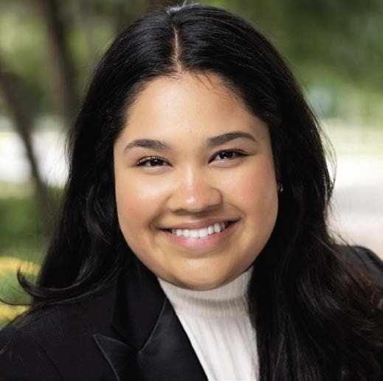
TUITION-FREE COLLEGE & TRAINING
Record 78,000 overall enrollment in Fall 2024
First-time in college enrollment at all-time high
Tuition-free college for graduating Bexar County Seniors
Supported by Public, Private and ACD funds
Program launch in 2019
Available Countywide
16,004 students since inception
Keren Morin Lugo
Promise Scholar
Palo Alto College
“
AlamoPROMISE has taught me that my hard work does not go unnoticed. It reminds me of the saying “querer es poder” or if there’s a will there’s a way.
”
Notes:
Use Stephanie’s data

Slide 35

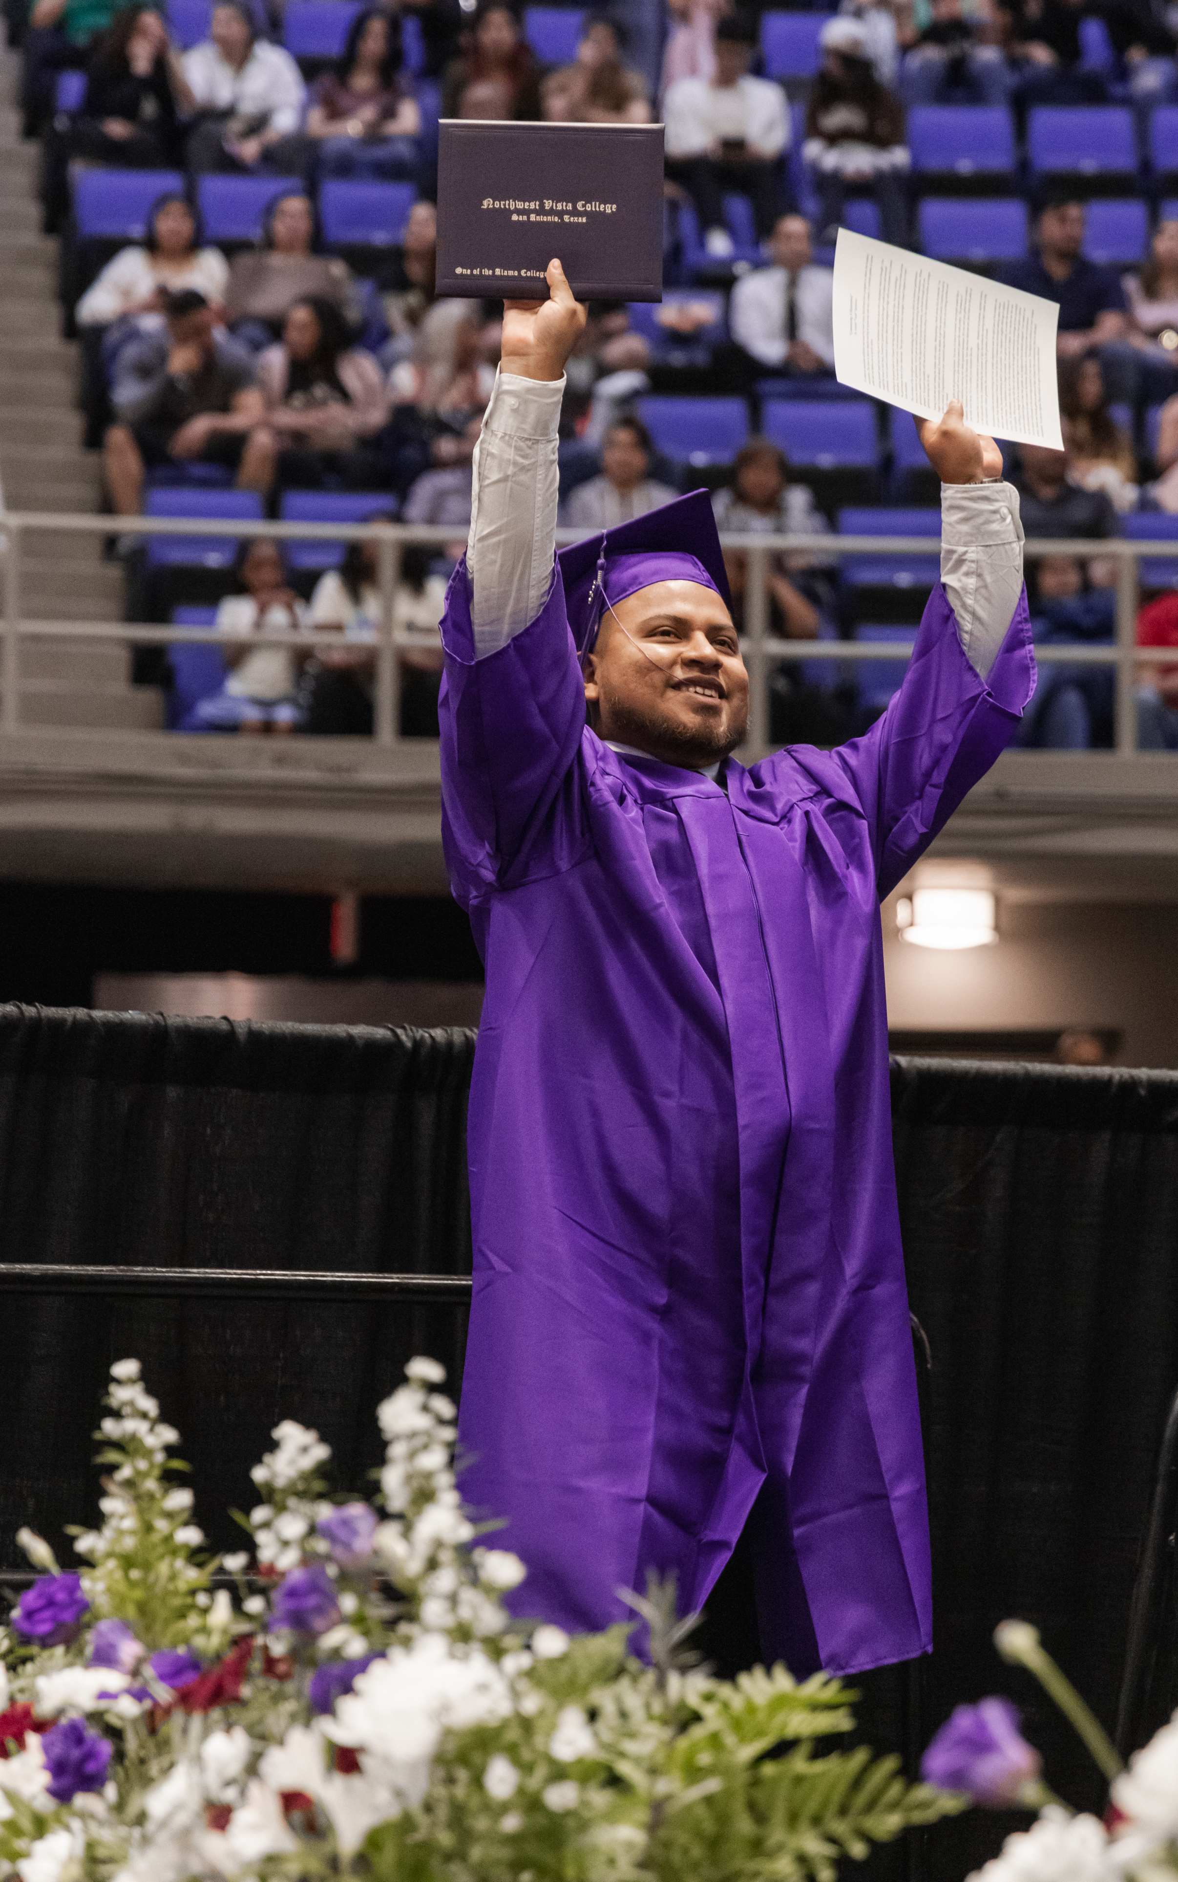
FUTURE FOCUS
Expanding the Talent Pipeline

Slide 36
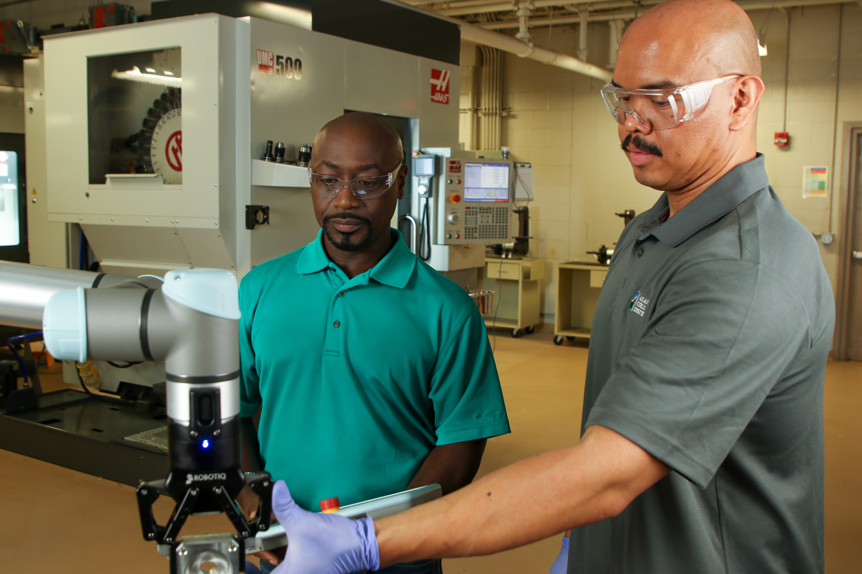
DOUBLING WORKFORCE CAPACITY IN 5 YEARS
FUTURE MILESTONES
New Workforce Programs to Meet Demand
Over 30 New High-Wage, High-Demand Programs
59 New Certificates & Skills Awards
13 Upcoming Programs slated for Fall 2024

Slide 37
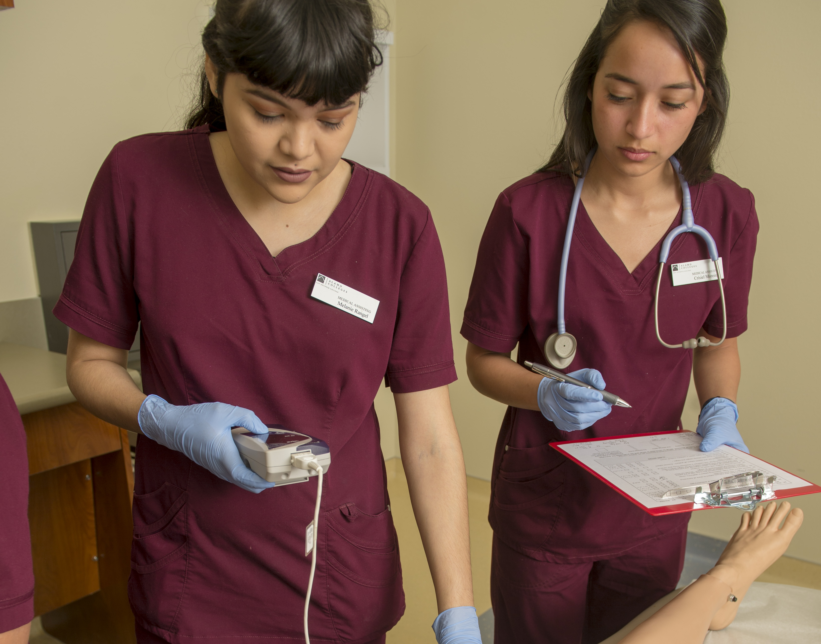
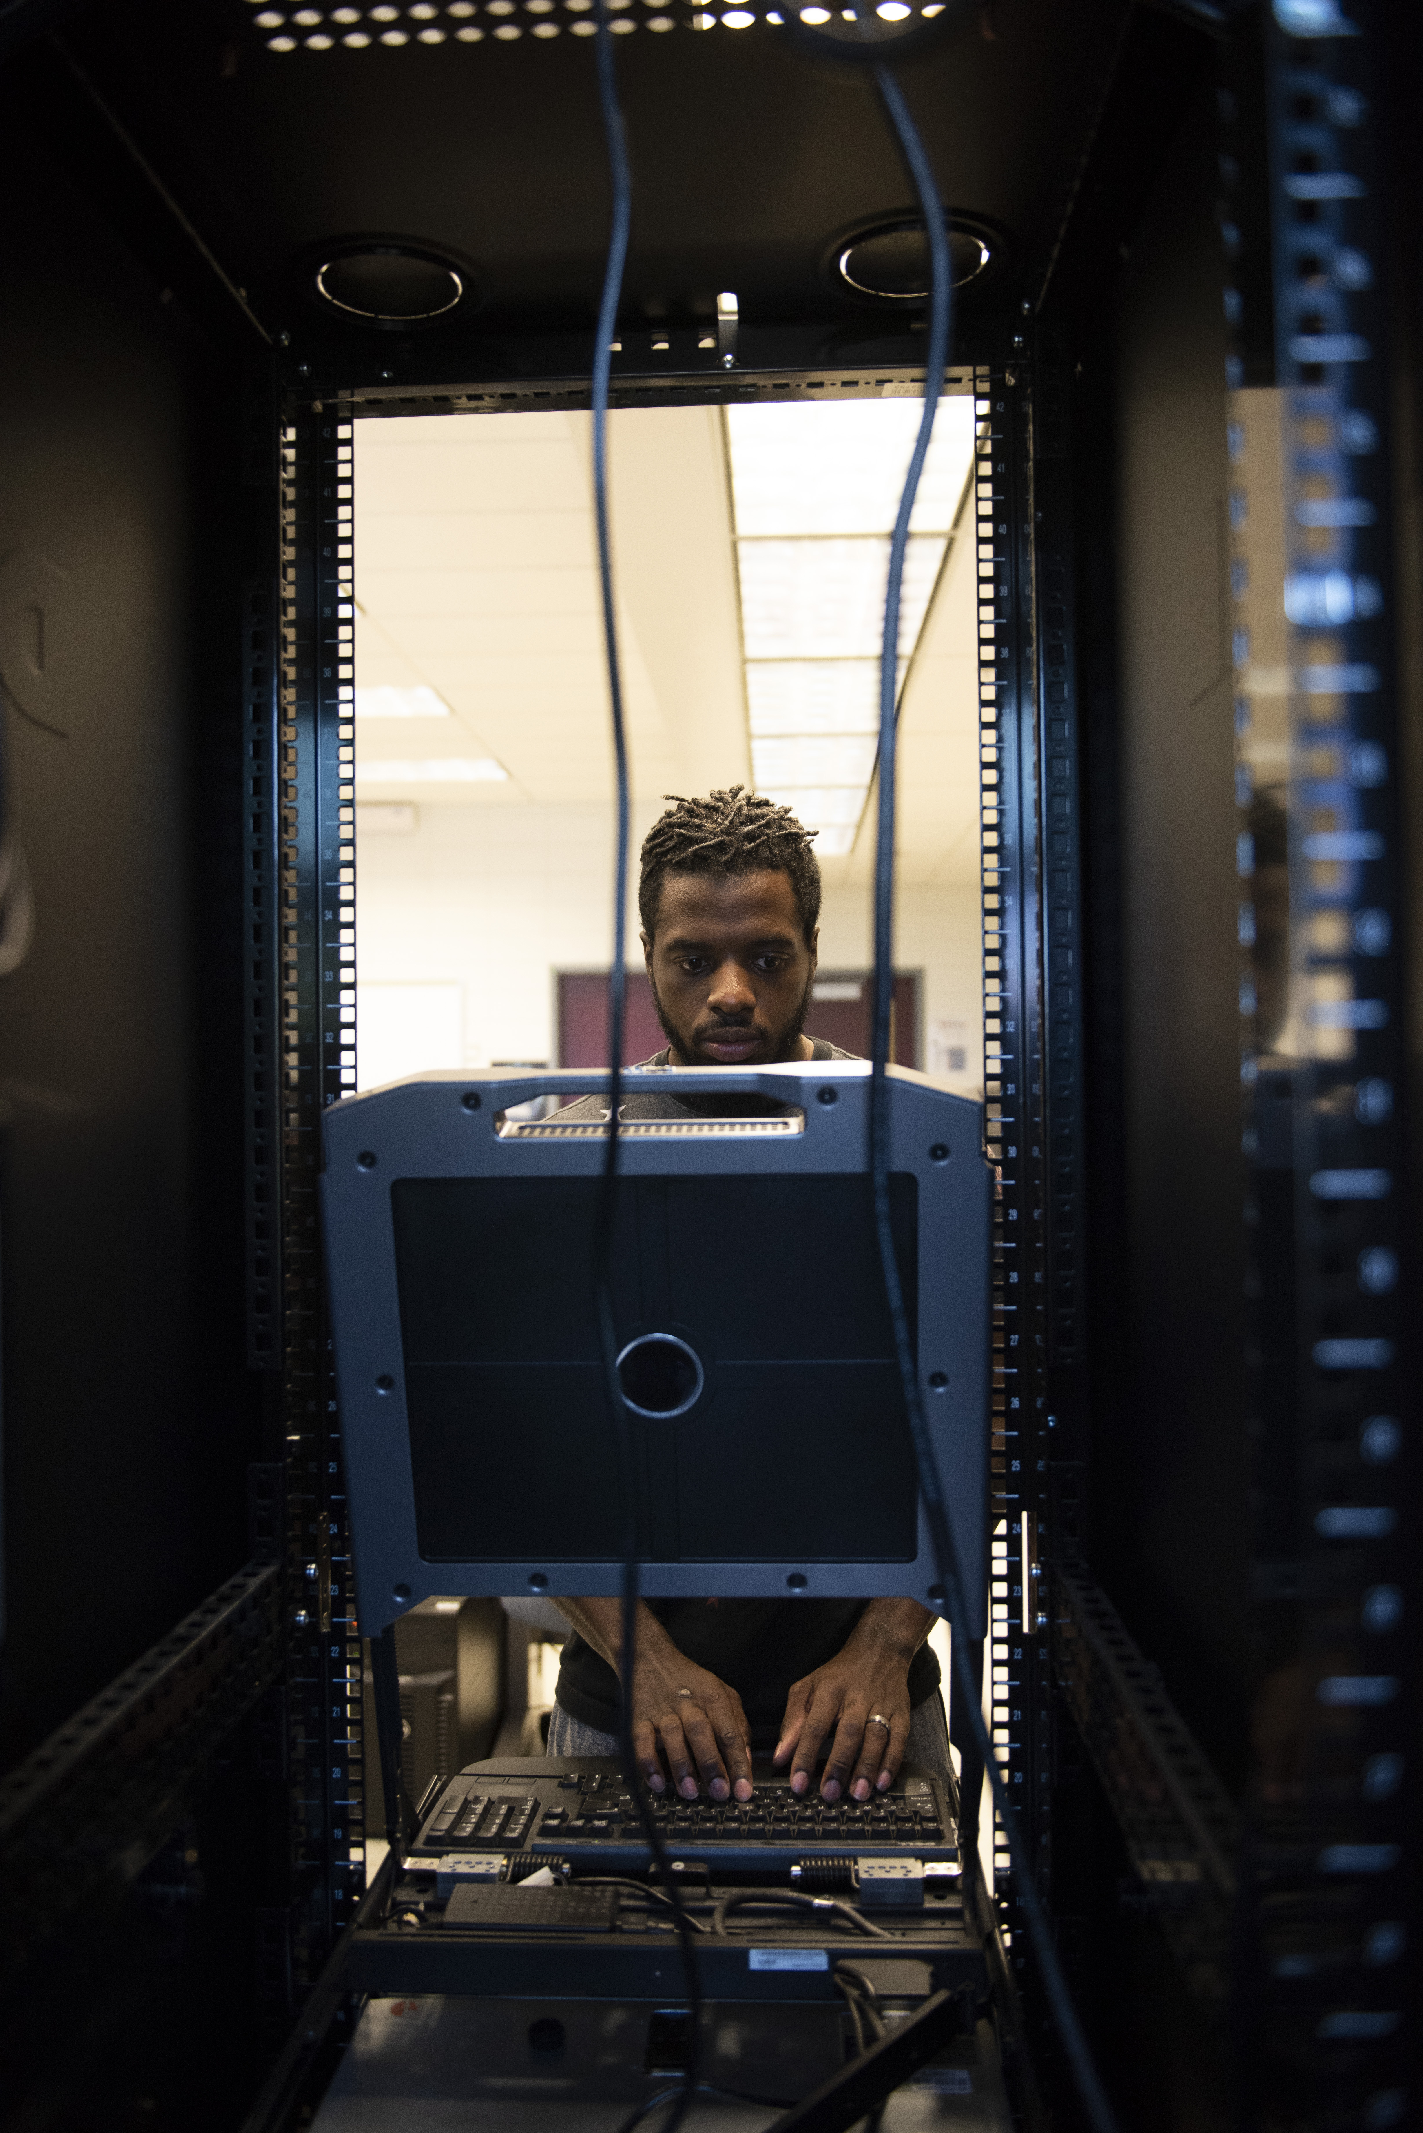
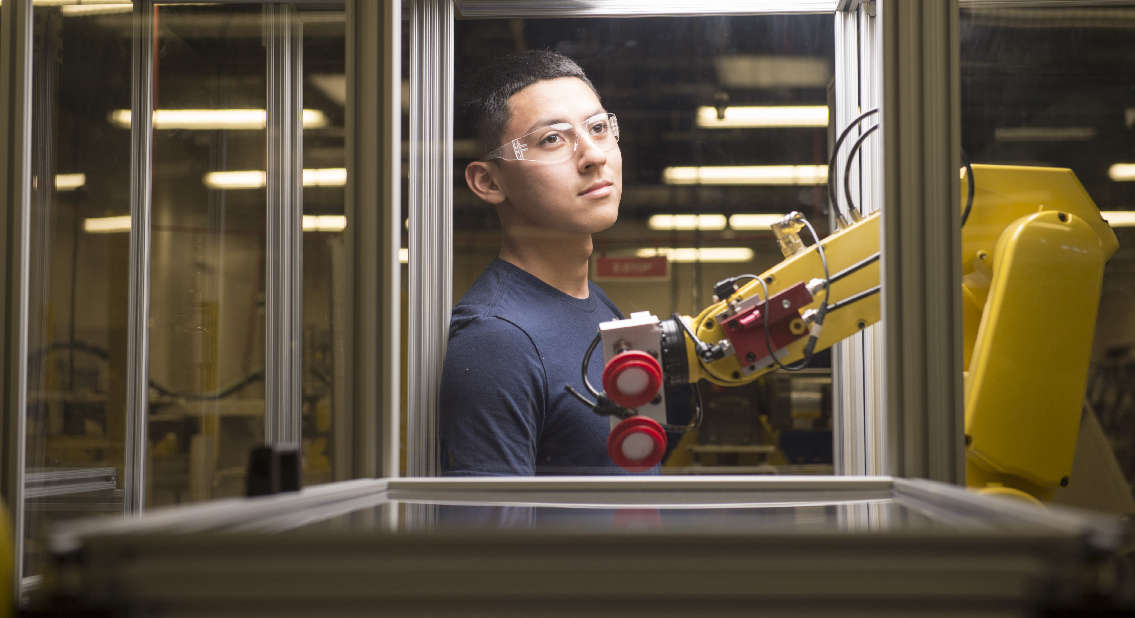
FUTURE MILESTONES
HIGH-WAGE, HIGH-DEMAND
Average 3-year post graduation salary
$53,711
$53,571
$51,379
Healthcare
Information Technology
Manufacturing

Slide 38
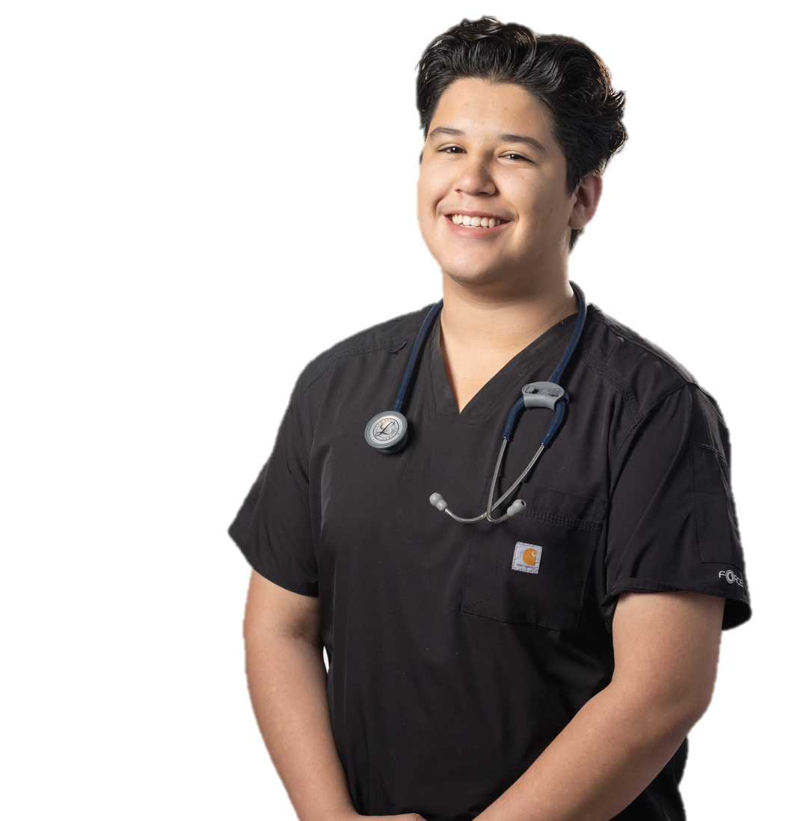

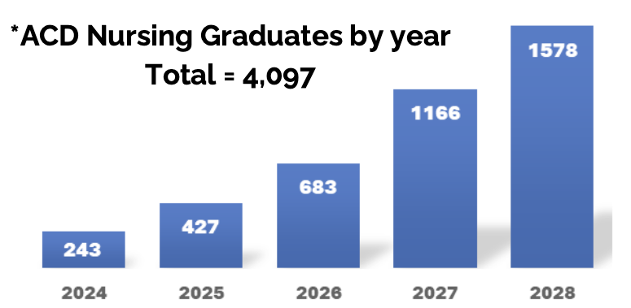
FUTURE MILESTONES
4,000+ NEW NURSES ADDED TO WORKFORCE
by 2028
Nursing Pathways at ACD
Licensed Vocational Nurse
Associate Degree in Nursing
Bachelor Degree in Nursing
From 300 in 2022 to 4,097 by 2028

Slide 39
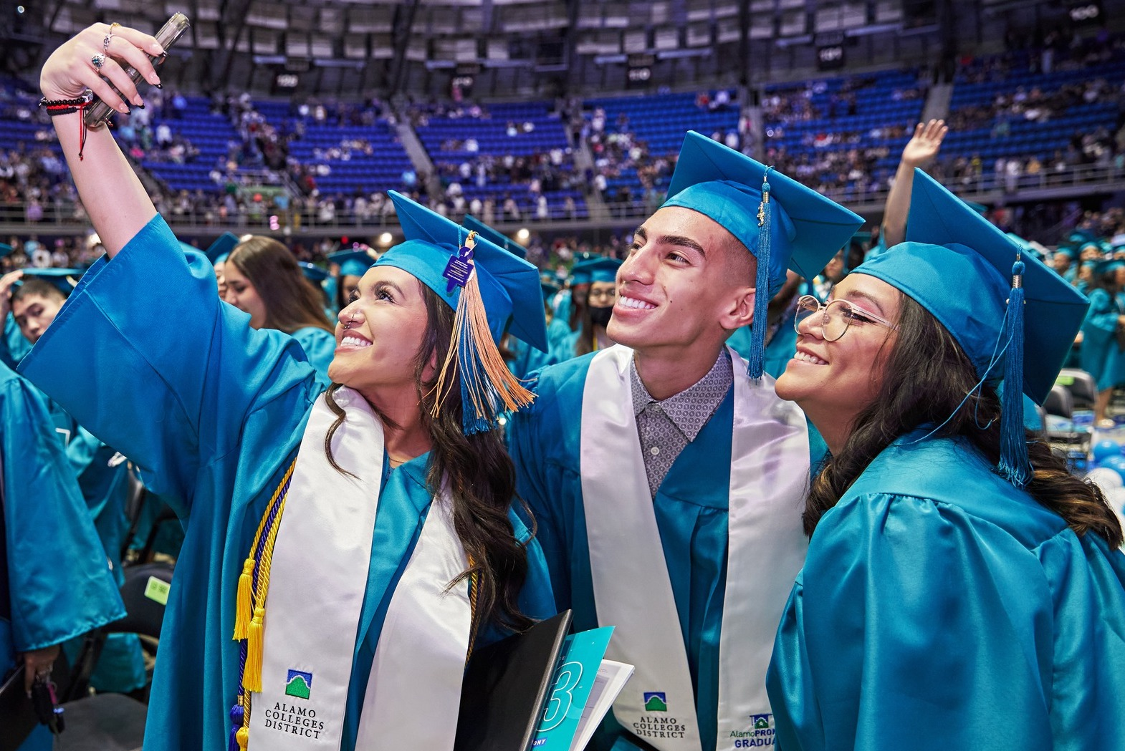
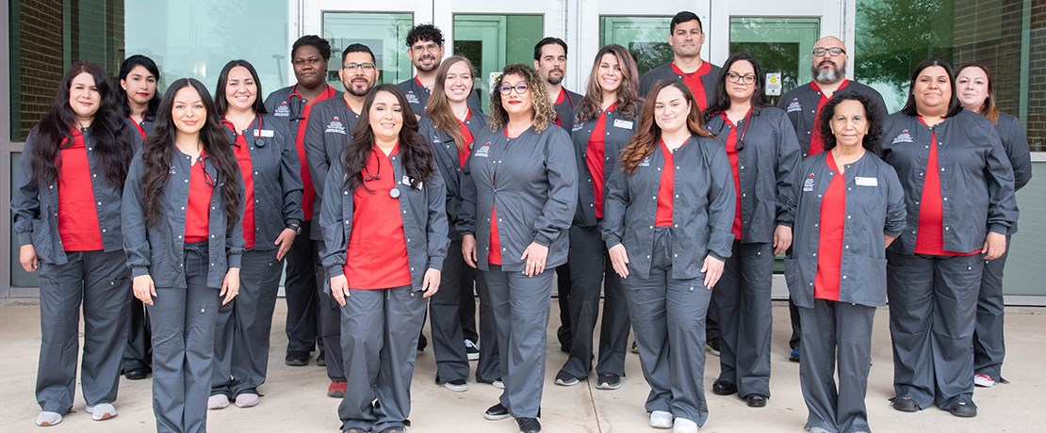
FUTURE MILESTONES
BACHELOR’S DEGREE
OFFERINGS
2021
2024
SAC – Nursing
Launched Fall 2021
NVC – Cloud Computing
PAC – Operations Management
SPC – Cybersecurity
NLC (In Development)

Slide 40
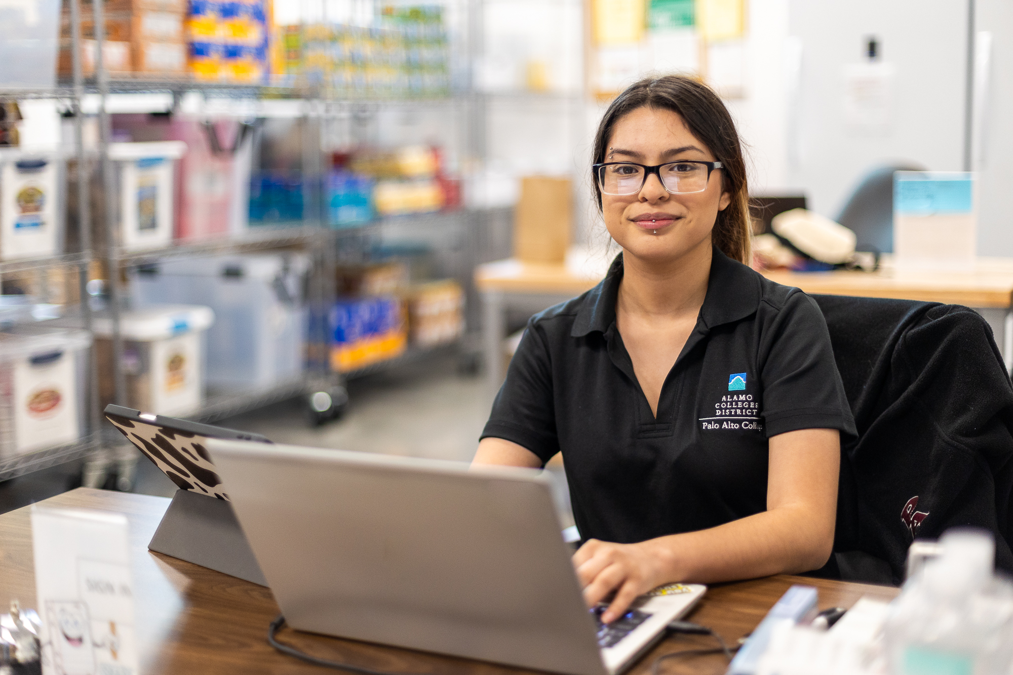






FUTURE MILESTONES
MICRO-CREDENTIALS AND ESSENTIAL SKILLS TRAINING
Enhanced emphasis on Micro-credentials and Marketable Skills
Provide credited badges for learners to affirm their marketable skills with employers.
Notes:
How many WF programs – 11 new programs

Slide 41
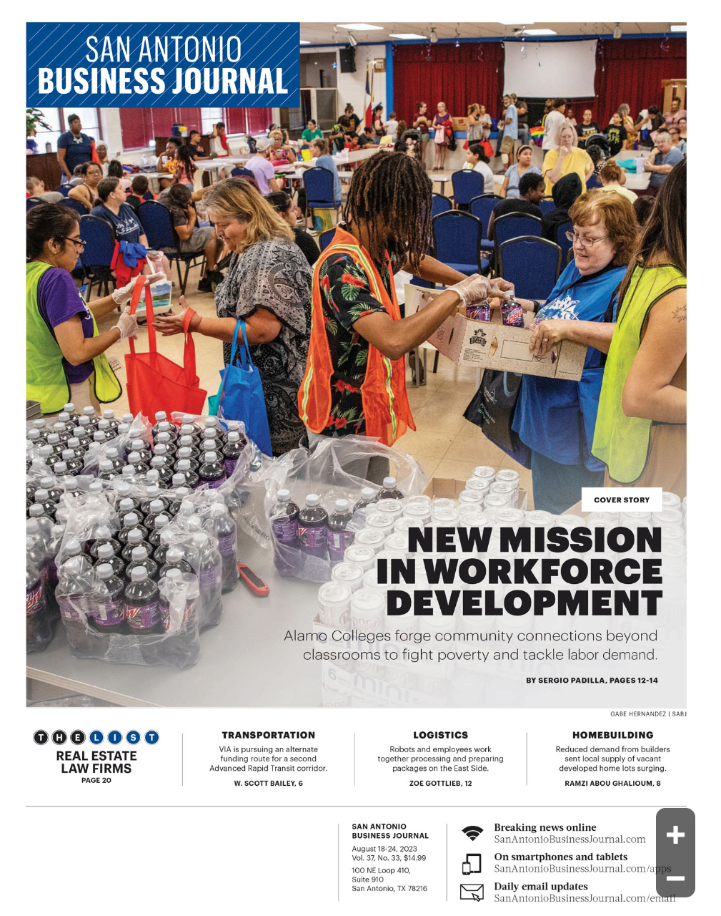

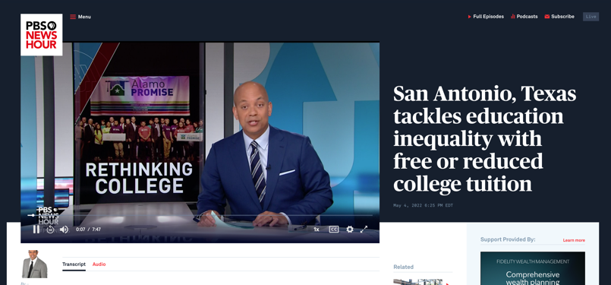

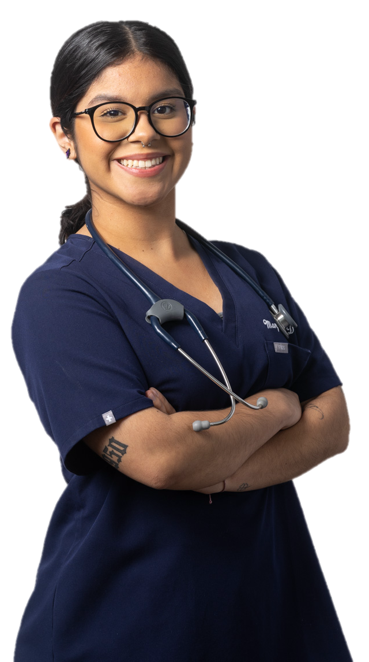
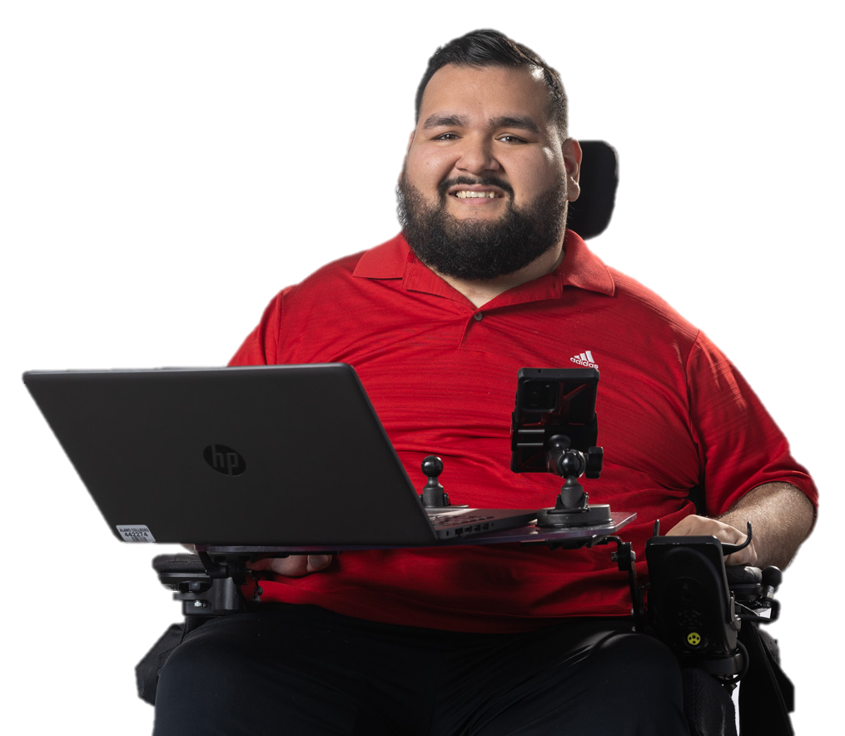
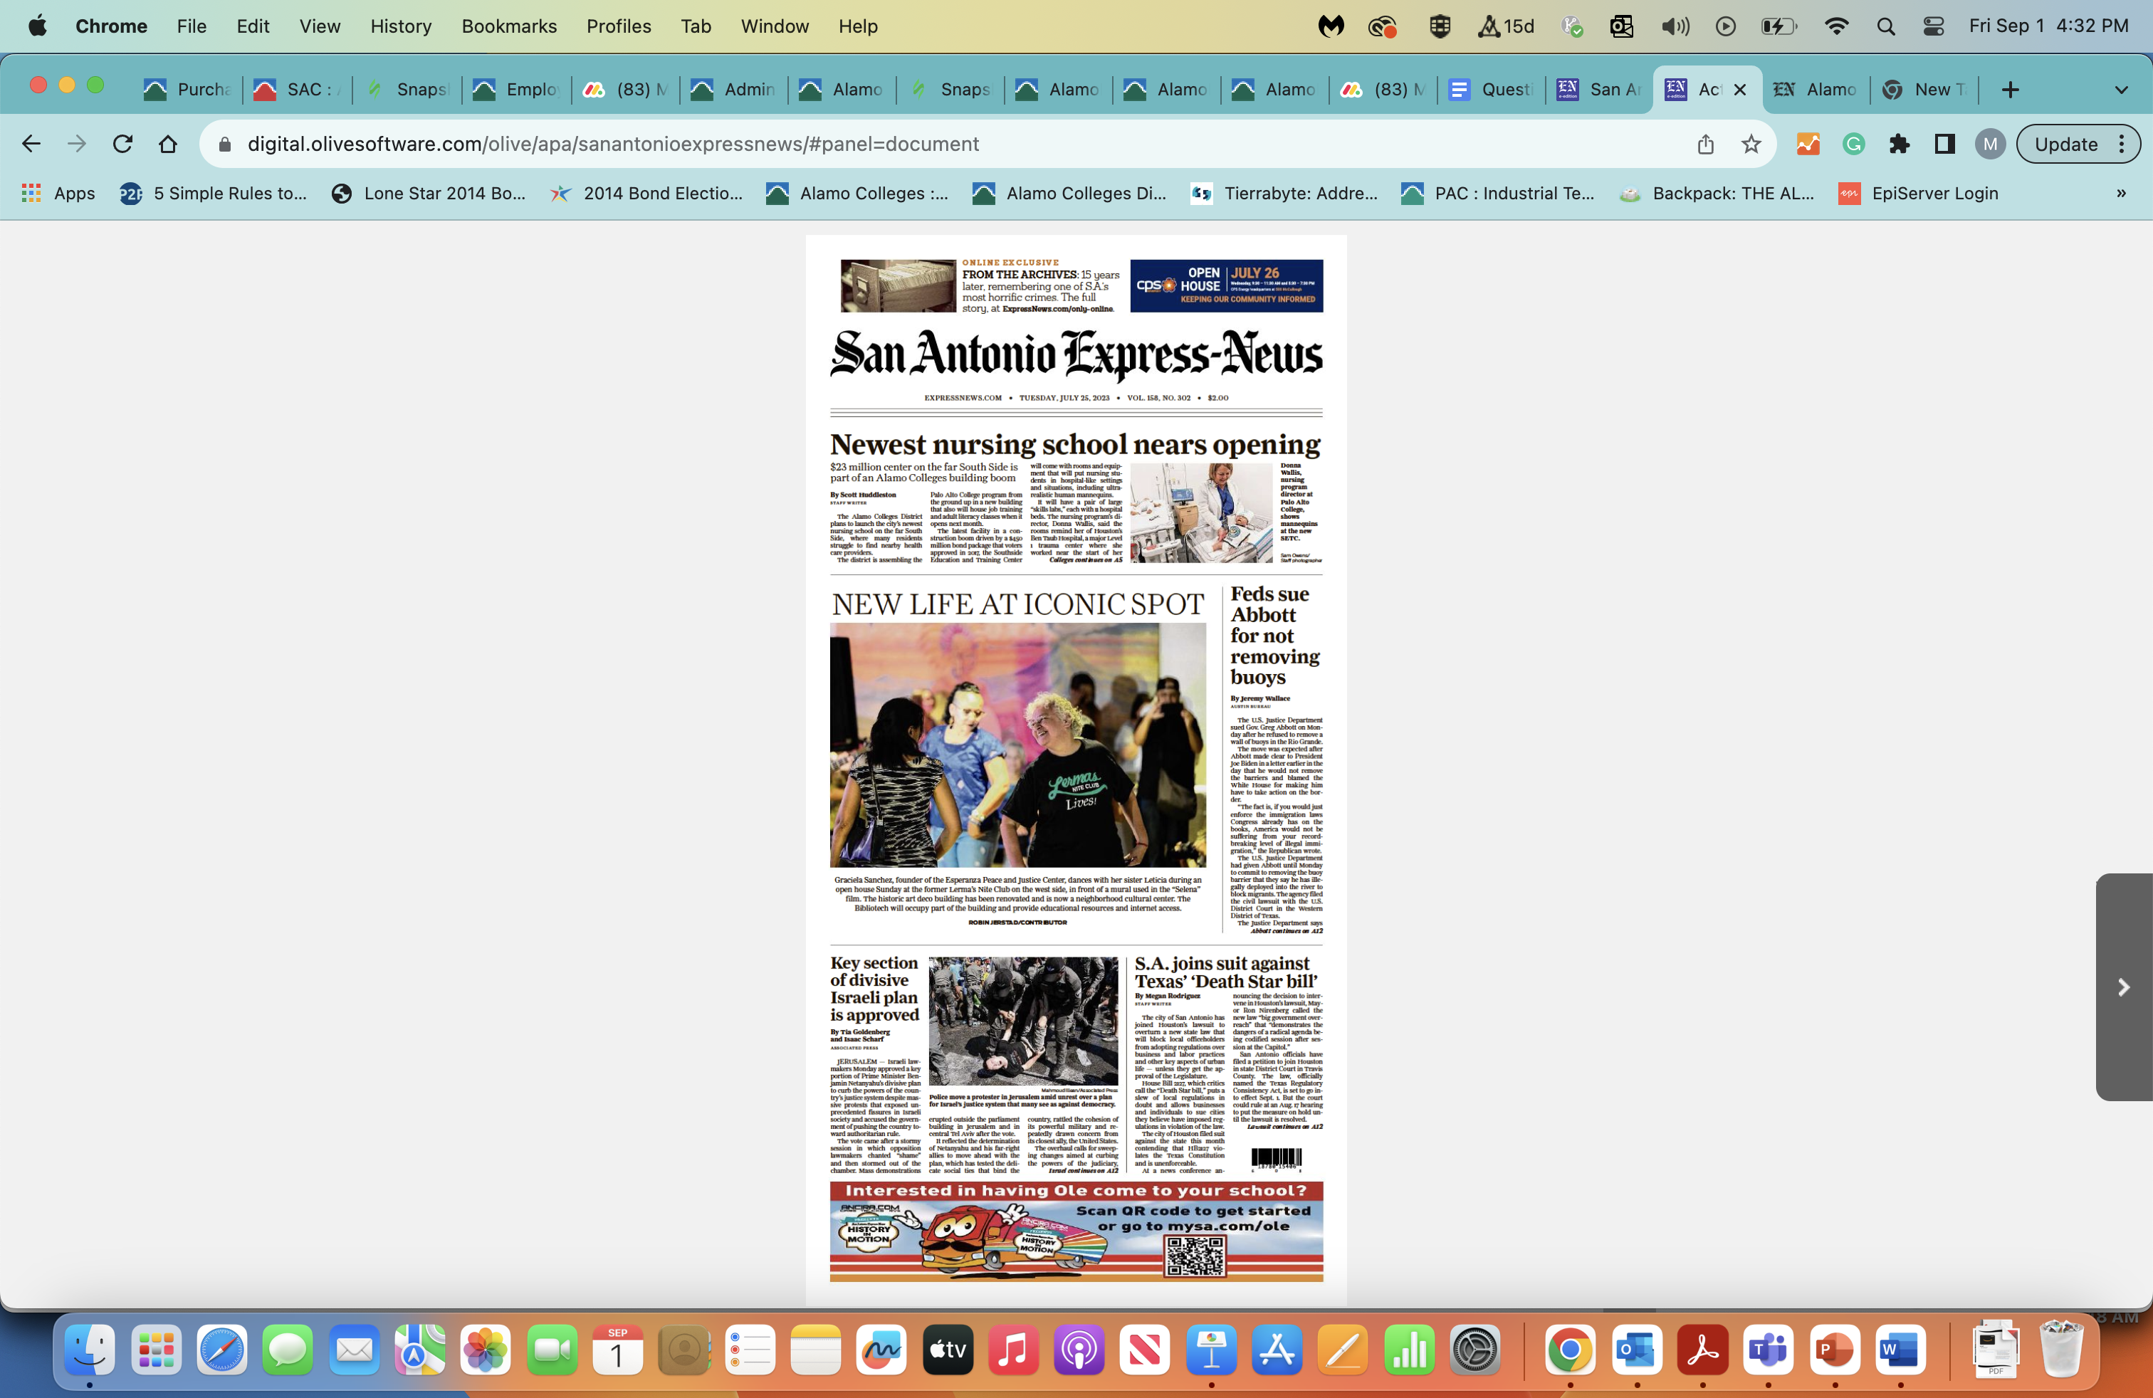
FUTURE ASPIRATIONS
SAN ANTONIO’S
SUCCESS STORY:
San Antonio Tops National Charts in College Graduation Rates
Ending the Struggle:
San Antonio Declared
Poverty-Free Zone
COVER STORY
Workforce Revolution:
San Antonio Top Source of
High-Demand Talent in Nation

Slide 42


THANK YOU
for contributing to our success!

Slide 43
EXECUTIVE DIRECTOR’S REPORT
BARTON T. SIMPSON
EXECUTIVE DIRECTOR

Slide 44
3Q INVESTMENT COMMITTEE REPORT
NOVEMBER 13, 2024
SLOAN THOMAS
COMMITTEE CHAIR

Slide 45
3Q 2024 INVESTMENT COMMITTEE SUMMARY REPORT
Market Performance
Q3 2024
The Federal Reserve cut the Federal Funds rate by 50 basis points in Q3, marking a shift after a rate hiking cycle that started in 2022. The cut was prompted by decelerating inflation and early signs of weakness in the labor market.
Inflation continued to decelerate, with headline CPI at 2.5% in August (down from 3.0% in June) and well below the 9.1% peak in June 2022.
For the S&P 500, ten sectors posted positive returns for the 3Q; equities in regions outside the US were mixed.
The S&P 500 rose by 5.9% in Q3 2024; the Dow Jones Industrial Average increased 8.7%; the Russell Midcap gained 9.2%; and the Russell 2000 small-cap index rose 9.3%.
Total investment performance including SAC/PAC account was a gain of $4.47 million bringing total funds to $80.1 million including our cash accounts. Title V/Title III investment performance was a gain of $230,532 bringing total funds to $4.70 million.
Expenses remain in excellent position with annual fees at 0.47%.

Slide 46
3Q 2024 INVESTMENT COMMITTEE SUMMARY REPORT
2024 YTD Performance
US equity markets particularly for the S&P 500 (+22.05%) have resulted in solid portfolio performance in 2024 ytd. Investments return total $8.6 million for 2024 ytd.
After a small gain in the last quarter, the Portfolio performance continues to improve with total funds reaching $80.1 million.
Portfolio exposure to China/Hong Kong
As of September 30, the portfolio had a total exposure of $909,434 to China/Hong Kong assets or 1.13%
Action Item
The Committee reviewed data (3-year rolling returns) and benchmark data on Endowments and recommends a 2025 distribution rate of 4.60%, an increase from the2024 rate.

Slide 47
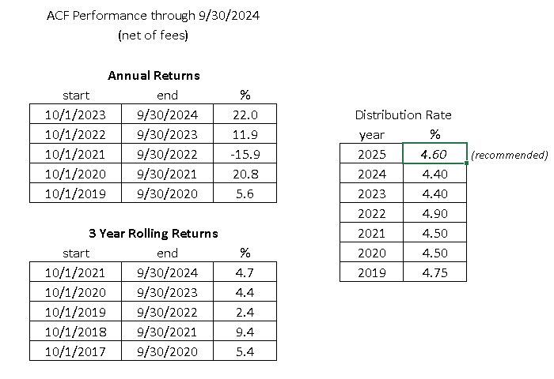
ACTION ITEM – APPROVAL TO ADOPT A DISTRIBUTION RATE OF 4.60% OF ENDOWED FUNDS FOR 2025
ACTION ITEM: Approval to adopt a distribution rate of 4.60% of endowed funds for 2025.
BACKGROUND: The existing policy gives the Alamo Colleges Foundation board of directors the authority to determine distributions on an annual basis under the guidance of the Investments Committee. The investment consultant (Graystone Consulting) recommends a distribution rate 4.60% of 4.40% for 2024. Formerly, a distribution rate of 4.40% was adopted for 2023, 4.90% for 2022 and 4.50% for 2021. According to a NACUBO-Common fund Study of Endowments, endowments across all institutions averaged a spending rate of 4.8% in 2023, which increased from 4.2% in 2022. The study reported 4.8% in 2021 and 4.6% in 2020.
RATIONALE: The Investments Committee recommended setting a distribution rate of 4.40% on endowed accounts last year. This recommendation was based on principles and best practices in the Process for Setting the Distribution Rate (attached) that advance prudent decision making. Another priority was recognizing the huge scholarship needs of our students. The rationale behind increasing the distribution rate is backed by the long-term return results that have been above the rate in most rolling periods.
RECOMMENDATION TO THE BOARD: Approve adoption of a distribution rate of 4.60% of endowed funds for 2025.

Slide 48
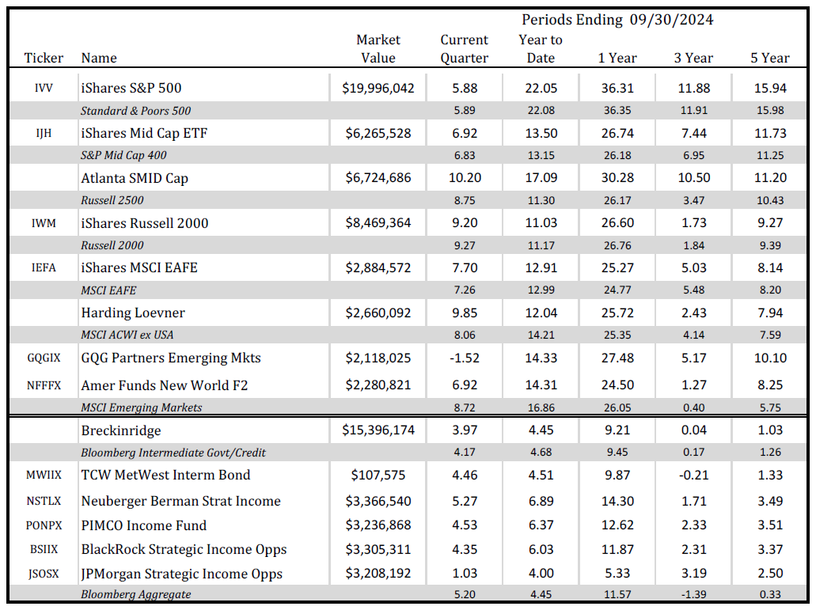
INVESTMENT PERFORMANCE SUMMARY TABLE

Slide 49
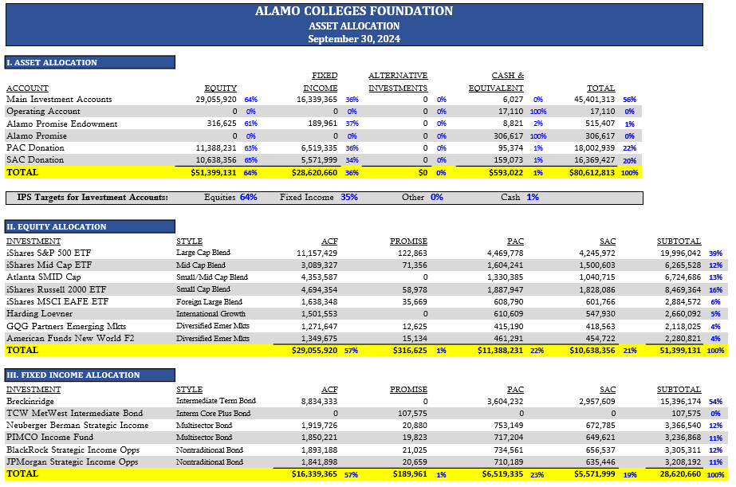

Slide 50
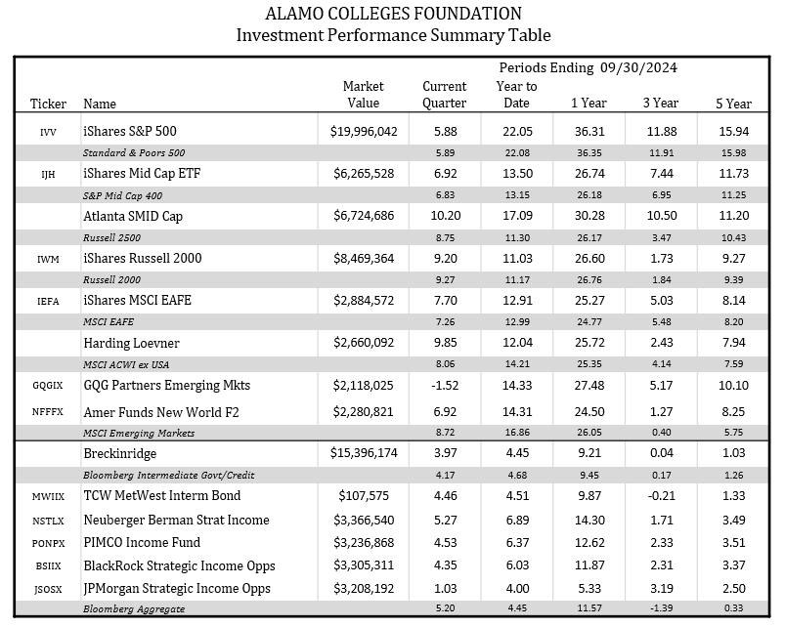

Slide 51


Slide 52
Thank you.

Slide 53

Treasurer's Report
Financial Summary
2024 3rd Quarter
(July 1, 2024 - September 30, 2024)
Deborah Knapp, Treasurer
November 13, 2024

Slide 54
2024 Q3 Revenues
Total Revenues period July 1, 2024 - September 30, 2024: $2,267,000*
    Non-endowed revenue** : $1,565,973
      $180,000 Impetus Foundation
      $155,000 Baptist Health Foundation of San Antonio
      $150,000 PepsiCo Foundation
      $130,000 Microsoft Corporation
      $100,000 City of San Antonio
    Endowed revenue ** : $283,678
      $85,000 Richard Spencer Lewis Memorial Foundation
      $50,000 Barnes and Nobles
      $45,000 Impetus Foundation
      $35,000 Dana Anthony
    Interest and Dividends: $417,349
* Amounts have been rounded up throughout this presentation
** Includes period highlights

Slide 55
2024 Q3 Expenses
Total Expenses period July 1, 2024 - September 30, 2024: $2,367,634*
  Non-endowed accounts: $1,886,434
      $1,027,538 Program Support **
          $396,301 PAC College Operation MS Allocation
          $176,134 PAC High Wage/Demand MS Allocation
          $85,779 USAA AlamoPromise Re-Engage
          $82,423 SAT@QUR Program
      $858,896 Scholarship Awards**
          $24,650 Tres Grace Family Scholarships
          $24,361 LULAC Rey Feo Child Scholarships
          $23,500 Greehey Family Foundation Scholarship
  Endowed accounts: $481,201
      $481,201 Scholarship Awards
* Amounts have been rounded up throughout this presentation
** Includes period highlights

Slide 56
Investment Trend Data, 2022 – 2024
2022: ($ 12,397,062)
2023: $ 7,859,258
2024 Q1-2: $ 7,783,392

Slide 57
In Summary – 2024 Q3 (July - September)
Total net assets at the beginning of period: $82,019,236*
Total revenues: $2,267,000
Total expenses: ($2,367,634)
Investment gain: $4,294,533
Total net assets at the end of period: $86,213,135
* Amounts have been rounded up throughout this presentation

Slide 58
Net Assets Trend Data 2013 – 2024*
$20M
PAC gift
$15M
SAC gift

Slide 59
Thank you.
Learn more at
alamo.edu

Slide 60


Alamo Colleges Foundation
2024 Development Report
Jan 1 – Oct 31, 2024
Notes:
Good afternoon. It’s a pleasure to be here with you today to share fundraising results for calendar year 2024 year to date.

Slide 61

Year over Year Fundraising Comparison
Campaign | Jan 1 – Oct 31 2023 | Jan 1 – Oct 31 2024 | YOY $ Change +/- | YOY % Change +/-
All Revenue Sources* | $6,926,466 | $6,182,264 | -$744,202 | -%12
*Excludes government grants
Notes:
This first slide provides an overview of fundraising revenue year over year, including the variance both in dollars raised and percent change. As of October 31 performance was down 12% year over year, or about $750K. This year over year variance is primarily attributable to the $1.3M USAA gift to AlamoPROMISE received in spring of 2023.

Slide 62


Fundraising Comparison to Goal
Campaign | 2023 Actual | 2024 Goal | 2024 Actual, year to date | $ Gap to Goal | % Goal Achieved
All Revenue Sources* | $8,611,420 | $8,625,000 | $6,182,264 | $2,442,736 | 72%
*Excludes government grants
Notes:
This next slide shows fundraising performance to date against the goal we set for 2024. The 2023 actual number in the second column for comparison. Moving right, you can see our goal for 2024 of $8.625 M and the dollars raised to date, about $6.2M or about 72% of the goal achieved. This leaves a gap of about $2.4M.
Share only if asked:
We are behind plan by about -7%

Slide 63
2024 Year-End Projections
Campaign | Actual $ 10/31/2024 | Additional Revenue Expected by 12/31/2024 | 2024 Projection | 2024 Goal | Variance $ | Variance % | 2023 Actual
All Revenue Sources* | $6,182,264 | $3,084,852 | $9,267,116 | $8,625,000 | +$642,116 | +7.4% | $8,611,420
*Excludes government grants
Notes:
This next slide shows year end projections for 2024. As of October 31, we had just under $6.2M in hand. We anticipate receiving another $3M in pledge receivables and pending requests by year end, which should put us over goal by about $600,000 dollars.
That said, we do have several very significant gifts pending which factor into this projection. Fulfillment of those gifts, along with the timing of gift receipt, will impact where we finish up the year.

Slide 64
Major Gifts in Progress
Kate Marmion Charitable Foundation $300,000 for AlamoPROMISE
Chesmar Foundation, $375,000 for nursing scholarships
H-E-B $250,000 for advocacy, scholarships and emergency assistance, plus in-kind support valued at $15,000
Firstmark Foundation and Firstmark Federal Credit Union $100,000 for financial education
Ann and Bob Stevens considering a gift of $100,000 for scholarships
Notes:
I also wanted to highlight just a few of the major gift opportunities our development team is working on now.

Slide 65

Event Update – 2024 GED Brunch
  Join us for the 17th annual (Hats Off to GED!) GED Brunch hosted by the Fabulous GED Brunch Committee and our own Martha Tijerina
  Saturday, December 7, 2024, at the Westin San Antonio North – Check-in opens at 9 a.m.; Program at 11 a.m.
  Expected to raise $135,000 for GED programs across the Alamo Colleges District
  41 tables sold of 65 total
Notes:
I’d like to invite Martha Tijerina to provide an update on this year’s GED Brunch, coming up on December 7th.
Martha’s comments
Thank you so much, Martha, to you and the whole committee, as well as all our board members supporting this effort! We appreciate you!

Slide 66

MOSAICO 2025 Update
  Co-Chairs Amber and Sloan Thomas and Jamie and Travis Kowalski; Honorary Chairs Mayor Ron Nirenberg and First Lady Erika Prosper Nirenberg
  Thursday, March 27, 2025, at the Witte Museum, Mays Family Center and Zachry Family Acequia Garden
  Thank you to our Board Members serving on this year’s committee: Norma Reyes, Deborah Knapp, Wendell Hall, Laura Linhart-Kistner, Lisa Andrade Gonima and Sloan Thomas
  This year’s goal is $1,300,000
    $515,000 in revenue committed to date
    25 tables sold of 55 total
Notes:
Finally, we have a quick update on MOSAICO 2025. Just over $500,000 has been committed to date.
We want to thank:
Our honorary chairs Mayor Ron Nirenberg and First Lady Erika Prosper Nirenberg
Co Event Chairs Sloan & Amber Thomas and Jamie & Travis Kowalski
As well as our board members serving on this year’s MOSAICO committee

Slide 67

Annual Employee Giving Campaign Results
  Employees may give to an Alamo Colleges
  Foundation cause or a local United Way
  impact partner. Alamo Colleges Foundation
  (Student Helpline) is one of the impact
  partners as well.
  Approximately 75-80% of monies raised each year are designated to the Foundation.
  2024 Participation: 54.27%
  2024 Dollars Raised: $458,198 and counting!
  - NEW RECORD!
  - Previous record was $375,197 (2023)
Notes:
I would also like to take this opportunity to recognize the outstanding performance of Richard Farias and Franchesca Velten who led this year’s Alamo Gives Back employee giving campaign under the leadership of our 2024 Campaign Chair, Bart Simpson.
To close our report, I’d like to invite Richard or Bart to share some great news about this year’s campaign results.
If Richard isn’t attending, Bart may wish to make a few comments.

Slide 68

Notes:
Finally, please save the date for our annual Holiday Appreciation Reception, to be held from 5 to 7 p.m. on Thursday, December 5th at the San Antonio Country Club. We look forward to seeing you there!

Slide 69

Thank you!
Notes:
Again, these results reflect the work not only of the Foundation team, but of all of us across the District working together.
On behalf of the entire Foundation team, I want to thank our Alamo colleges faculty, staff and administration for their generosity as well as their partnership and hard work.
This brings me to the end of the presentation. I’d be happy to answer any questions you may have.
Thank you

Slide 70
Alamo Colleges Foundation
Scholarship Team
Q3 Board Report November 2024
Amy Carcanagues
Director of Scholarship Programs

Slide 71
UPDATE: AWARDING BY YEAR

Slide 72
UPDATE: FUNDS PAID IN AUGUST

Slide 73
UPDATE: ALAMO PROMISE
FOUNDATION AWARDING BY ACADEMIC YEAR
Since 2020, over $3.8 million paid to students from Foundation last dollar funds
For Fall 2024, we have 12,362 Alamo Promise Scholars enrolled across the colleges

Slide 74

FALL 2024 INITITATIVE UPDATE: CAREER WEBINARS
Pepsi Co Foundation provided funds for programming
Offering Career Development Series to explore how to define and communicate value, craft an elevator pitch, rework your resume, create your brand, leverage LinkedIn and use strategies to secure internships/employment

Slide 75
Thank you!
Learn more at
alamo.edu/foundation/scholarships

Slide 76



2024 Institutional Advancement
Grants Report
ACF Board Meeting
11.13.2024

Slide 77
Overview of Services
District-wide coordination of limited submission state grants
District-wide coordination with Chief Legislative, Industry, & External Relations Officer on congressional requests
Grant submissions that require the fiscal agent to be a 501c3
Submission of district-wide grants supporting the Chancellor's charges or initiatives with district-wide impact

Slide 78






2024 Proposal Report (Jan – November)
2 Proposals In Progress
$1,250,000
11 Proposals Submitted
remain under consideration
9 Proposals Were Declined
$15,559,600
$29,180,088
11 Grants Awarded
$6,320,531
15 Prospective Opportunities being researched

Slide 79


Reminder: Grants Dashboard is Always Available by Link
The Grants in Pipeline Dashboard aids planning by enabling up-to-date snapshots of grants’ status.
https://bit.ly/GrantsDashboard

Slide 80

Grant Highlight
Recently awarded: $2,749,496
Funder: Department of Education
Strengthening Institutions Program
Recipient: NLC (with a district-wide focus)
Project Period: 2024 to 2027
Project: AlamoSUCCESS
Purpose:
The purpose is two-fold: 1) in years 1-3, to “democratize” data by providing faculty and staff training in use of multiple newly-developed dashboards and self-service analytics tools and 2) in years 3 and 5 provide additional services to a) student groups including pregnant or parenting students, and b) near-completers who have not re-enrolled since 2018. (Note: student groups to receive additional services can change if there is evidence of greater need in other populations.)

Slide 81
On behalf of the Grants Team,
Thank you.

Slide 82
OTHER BUSINESS
NOVEMBER 13, 2024
W. WENDELL HALL
CHAIR

Slide 83
OTHER BUSINESS
FOUNDATION BOARD FORMS TO COMPLETE:
UPDATE BOARD MEMBER PROFILE
ANNUAL RENEWAL OF CONFLICT-OF-INTEREST STATEMENT – SIGNATURE REQUIRED
ANNUAL RENEWAL PLEDGE FORM

Slide 84
UPCOMING MEETINGS AND EVENTS
2024 Alamo Colleges Foundation Holiday Appreciation Reception;
Thursday, December 5, 2024; 5 – 7 PM; San Antonio Country Club
17th Annual Fabulous GED Brunch; Sat., December 7, 2024;
  9 AM-Holiday Market and 11 AM – 1 PM-Brunch and Program; The Westin San Antonio North

Slide 85
2025 PROPOSED MEETING DATES
Wednesday, February 19, 2025, noon – 2:00 p.m.
Wednesday, May 7, 2025, noon – 2:00 p.m.
Wednesday, August 13, 2025, noon – 2:00 p.m.
Wednesday, November 12, 2025, noon – 3:00 p.m.
(Annual board meeting/Election of officers)
  Location: ACCESS, Broadway Room – room 100

Slide 86
Thank you!

