Slide 1
NLC 2018 Emerging Leaders
Dr. Veronica Garcia

Slide 2
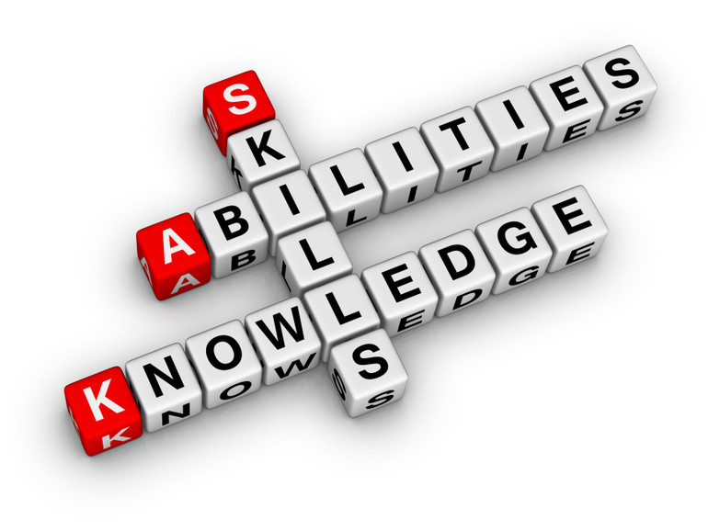
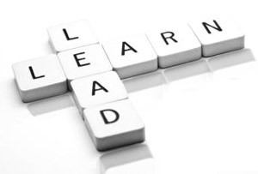
Welcome NLC Emerging Leaders!
Congratulations on being a part of NLC’s inaugural Emerging Leaders class. This class is designed to enable you to take your recognized ability and learn how to effectively lead others to grow and succeed.

Slide 3
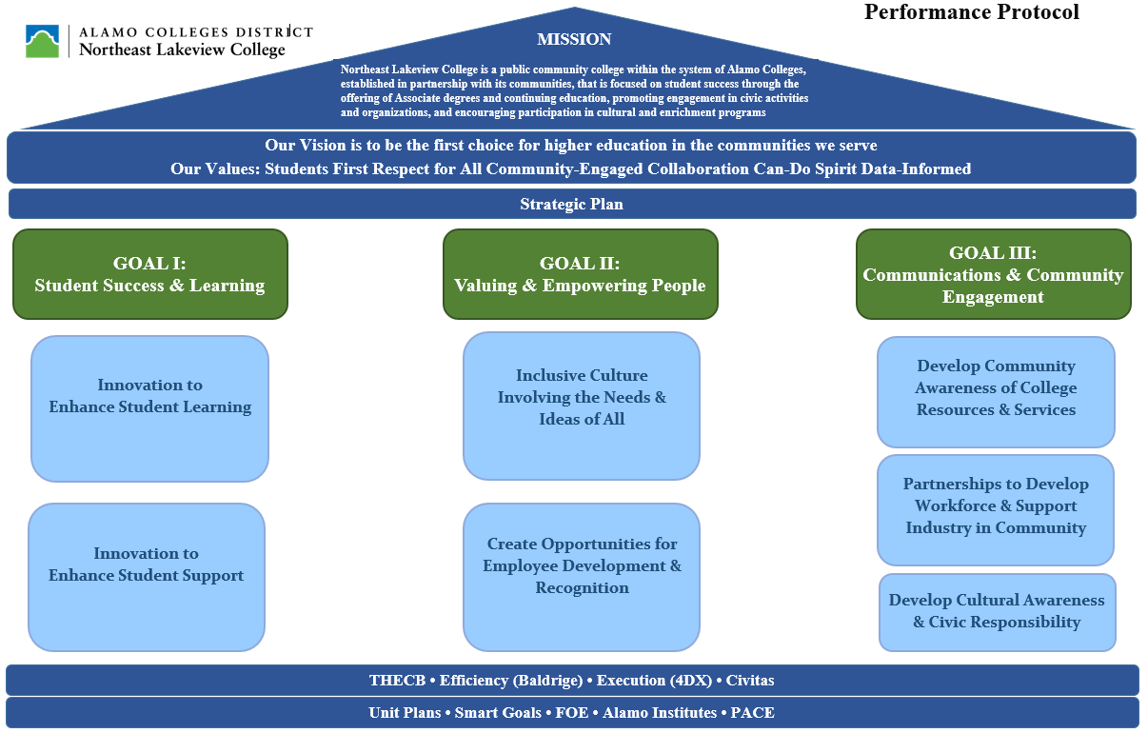
Who are we?
Northeast Lakeview Mission and Vision
Mission
Northeast Lakeview College is a public community college within the system of Alamo Colleges, established in partnership with its communities, that is focused on student success through the offering of Associate degrees and continuing education, promoting engagement in civic activities and organizations, and encouraging participation in cultural and enrichment programs.
Vision
The first choice for higher education in the communities we serve.

Slide 4
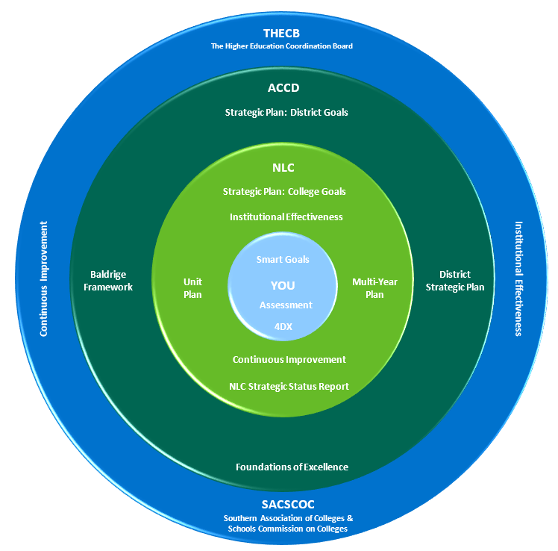
Some of the tools that enable NLC’s ongoing success:
7 Habits of Highly Successful People
The Four Disciplines of Excellence (4DX)
Baldrige Excellence Builder
Foundations of Excellence
Smart Goals
Unit Plans
Surveys (PACE, Noel Levitz, CCSSE)
Most important?
YOU!

Slide 5
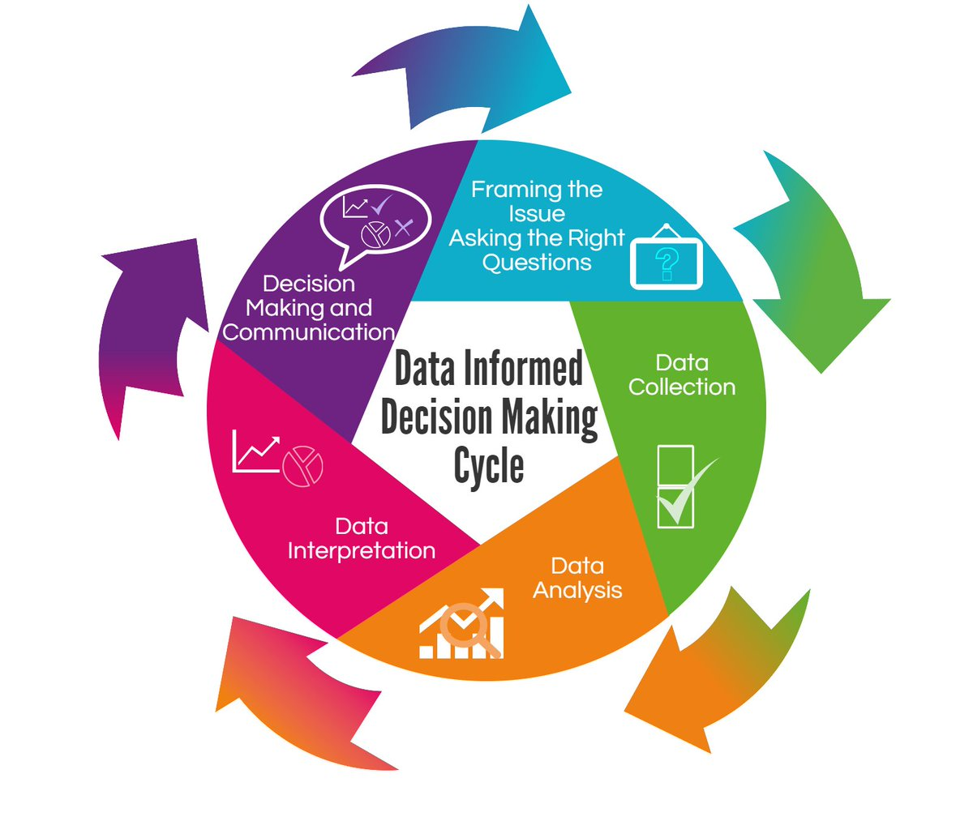
What are the NLC Values?
Students First
Respect for All
Community Engaged
Collaboration
Can-Do Spirit
Data Informed

Slide 6
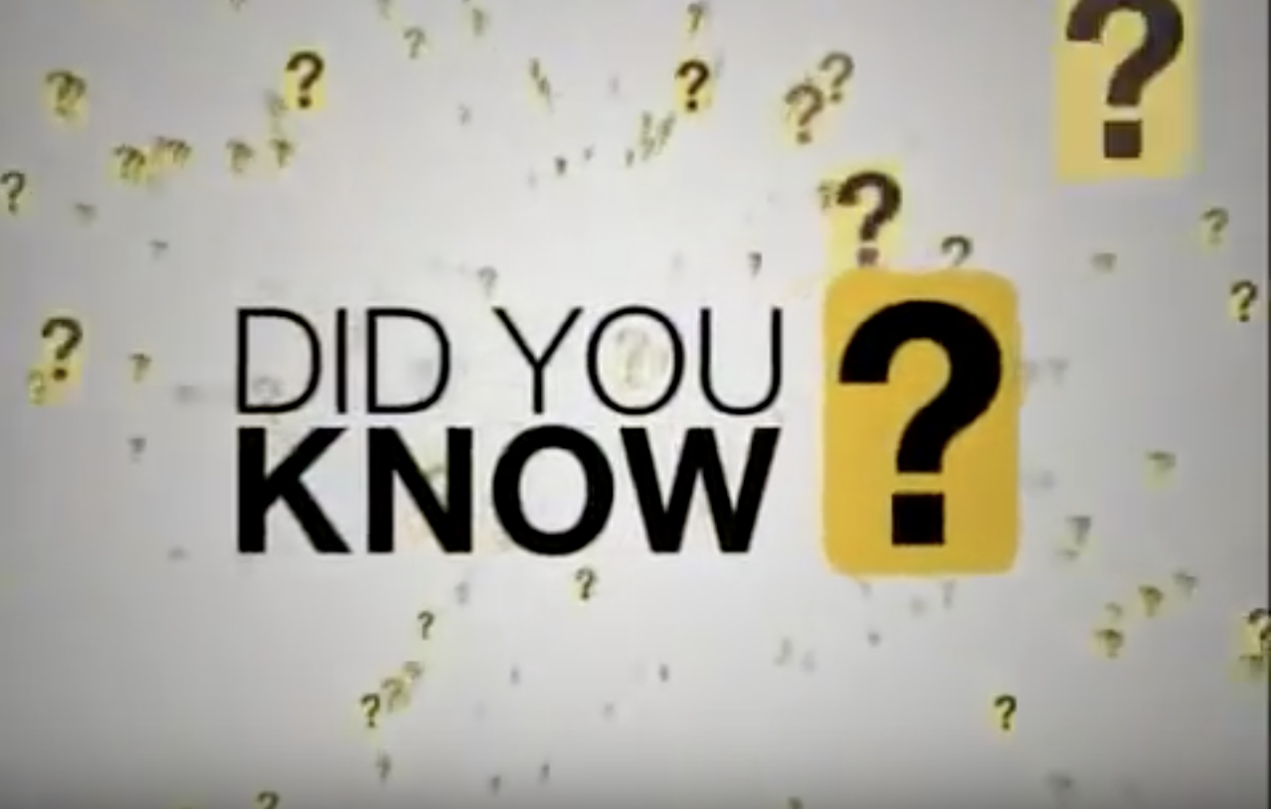
https://www.youtube.com/watch?v=mwl_gplTzhY&feature=youtu.be

Slide 7
A Leader in Every Seat: An Excellent Leader . . .
Inspires Trust
Communicates a Clear Vision
Is a Systems Thinker
Nurtures Talent

Slide 8
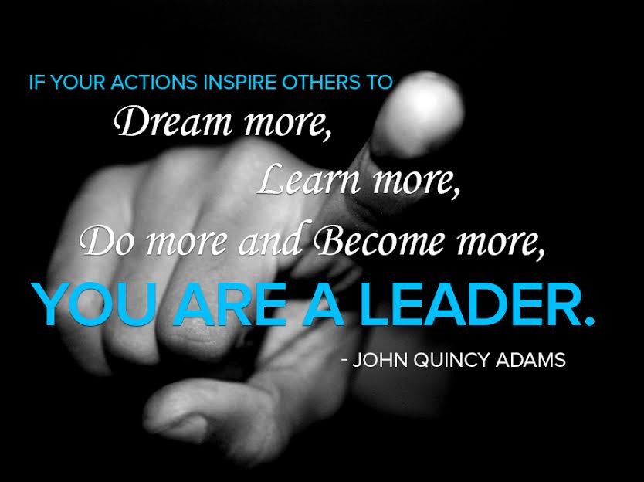
How a Leader Inspires Trust
They Know How to Listen
They are Effective and Honest Communicators
They Engage in Dialogues
They Maintain a Positive Attitude
They are Solution Driven
They take Responsibility

Slide 9
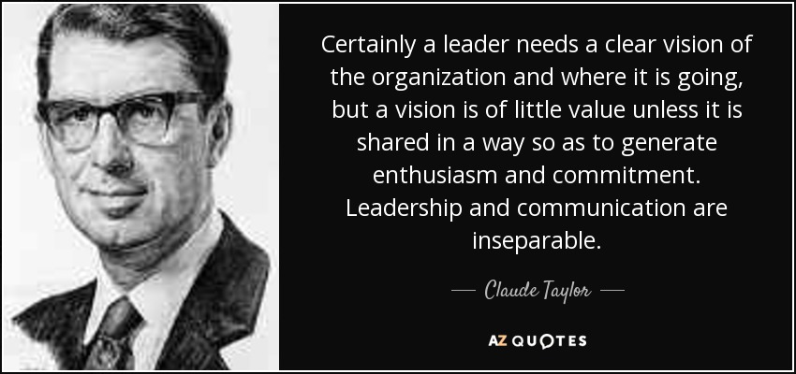
How a Leader Communicates a Clear Vision
They Define Purpose
They Clarify Expectations
They Encourage Questions to Ensure Common Understanding
They use Data to Inform Decisions
They Assess Success using Performance-based Indicators
They “Walk the Talk”— Their Actions Match their Words

Slide 10
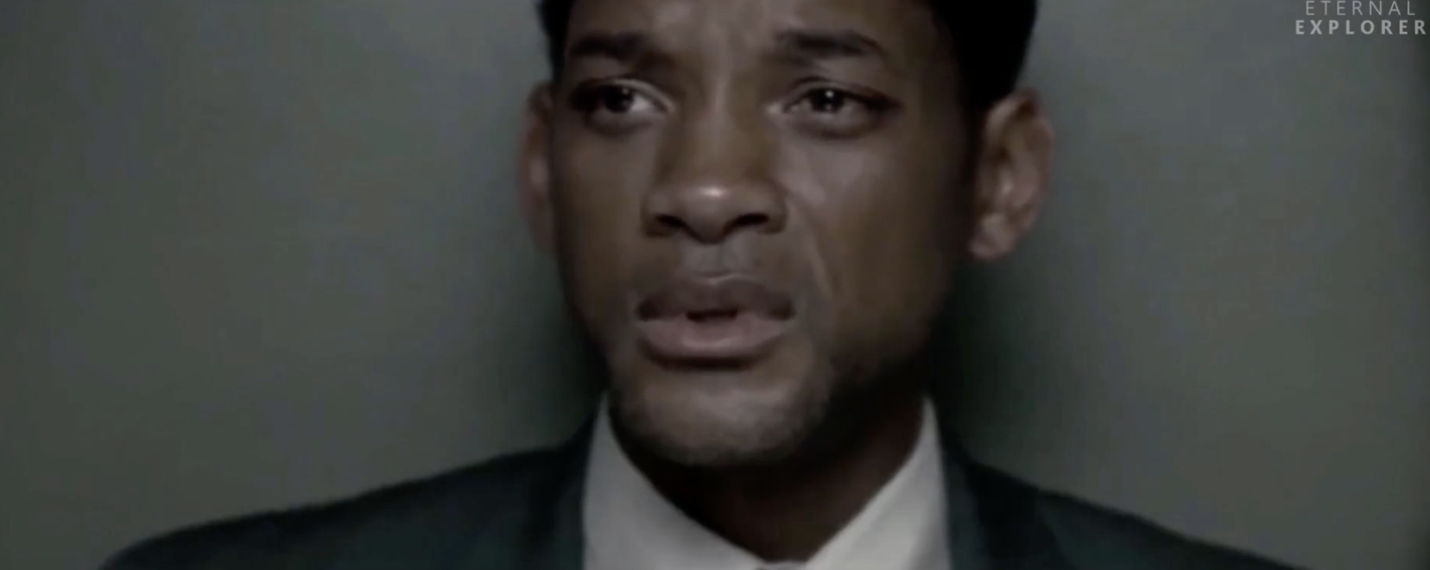
https://www.youtube.com/watch?v=9q__aQFmhig&feature=youtu.be

Slide 11
Leaders as Systems Thinkers
Creating Common Cultural Norms Within and Across ACD Colleges
First, what is “Systems Thinking”?
Instead of looking at a system and breaking it down to its component parts, systems thinking looks at the way a system's parts are interrelated, how they work together, and how that interaction fares over time.
Aligning Systems at NLC
ACD and NLC use several complementary approaches to align process and outcomes. We’ve seen these already—can you name a few?
Covey/7 Habits
Baldrige
The Four Disciples of Execution
Foundations of Excellence

Slide 12
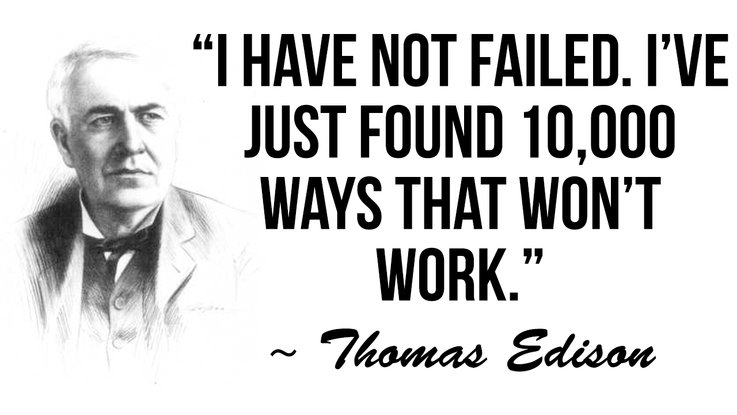
How Leaders Nurture Talent: Answer these Questions
What is the least important word?
I
What is the most important word?
We
What are the 2 most important words?
Thank you
What are the 4 most important words?
What do you think?

Slide 13
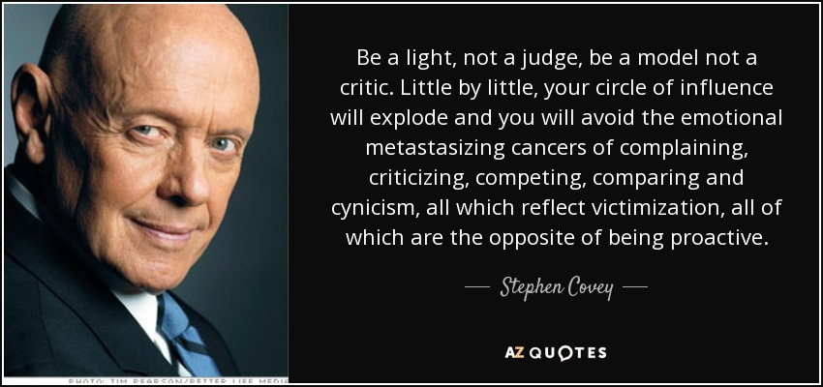
How Leaders Nurture Talent: Avoid the 4 Cs
Criticizing
Complaining
Comparing
Competing

Slide 14
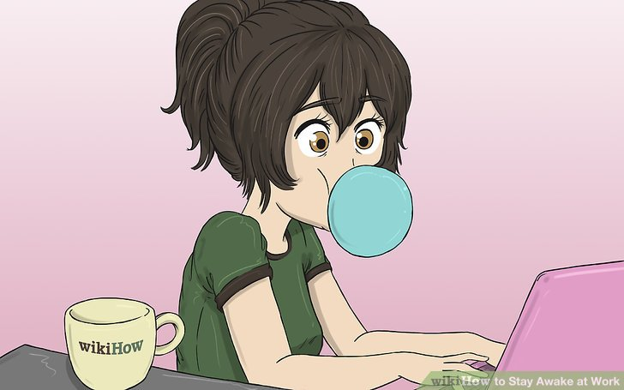
Balancing Work and Life is Critical
What are some strategies to create balance between the needs of the job and the needs of the self?
Establish Boundaries
Give Yourself Permission to Recharge
Positive Affirmation
Making Time for Yourself During the Day
Some ideas for refreshing during the day are taking a walk, watching a quick YouTube video . . . What are some of your strategies?

Slide 15
Other Traits & Skills of Successful Leaders
That’s a lot of information! Can we think of any other characteristics of successful leaders?
Intelligent
Honest
Creative
Adaptive
Cooperative
Dependable
Energetic
Diplomatic & Tactful
Strong Communicator
Organized
Socially Skilled
Tolerant of Stress

Slide 16
Leaders Maximize Opportunities
One more thing successful leaders have in common is they know a good thing when they see it. That includes recognizing the opportunities to develop professionally, both in formal and informal settings.
Take Advantage of this Emerging Leaders Experience! Listen! Learn! Apply!
Mentor Each Other Through this Process! Each of You is Here for a Reason!
Create a Network to Try Out New Ideas or Solve Existing Challenges!
Surround Yourself with Positive People & Experiences!

Slide 17
Your Emerging Leader Challenge!
This program is about learning, but it is also about doing. As part of your experience, you are being given a task: Take on three real and vital projects and make them your own. At the end of this series you will be able to present recommendations to three PACE-inspired projects:
Address & Propose Interventions on PACE-indicated concerns related to
Institutional Structure
Supervisor Relationships
Teamwork

Slide 18
This is YOUR Emerging Leader Program!
I am so happy you have this opportunity and I can’t wait to see what you do with it! Enjoy!

