Slide 1
LVS Update on Action Items/College Updates/10th Anniversary Celebrations
Presented at Friends of Nighthawks Meeting
September 27, 2017

Slide 2
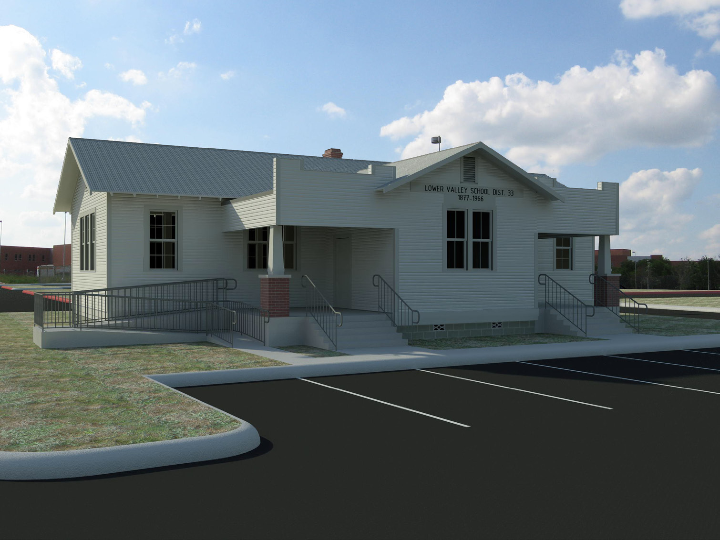
Lower Valley School Update
Action Items
-Institute of Texan Cultures (downsizing/not interested at this time)
- City of Schertz Historical Preservation Society (trying to start a Cibolo Valley Museum)
Schertz Main Street Committee
- Reviewed items in storage containers (comprehensive inventory begins)
- Schertz Chamber & SCUCISD interested in many of the items
Proposed- Living History Museum
FRIENDS OF NIGHTHAWKS
Notes:
Dean Weirtz will be in attendance at the meeting and can provide a description and overview of what he envisions and next steps
Maggie will be there and can also discuss her visions for the LVS from the Schertz Chamber prespective

Slide 3
Lower Valley School Update
Next Steps
- continue to inventory items
- Discuss amongst group viable options and determine final steps/tasks
Proposed- Living History Museum
FRIENDS OF NIGHTHAWKS
Notes:
Dean Weirtz will be in attendance at the meeting and can provide a description and overview of what he envisions and next steps

Slide 4
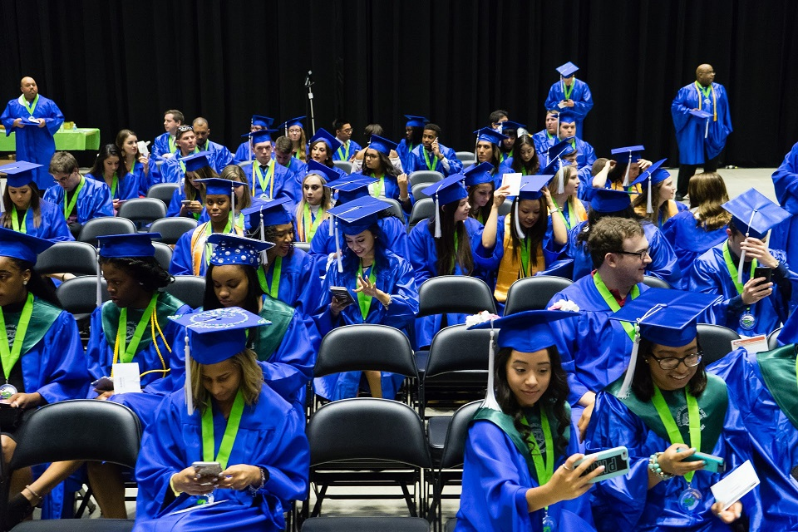
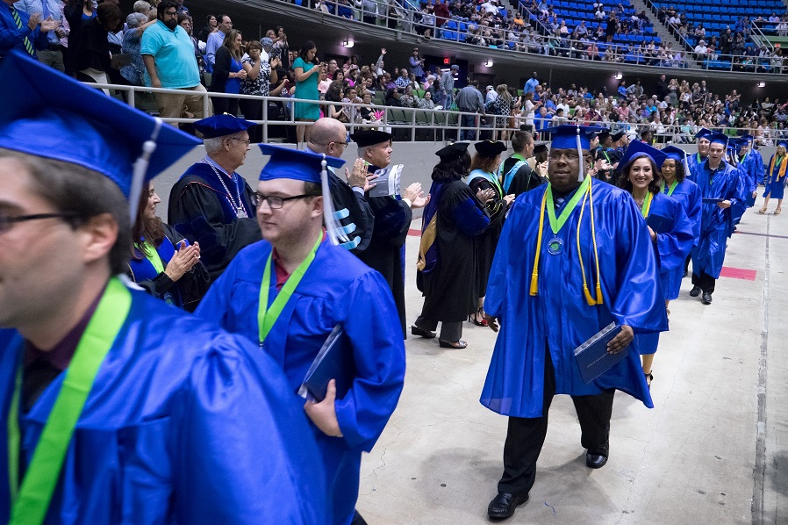
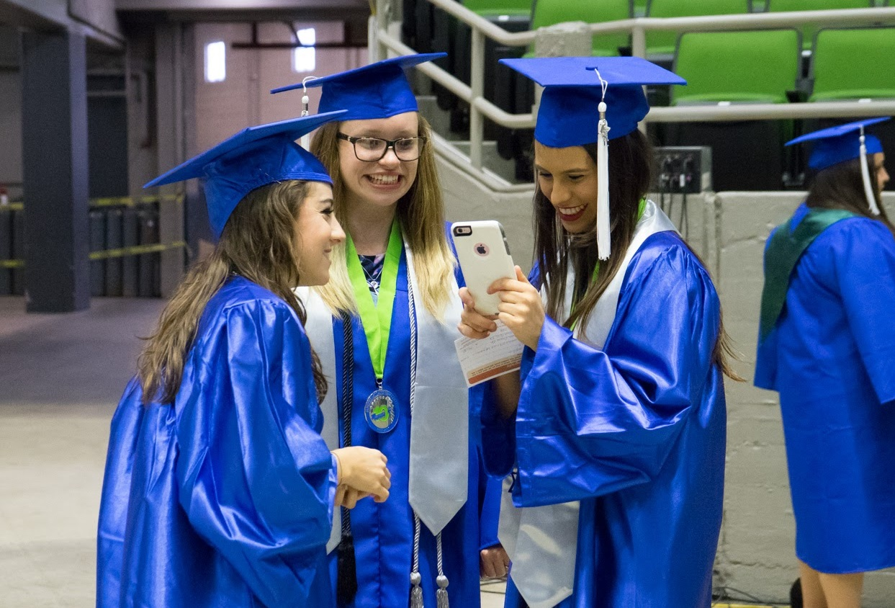
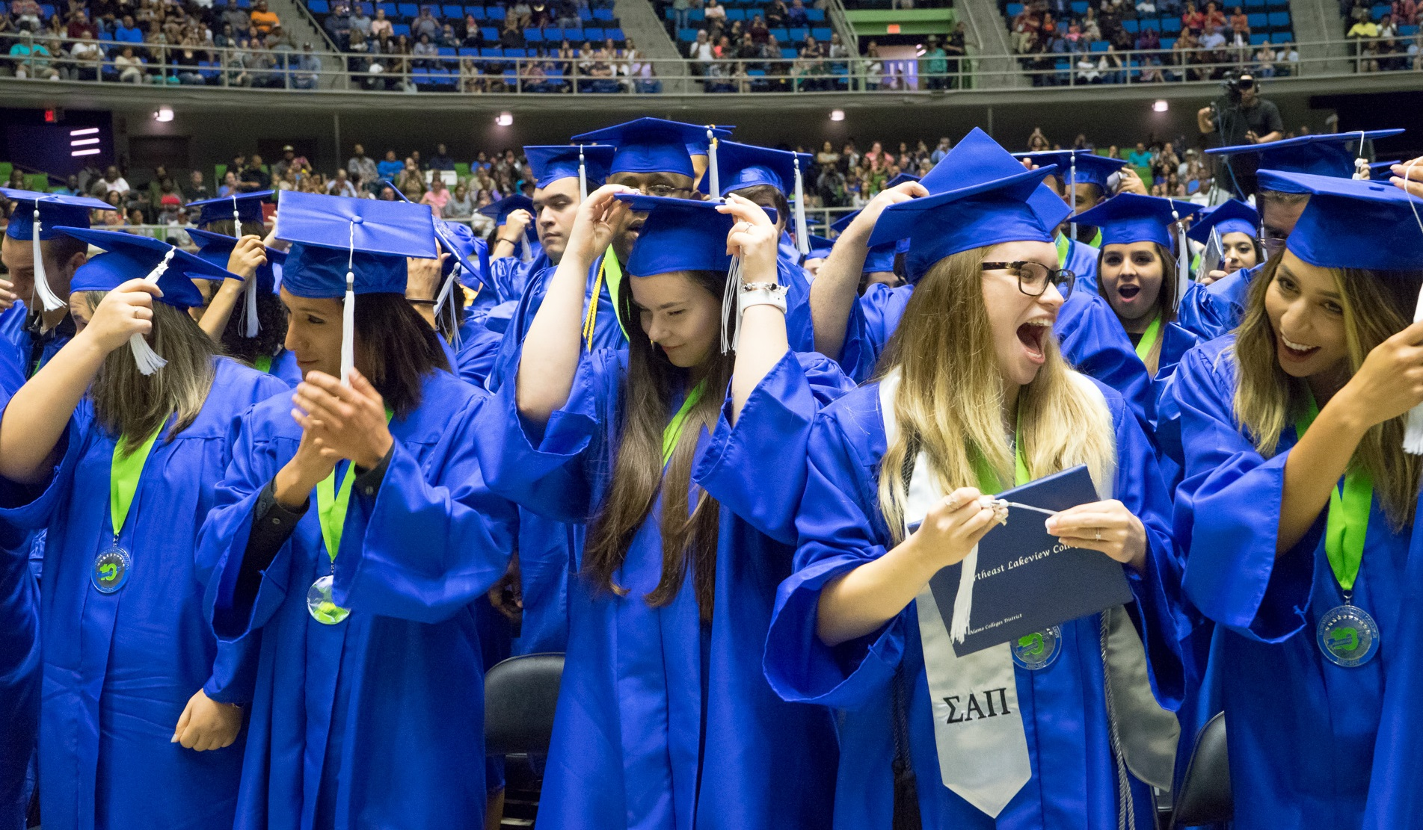
COLLEGE UPDATE
EXCEEDS GOAL IN NUMBER of GRADUATES
3.6%
FRIENDS OF NIGHTHAWKS

Slide 5

Texas A&M Engineering Academy
At Northeast Lakeview College
A&M School of Engineering partnering with Alamo Colleges District – Northeast Lakeview College
- co-enrollment program for students selected by Texas A&M University
- students will take one ENGR course each semester for two years (10 credits) at NLC (taught by A&M instructor)
- students can transfer directly to A&M engineering program at College Station
First Cohort scheduled to begin Fall 2018
Application available in January 2018
FRIENDS OF NIGHTHAWKS

Slide 6

Community Awareness
Celebrating a Decade of Student Success
Established in 2007, Northeast Lakeview College is the newest institution in the Alamo Colleges District and in 2017 is celebrating its 10 year milestone.
Recognize the community for their support
Bring community out to our beautiful campus
Increase community support and awareness
alamo.edu/nlc/10thanniversary
FRIENDS OF NIGHTHAWKS

Slide 7

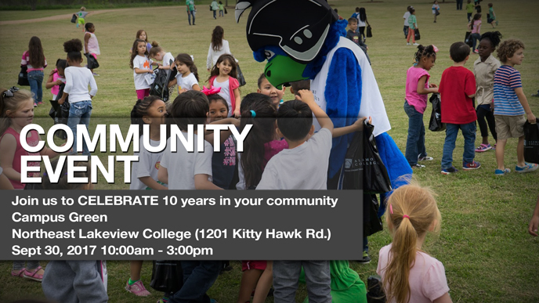
Upcoming Events
5K Race Around the Lake
Saturday, September 30, 2017
8am start
Race/Family Fun Run & Walk
DONATIONS STILL BEING ACCEPTED
Celebrate 10 - Outdoor Community Event
Saturday, September 30, 2017
9:45am – 3pm
entertainment, activities for all ages
MORE THAN 35 vendors/food trucks/activities
alamo.edu/nlc/10thanniversary
FRIENDS OF NIGHTHAWKS

Slide 8

Fundraising
President's Gala
Thursday, November 9, 2017
Hilton Garden Inn (Live Oak)
Table Sponsorships Available
Individual Tickets
Goal: $100K (proceeds go to student scholarships)
alamo.edu/nlc/10thanniversary
FRIENDS OF NIGHTHAWKS

Slide 9
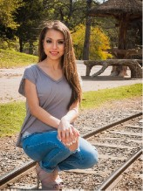
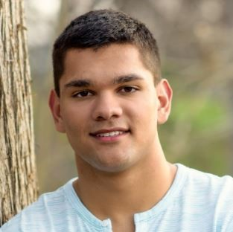
Your Dollars in Action
Celebrating a Decade of Student Success
Stephanie Lucero
RBFCU Endowed
Founder’s Scholarship
Jared Dinan
NLC General Scholarship
Ultimate Goal:
Nurse
Ultimate Goal:
Liberal Arts
“I am honored to receive this award. I believe that I am
destined to become a nurse because I remember attempting
to heal wounds on various playground injuries. It is because
of your generosity that I am able to focus on my studies and
relieve some of the stress that my family may have as well as
pay for tuition."
“Working my way through college, I am truly grateful for this scholarship as it has given me the opportunity to work less and focus more on school and better my education.”
FRIENDS OF NIGHTHAWKS

Slide 10

Questions or Comments?

