Slide 1
State of the College
Fall 2017 Convocation (August 22, 2017)
Dr. Veronica Garcia

Slide 2
WELCOME BACK FACULTY !

Slide 3
SS welcomed over XXX new students through NSO’s
WELCOME BACK FACULTY !

Slide 4
SS welcomed over XXX new students through NSO’s
10th anniversary planning (5K, community event, gala)
WELCOME BACK FACULTY !

Slide 5
SS welcomed over XXX new students through NSO’s
10th anniversary planning continues (5K, community event, gala)
WELCOME BACK FACULTY !
Summer Science Research

Slide 6
SS welcomed over XXX new students through NSO’s
10th anniversary planning continues (5K, community event, gala)
WELCOME BACK FACULTY !
Summer Science Research
Processing Financial Aid

Slide 7
SS welcomed over XXX new students through NSO’s
Drone Camp
10th anniversary planning continues (5K, community event, gala)
WELCOME BACK FACULTY !
Summer Science Research
Processing Financial Aid

Slide 8
SS welcomed over XXX new students through NSO’s
Drone Camp
10th anniversary planning continues (5K, community event, gala)
WELCOME BACK FACULTY !
Summer Science Research
Underwater
Robotics
Processing Financial Aid

Slide 9
SS welcomed over XXX new students through NSO’s
Youth Summer
Interns
Drone Camp
10th anniversary planning continues (5K, community event, gala)
WELCOME BACK FACULTY !
Summer Science Research
Underwater
Robotics
Processing Financial Aid

Slide 10
SS welcomed over XXX new students through NSO’s
Youth Summer
Interns
Drone Camp
10th anniversary planning continues (5K, community event, gala)
WELCOME BACK FACULTY !
Summer Science Research
Underwater
Robotics
Employee
Parking
Processing Financial Aid

Slide 11


COLLEGE UPDATE
NORTHEAST LAKEVIEW COLLEGE NOW OFFERING FINANCIAL AID
New students, current students, SAC @ NLC
Effective 2017-2018 academic year
Integrated marketing/communications to students
BIG STEP FOR INSTITUTIONAL GROWTH
RESULTS: Over 200 ISIR’s in pipeline
Students can speak to their advisor or Financial Aid Office

Slide 12
GRADUATION NUMBERS
Graduation Totals | Fall 2016 (Final) | Spring 2017 (Final) | Summer 2017 | Preliminary 2016-2017 Total
2016-2017 Graduation Goal: 136
Projected Grads | 45 | 54 | 40* | 139
Actual Grads | 39 | 61 |  | 100
% Grad Completion | 87% | 112%
*Preliminary (until Summer grades certified)

Slide 13
COLLEGE UPDATE
SACSCOC UPDATE

Slide 14
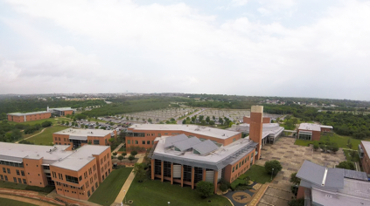
CIP & New Building Construction
Bond Passed on May 6, 2017 ($450 Million)
NLC to receive $42 Million
Technology Center of Excellence ........... ………20,000,000*
Science Building ........................................ 20,000,000*
Physical Plant Improvements .................. 2,000,000
*Buildings are expected to be combined and their size may be expanded, funds permitting.
alamo.edu/nlc/CIP

Slide 15
CIP & New Building Construction
NEXT STEPS
Cross-college committee formed
Discussions about the facilities and class and lab utilization
TIMELINE
Summer 2017 – info gathering; preliminary scratch list/design needs
Fall 2017 – review preliminary drafts/finished product provided to NLC
Feb. 2018 – Funding for Bond available

Slide 16
VPAS UPDATE
TIMELINE
Advertising – begin advertising position at the close of Fall semester
Finalize – by the end of Spring 2018 semester
Start Date – July 1, 2018

Slide 17
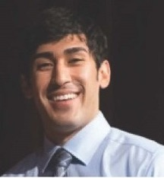
EMPLOYEE GIVING CAMPAIGN
Campaign is underway
Nicolas Villarreal
RBFCU Endowed
Founder’s Scholarship
$14,000 in 2016
57% participation
Goal for 2017
Ultimate Goal:
Neurologist
“This scholarship gave me the motivation I needed to keep going and helped me pay off my remaining tuition balance and provided the extra funds I needed so that I could purchase my textbooks. I am extremely appreciative as I know I have a long, expensive journey to my end goal.”
62%participation

Slide 18

CAMPUS CARRY
EFFECTIVE AUG 1
Online FAQ
Digital tv’s and website
SIGNAGE
POSTERS
Panel Discussion (9/01/17)
Active Shooter (10/06/17)

Slide 19
CAMPUS CARRY
PROHIBITED LOCATIONS AT NLC
NLC BLDG # | BLDG | # of Signs | Locations | Notes:
100 | Wellness Center | 3 | Exterior Main Entrance | Whole Building Prohibition
200A | Science | 8 | RM 209a, 208a, 208, 209 | Chemistry and Biology Prep and Storage Areas
300 | Student Commons | 2 | RM 222H, 227 | Mental Health Counseling and Testing Area
400 | Fine Arts | 3 | RM 106(2), 213 | Ceramic RM and Metallurgy RM and Storage(Acetylene)
600 | Library | 1 | RM 212 | Academic Testing Area
NLC | Campus Grounds | 3 | Exterior Entrances | 30.07 Pole Signs
N/A | JECA | 2 | Exterior along Walkway and Entrance | Whole Building Prohibition 30.06 Pole Signs
N/A | JECA | 2 | Exterior along Walkway and Entrance | 30.07 Pole Signs

Slide 20
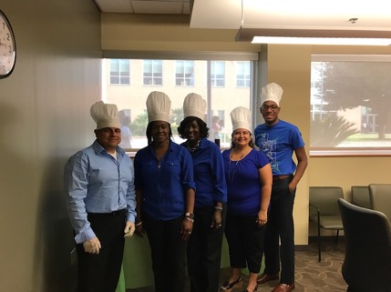
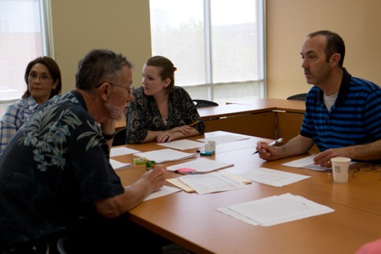
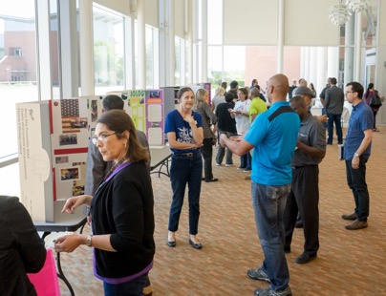
Vision for 2017-2018
Strengthen Communication and Engagement
Enhance Strategic Goals

Slide 21
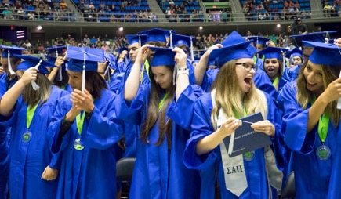
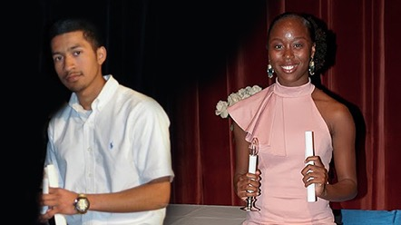
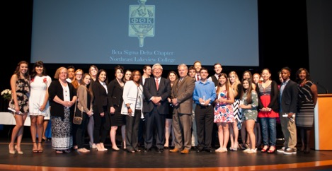
STUDENT SUCCESS & LEARNING
Exceeding $90K in PTK Awarded
# of graduates scholarships 5-Star Status

Slide 22
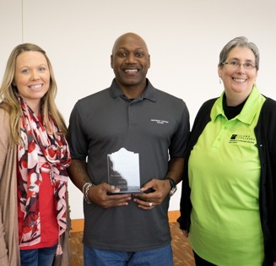

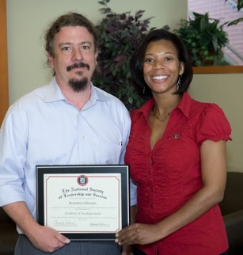
VALUING & EMPOWERING PEOPLE
Awards & Recognitions
Culture of Inclusion
(Valuing opinions / involvement in institutional mission)

Slide 23
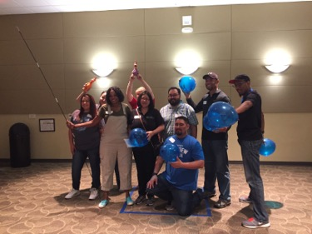

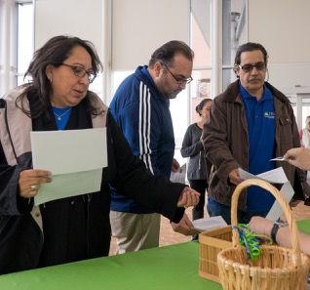
COMMUNICATION & COMMUNITY ENGAGEMENT
Transparency & Timely Dissemination of Information
Shared Organizational Leadership

Slide 24

Questions or Comments?

