Slide 1
Student Development:
Individual Success Plan
Fall 2022

Slide 2
First Time in college team
Certified Advisors
Business and Public Service
  Ed Rangel
Creative And Communication Arts
  Jen Correa
Health and Bioscience
  Maria Cooper
  Marilyn Luna
STEM
  Rigo Amaya

Slide 3
Objectives
Important Policies
Degrees and Pre-Majors
    Importance of having correct Pre-Major in system
GPS and ISP
Registration
My Mission Statement

Slide 4
Important policies
Smart Start
Six Course Drop Ruling
Developmental Education Enrollment Ruling (27-Hour Rule)
Three-Peat (Third Attempt) Enrollment Ruling
Student Email Policy
Academic Standing
Satisfactory Academic Progress (Financial Aid)
San Antonio College 2022-2023 Catalog:
https://mysaccatalog.alamo.edu/index.php?catoid=250

Slide 5
Degrees
Associate of Arts
Associate of Science
Associate of Arts in Teaching
Associate of Applied Science
Certificate
Bachelor of Science in Nursing (RN to BSN Bridge Program)

Slide 6
Pre-Majors
Associate of Arts
  Accounting
  Art
  Architecture
  Criminal Justice
  English
  History
  Music
Associate of Science
  Biology
  Biology/Pre-Nursing
  Chemistry
  Computer Science
  Engineering
  Mathematics
  Psychology
https://mysaccatalog.alamo.edu/content.php?catoid=250&navoid=19206

Slide 7
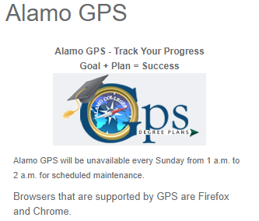
GPS
Intuitive software that outlines courses needed for degree
Provides a snapshot of your
  Degree
  Major/pre-Major
  GPA
  Holds
  Hours Attempted
  Academic Standing
  Advisors Name

Slide 8
Individual Success plan (isp)
Customized degree plan to keep you on your path to graduation and/or transferring
Course recommendations are based on:
  Declared major or pre-major
  Test scores
  Transfer credits
  AP and Dual Credits found in our system

Slide 9
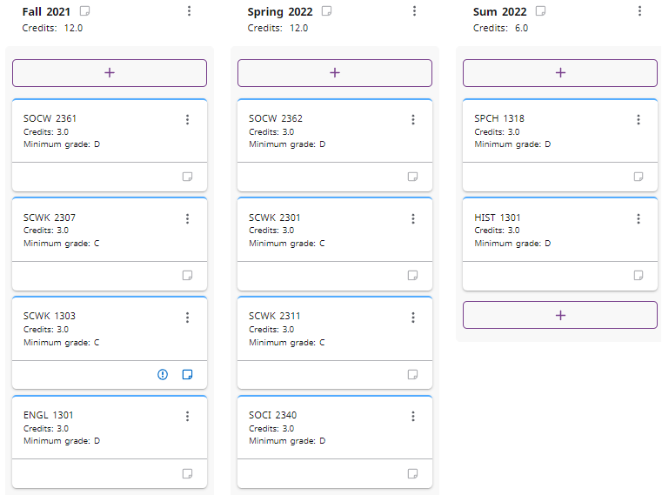
ISP

Slide 10
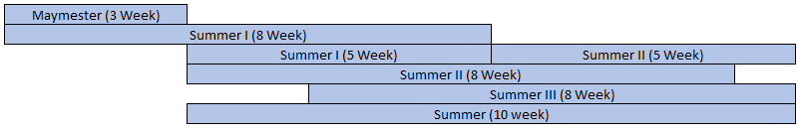
Registration: Parts of term
Fall and Spring
Summer

Slide 11
Registration: Course Load
Students should not enroll for more semester credit hours than the number of weeks in a semester or part of term
Fall/Spring Semesters
  16 Week Sessions - Maximum Hours: Eighteen (18) semester credit hours
Flex I and Flex II
  8 Week Sessions - Maximum Hours Per 8-Week Session: Eight (8) semester credit hours
Fall/Spring Start Two
  14 Week Sessions - Maximum Hours: Fourteen (14) semester credit hours
Fall and Spring, Flex I and II, and Start Two semester credit hours count toward the Fall and Spring totals.
Summer Semester
  Maymester 3 Week Session - Maximum Hours: Three (3) semester credit hours
  Summer I 5 Week Session - Maximum Hours: Six (6) semester credit hours
  Summer II 5 Week Session - Maximum Hours: Six (6) semester credit hours
  Summer 8-Week Session - Maximum Hours: Eight (8) semester credit hours
Not to exceed 17 semester credit hours for the entire Maymester and Summer session combined.

Slide 12
Registration: enrollment status
Fall/Spring Semesters
  Full-Time Student - Twelve (12) or more semester credit hours
  Half-Time Student - Six to eleven (6-11) semester credit hours
Summer Semester
  Full-Time Student - Six (6) semester credit hours
  Half-Time Student - Three to five (3-5) semester credit hours
Note: The above enrollment status is based on a semester, not sessions within the semester. For Financial Aid or Veteran Affairs enrollment status, please check with designated department.

Slide 13
Registration: Reading Registration Screen
The CRN stands for Course Reference Number – this is a unique 5 digit number associated with that specific course offering; each course has a unique CRN

Slide 14
Registration: Reading Registration Screen
When selecting your class pay attention to what campus the course is being offered by reading the College column

Slide 15
Registration: Reading Registration Screen
Courses are broken down into Subjects and Course Numbers
  Subjects are 4 letter codes
  Course Numbers are 4 digit codes
  The first number in a course code represents the course level
  0 – Developmental Level
  1 – Freshman Level
  2 – Sophomore Level
  The second number in a course code represents how many hours a course is worth

Slide 16
Registration: Reading Registration Screen
Meeting Times provides you with the days of the week, time, location and the start and end dates for the class; start and end dates are important as this tells you what part of term a class is and how many weeks you will be in class

Slide 17
Registration: Reading Registration Screen
Status provides you with how many seats are still available

Slide 18
Registration: Reading Registration Screen
Instructional Method provides you with how the course will be taught; Face-to-Face, Online (Asynchronous) or Online (Synchronous/Zoom)

Slide 19
Registration: Reading Registration Screen
Attribute provides you with course information including if the course has special attributes like a Learning Community

Slide 20
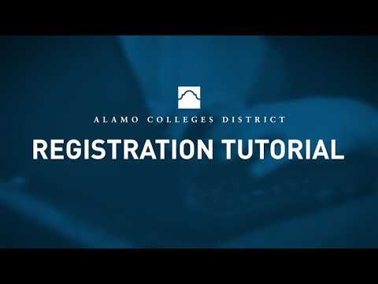
Registration
https://www.youtube.com/watch?v=F6QL4isD1q4

Slide 21
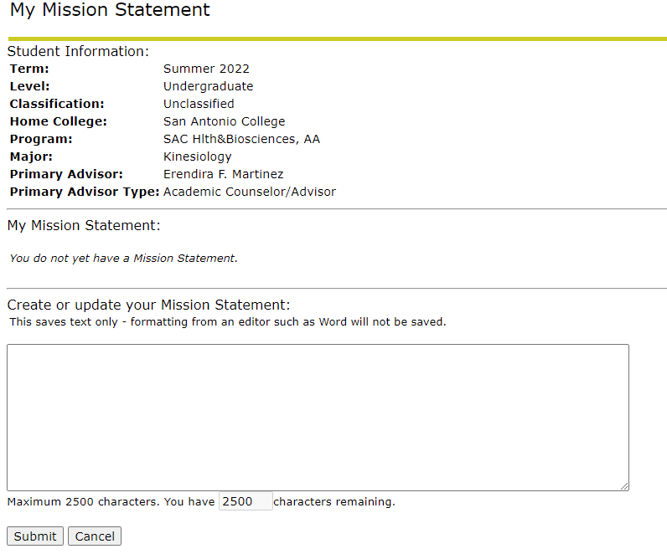
My mission statement
What are you educational and career goals?
  Log into ACES
  Click on your “Student” tab
  Click “Web Services”
  Click the “Student” link
  Click the “My Mission Statement” link
  Write a brief statement regarding your educational and career goals
  Once completed, click “Submit”

Slide 22
Scheduling an Advising session
To schedule an Advising Sessions you will need to:
  Log in to your ACES Account & click on the “Start Here” tab
  Select the “Alamo NAVIGATE” icon
  Click “Login”
  Select the “Appointments” tab
  Select “Schedule an Appointment”
  Select the Reason for your appointment and hit Next
  Select the Location and hit Next
  Select the Day and Time that works for you and hit Next
  Enter “Zoom Appointment” in the Notes box
  Review the selection and confirm your appointment

