Slide 1

Guardian
Receiving Letters of Accommodation
Notes:
This is a presentation for faculty on how to view letters of accommodation through the Guardian System

Slide 2
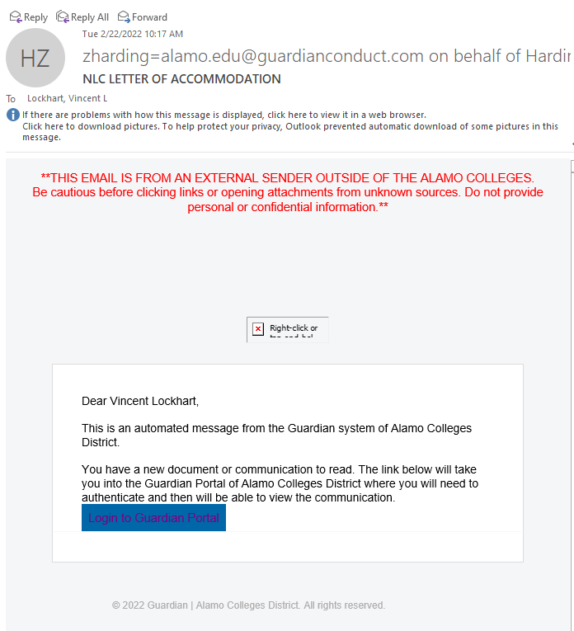
Outlook inbox
Notes:
You will receive an email from a member of the DSS staff via outlook notifying you that you received a Letter of Accommodation. In this email, click the link “Login to Guardian Portal”.
After opening the link, you will see the Single Sign-On (SSO) for your Alamo account. If you are already logged into your Alamo account on the same browser you may be logged into Guardian automatically.
(Replies to this email will automatically be routed to whomever sent you the Letter through Guardian.)

Slide 3
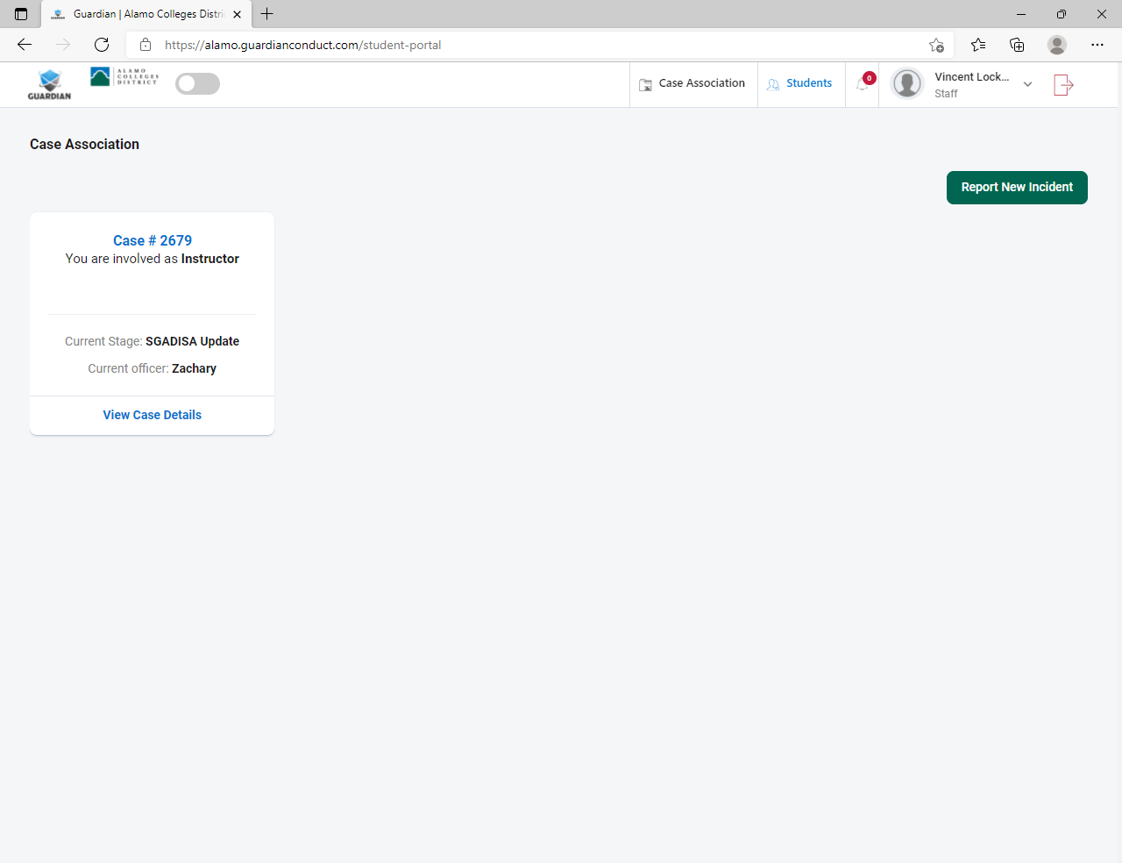
Case Association/
Active Letters
Notes:
After logging into Guardian, you will likely see the form submission screen. This is the screen anyone without a caseload sees. As a faculty member you will most likely not be assigned any cases, instead will only be “associated” with them.
However, from any screen within Guardian, you will always see a Case Association link and the notification Bell Icon at the top.
If this is your first time opening the letter you may click the Bell Icon to see anything new you have received.
If you have already opened the letter previously and wish to view it again, click on Case Association at the top of the screen
In the Case Association Screen you will see every “Case” you are associated with. Depending on your involvement with other cases, not every case in this screen could mean a Letter of Accommodation.
From this screen, click on “View Case Details” of the case you wish to view the progress or LOA of. You will not have access to any information you are not supposed to see.
Additionally, The cases in this screen will disappear from your view once the case is closed at the end of the semester.

Slide 4
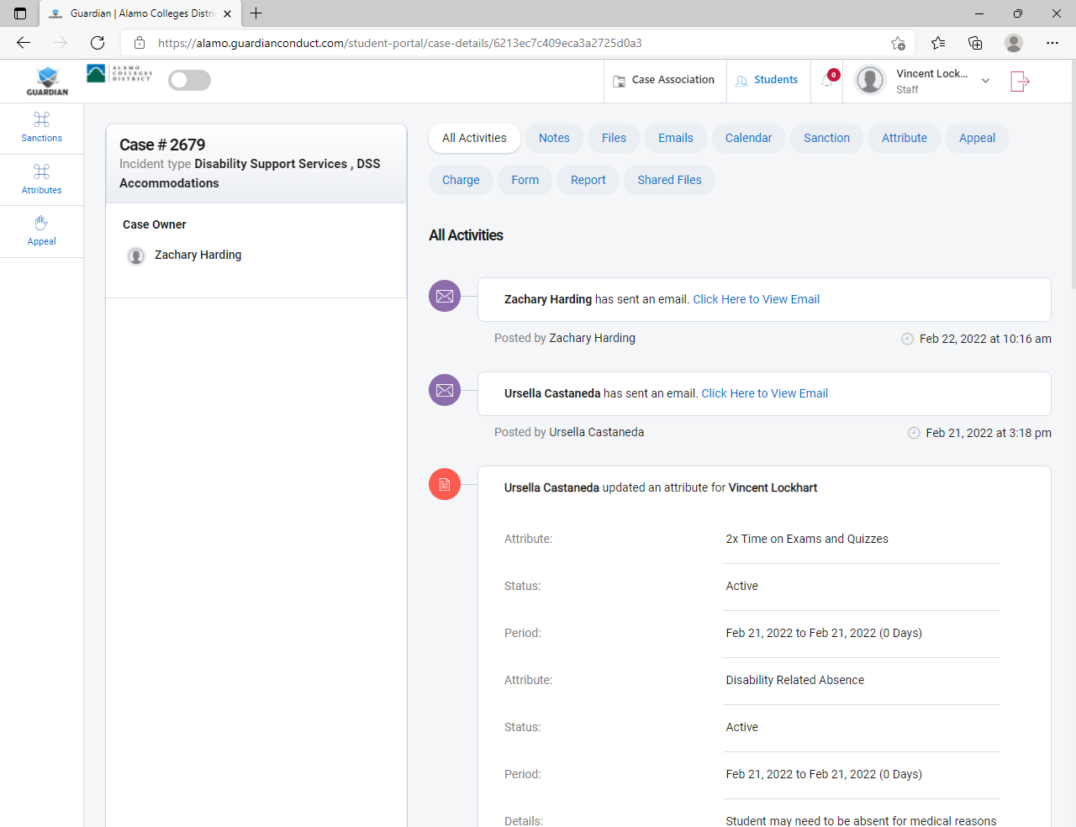
Viewing the LOA
With the Case open, you can view any correspondence sent to you through Guardian regarding that specific case. To view the LOA click the blue “Click Here to View Email” link. That will open the LOA and at the bottom of the LOA will be a PDF of the letter available to download.
You will be able to access the LOA at any time by logging into your Guardian account at: https://alamo.guardianconduct.com
It is more secure to keep the letter within the Guardian system, but you are welcome to download the PDF at your discretion. Keep in mind you need to destroy any downloaded or printed copies at the end of the semester or in the event the student is no longer in your class.
Notes:
With the Case open, you can view any correspondence sent to you through Guardian regarding that specific case. To view the LOA click the blue “Click Here to View Email” link. That will open the LOA for you to view the student’s name, course, and accommodations
At the bottom of the LOA there will likely be a PDF of the letter available to download. It is more secure to keep the letter within the Guardian system, but you are welcome to download the PDF at your discretion. Keep in mind you need to destroy any downloaded or printed copies at the end of the semester or in the event the student is no longer in your class.

Slide 5
Thank you
You will be able to access any active LOAs at any time by logging into your Guardian account at: https://alamo.guardianconduct.com
For any questions please contact your campus DSS department.
SAC: SAC-DSS@alamo.edu; ext. 60020

